Slide 1
EU-CERT: European Certificates and Accreditation for European Projects
First EU-CERT transnational partner meeting (TPM1) in Germany, Cologne
The EU-CERT – Kick-off-Conference
11th - 13th of April 2022
Partner Presentation University of Paderborn
Reference Number: 2021-1-DE02-KA220-ADU-000033541
Duration:
01.02.2022 – 31.05.2024 (28 month)

Slide 2
Meeting Agenda

Slide 3
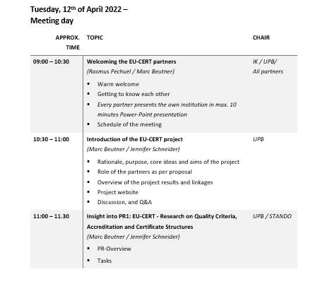
Meeting Agenda

Slide 4
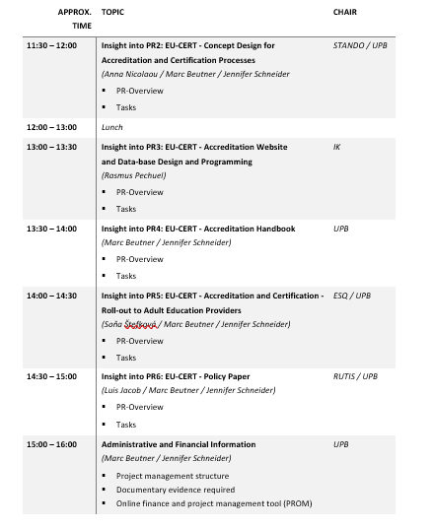
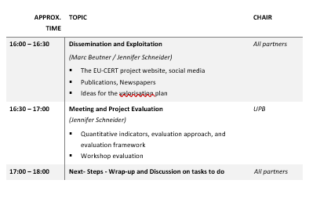
Meeting Agenda

Slide 5
Partners of EU-CERT
Associação Rede de Universidades da Terceira Idade PortugalCentro
Esquare France Provence-Alpes-Côte d'Azur
University of Paderborn Germany
(Coordinator)
TIR Consulting Group j.d.o.o Croatia Grad Zagreb
STANDO LTD Cyprus Κύπρος (Kýpros) Nicosia
Ingenious Knowledge GmbH Germany
(Technical partner)
"Dieses Foto" von Unbekannter Autor ist lizenziert gemäß CC BY-SA
"Dieses Foto" von Unbekannter Autor ist lizenziert gemäß CC BY-NC
"Dieses Foto" von Unbekannter Autor ist lizenziert gemäß CC BY-SA

Slide 6
About EU-CERT
The EU-CERT project focuses on adult education.
Initial position:
One of the core ideas is to promote adult education results created within ERASMUS+ projects. Typically, there is no certification or accreditation of those.
Preliminary Studie of EU-CERT- A needs analysis (Winter 2020, N=250)
87% of the consulted users complain about intransparency and weak quality of European adult education project results which cannot be transferred into daily adult education practice.
86.5% stated that there is a strong need to get to evidence-based approaches to certification and that certificates are badly needed in adult education. The participant emphasized that the need is specifically for accredited certificates.
84% answered, that adult education projects of the EU were seen critical with regard to the quality of their outcomes
The participants underpinned that many EU projects create results for adult education but
(a) not many people are aware of them (79%),
(b) the quality of the results is not certified (87%), and
(c) and the possibilities for an good transfer into other adult education organisation is not made clear ( 89.5%).

Slide 7
About EU-CERT
🡪 Here the EU-CERT project comes into action: The project tries to enhance quality in adult education and helps to ensure that adult education providers are able to find high quality adult education results which can be used in practice and which base on excellent adult education projects.
Therefore, the project consortium is going to develop a mechanism to monitor the effectiveness of adult education project via an accreditation system which is based on clear criteria and a solid accreditation procedure.
Core project result is the accreditation system of EU-CERT

Slide 8
About EU-CERT
Benefits of EU-CERT:
This will help to support common shared values in adult education and is the basis for civic engagement which is fostered by excellent adult education approaches.
Moreover, it fosters the participation of European adult educator in a high quality adult education network with ensured standards.
An accreditation system for projects which run under adult education promotes the idea of ERAMUS+ and offers another way of transparency and visibility in Europe.
All seniors and all European citizens get a possibilty to find excellent adult education resources via the accreditation information and standards. This is the crucial basis for enhancing quality assureance in adult education.

Slide 9
About the Project Results of EU-CERT

Slide 10
Project Results
Project Results | Starting period | End of period | Activity Title | Leading Organisation
Project Result 1 | 2022-02 | 2022- 10 | EU-CERT - Research on Quality criteria, Accreditation and Certificate Structures | University of Paderborn – Germany
Project Result 2 | 2022-02 | 2023-03 | EU-CERT - Concept Design for Accredition and Certification Processes | STANDO - Cyprus
Project Result 3 | 2022-05 | 2023-07 | EU-CERT - Accreditation Website and Data-base Design and Programming | Ingenious Knowledge GmbH - Germany
Project Result 4 | 2022-07 | 2023-07 | EU-CERT - Accreditation Handbook | University of Paderborn - Germany
Project Result 5 | 2022-03 | 2023-11 | EU-CERT - Accreditation and Certification - Roll-out to adult education providers | Esquare - France
Project Result 6 | 2022-02 | 2024-02 | IO6 EU-CERT - Policy paper | Associação Rede de Universidades da Terceira Idade - Portugal
Project Result 7 | 2202-02 | 2024-02 | IO6 EU-CERT - Layman ́s report | TIR Consulting Group j.d.o.o - Croatia

Slide 11
Project Result 1
EU-CERT - RESEARCH ON QUALITY CRITERIA, ACCREDITATION AND CERTIFICATE STRUCTURES (LEADING ORGA: UNIVERSITY OF PADERBORN)

Slide 12
Project Result 1 – Mixed- Methods Design of the Research
Needs analysis (Nov./ Dec. 2021):
more than 80% of the participants asked for evidences concerning the situation with regard to certification and accreditation in adult education
🡪 To take this need for serious we designed this first project result which ones with evidence derived from research in the partner countries.

Slide 13
Project Result 1 – Mixed- Methods Design of the Research
This project result 1 (PR1) provides deep research on existing certificate and quality assureance structures in the partner countries of EU-CERT.
It basis on the already existing needs analysis which was done before applying for this projects. The needs analysis gave a general overview on the accreditation and certification structure in adult education with regard to ERASMUS+. It should that there exist several general quality assureance solutions in the partner countries but that there is no focus no general accreditation process which takes the ERASMUS+ results into account and fosters transparency of the ERASMUS+ adult education programme. Also it was clear after the needs analysis that there is a variety of quality assureance approaches.
Our needs analysis before this application was a formal, systematic process of identifying and evaluating the need for such an certification and accreditation process in the field of adult education. It also showed that just a PDCA-cycle (Plan, Do, Check, Act) cannot be an adeqaute basis for future quality assureance and accreditation in adult education. This means, to design a feasible approach within EU-CERT, we need more detailed information about the existing processes.
To make sure that there are no double works and that existing strutures will be taken under account the IO1 research of EU-CERT gathers the existing quality criteria and puts them together in a criteria matrix. Therefore, the certificate structures and quality criteria will be explained by experts in interviews to get a deeper insight and also existing accreditation processes are explained and documented.

Slide 14
Project Result 1 – Mixed- Methods Design of the Research
Project result 1 (PR1) - EU-CERT - Research on Quality criteria, Accreditation and Certificate Structures" comes with
Qualitative Research:
(I) desktop research in each partner country and
(II) combines this with 5 expert interviews in each country
Quantitative Research:
(III) broad questionnaire on quality assurance with regard to ERASMUS+ and necessary quality criteria as well as exisiting certification elements
This is a crucial basis for the concept design
in PR2 and the programming in PR3

Slide 15
Project Result 1 – Mixed- Methods Design of the Research
It makes sure that technical issues and critera related issues are addressed in adequate ways. Moreover this means that it it necessary to focus on how the organisations in the partner countries keep the documentation of an educational programme, how they evaluate the quality of an educational programme and adherence to the curriculum and its quality. In addtion to that it is useful to get deeper knowledge about existing equipment and personnel resources of educational programme compared with the educational measure that is the subject of accreditation.

Slide 16
Project Results 1 - Qualitative Research
(I) desktop research in each partner country
Deep research on existing certificate and quality assurance structures in the partner countries of EU-CERT.
1. What are the common existing certificates in your country?
2. How is the quality assurance structure of the certificates in your countries?

Slide 17
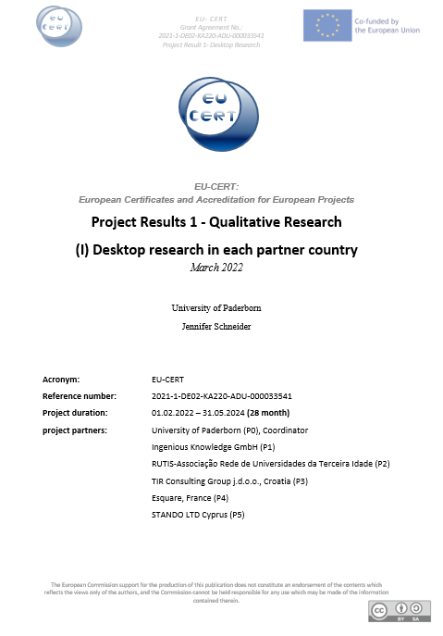
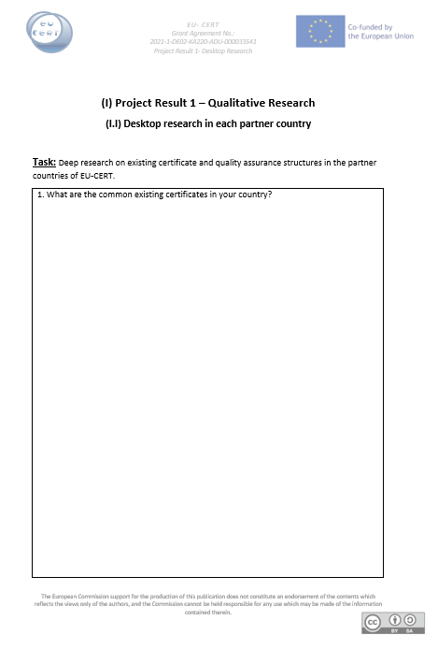
Project Results 1 - Qualitative Research
Document has to be translated in each partner language.
English version available

Slide 18
Project Results 1 - Qualitative Research
(II) 5 expert interviews in each country
Summary of potential semi- standard key questions:
How satisfied are you with the common existing certificates in your country?
What are necessary quality criteria for certificantes?
What is necessary to guarantee great transparency of certificates?
How satisfied are you with the quality assurance structure of the certificates in your countries?
What are necessary quality criteria for quality assurance structures?
What are benefits of certificates in educational environment?

Slide 19
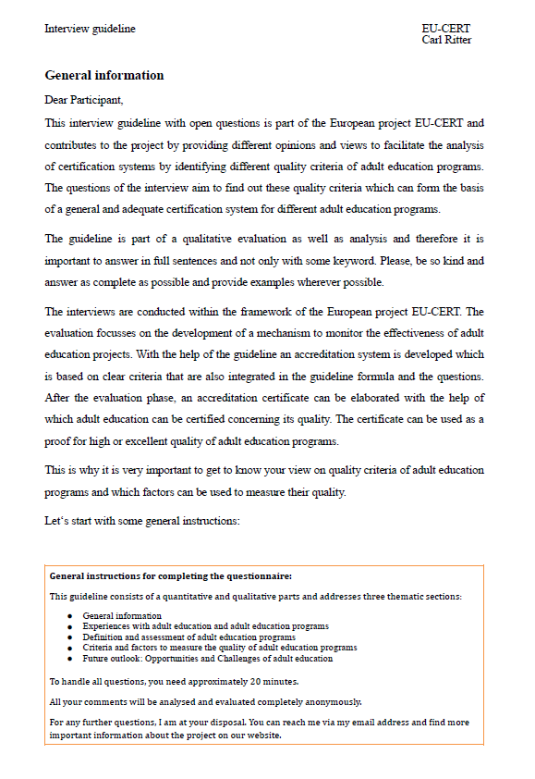
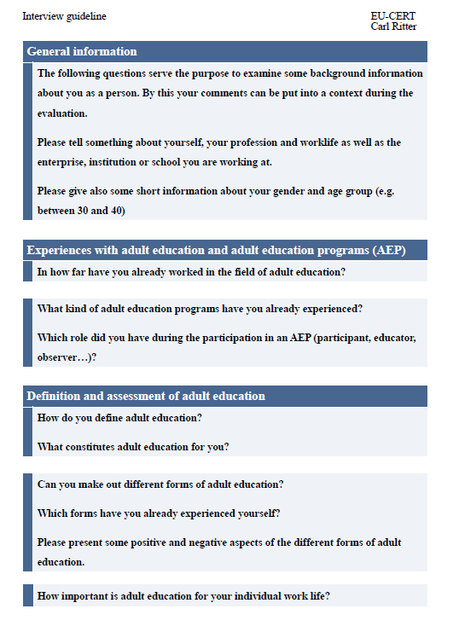
Project Results 1 - Qualitative Research
Interview guideline has to be translated in each partner language.
English version available

Slide 20
Project Results 1 – Quantitative Research
Quantitative Research:
(III) broad questionnaire on quality assurance with regard to ERASMUS+ and necessary quality criteria as well as exisiting certification elements
Based on the results of the qualitative research (I) and (II), we will create a standardise quantitaive questionnaire, which will be spread to experts as well as stakeholders
Herefore, we will use an online survey tool and spread the questionnaire link to all partner institutions
The survey will be available in all partner languages

Slide 21
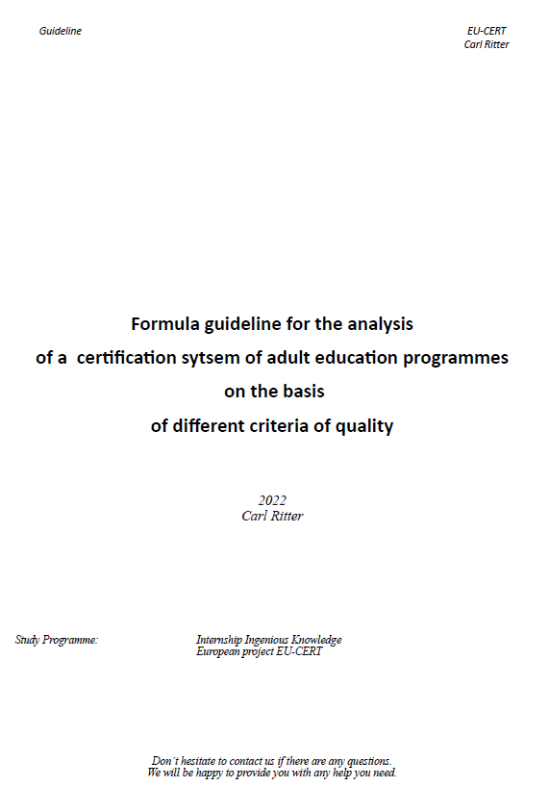
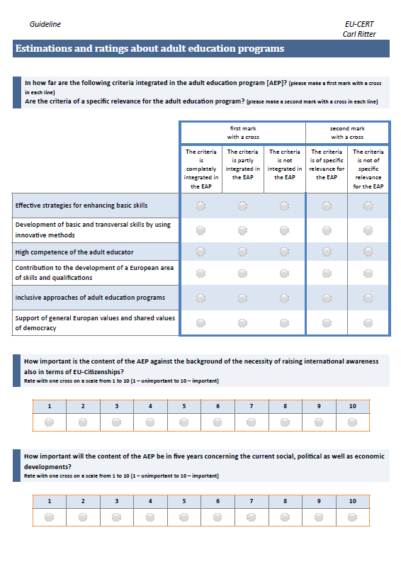
Project Results 1 – Quantitative Research
Quantitative questionnaire has to be translated in each partner language.
English version available

Slide 22
Project Result 1 – Research on Quality criteria, Accreditation and Certificate Structures
All Project Results 1 has to be translated in the following partner languages:
Croatian , German , English , French , Greek , Portuguese

Slide 23
Project Result 2
EU-CERT - CONCEPT DESIGN FOR ACCREDITATION AND CERTIFICATION PROCESSES (LEADING ORGA: STANDO)

Slide 24
Project Result 2 – EU-CERT - CONCEPT DESIGN FOR ACCREDITATION AND CERTIFICATION PROCESSES
Needs Analysis
Concept for the Accreditation System
Criteria based certificates

Slide 25
Project Result 3
EU-CERT - ACCREDITATION WEBSITE AND DATA-BASE DESIGN AND PROGRAMMING (LEADING ORGA: INGENIOUS KNOWLEDGE)

Slide 26
Project Result 3 – EU-CERT - ACCREDITATION WEBSITE AND DATA-BASE DESIGN AND PROGRAMMING
Information part
Accreditation Website
User / participants part
Evaluator / Accreditation part
communication part
Data-based part

Slide 27
Project Result 4
EU-CERT - ACCREDITATION HANDBOOK
(LEADING ORGA: UNIVERSITY OF PADERBORN)

Slide 28
Accreditation Handbook
The accreditation handbook will be a best practice guidelines/ report offers in a book format
To get in touch with the EU-CERT accreditation and certification system it is helpful to get an explanation of the processes and the criteria within a detailed handbook which provided a compilation of all information needed.
This offers more transparency to the target groups of the users of result in adult education but also to the target groups of coordinators of adult education project who want to get their project results accredited.
The impact of such a handbook is directly at all users. They get accustomed to the processes and can transfer these experiences also to future use of certificates.

Slide 29
Accreditation Handbook
The book will be assessable in a printed and an online version.
The accreditation handbook provides general information on accreditation for adult education and the accreditation and certification processes within EU-CERT:
addresses the quality criteria and
explains them and
their use.

Slide 30
Accreditation Handbook
The handbook will be assessable in a:
short version - Guideline A: which steers the user through the accreditation process and the website, etc.

Slide 31
Accreditation Handbook
The handbook will be assessable in a
Detailed version- Guideline B: which provides the provides help and hints for the accreditations/evaluators.
It will be also assessable in a complete book version which addresses the following aspects:
General introduction into accreditation, certification and certificates
The need for accreditation, certification and certificates in adult education
EU-CERT - Overview on the project, its aims and objectives
The Accreditation and Certification processes of EU-CERT
The quality criteria of EU-CERT
User guideline through the accreditation process and the website
Accreditators/evaluator guideline
Results of the EU-CERT Research on Accreditation and Certification in EUROPEAN adult education

Slide 32
Accreditation Handbook
Further information regarding the
accreditation handbook coming soon…

Slide 33
Project Result 5
EU-CERT - ACCREDITATION AND CERTIFICATION - ROLL-OUT TO ADULT EDUCATION PROVIDERS
(LEADING ORGA: ESQUARE)

Slide 34
Project Result 5 – EU-CERT - ACCREDITATION AND CERTIFICATION - ROLL-OUT TO ADULT EDUCATION PROVIDERS
15 adult education providers
Testing of the certification process
Testing of the accreditation process
Roll-out

Slide 35
Project Result 6
IO6 EU-CERT - POLICY PAPER
(LEADING ORGA: ASSOCIAÇÃO REDE DE UNIVERSIDADES DA TERCEIRA IDADE - PORTUGAL)

Slide 36
Project Result 6 – EU-CERT - Policy Paper
4 key issues
Importance of high quality training
Explanation of certification and accreditation processes
Importance of accreditation in adult education
Importance of development exchange and certification in adult education

Slide 37
Project Result 7
IO6 EU-CERT – LAYMAN´S REPORT (LEADING ORGA: TIR CROATIA)

Slide 38
Project Result 6 – EU-CERT - Laymen Report
Recommen- dations
Easy to read
European broad audience

Slide 39
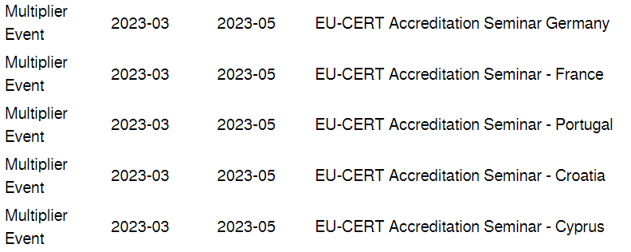
Multiplier Events
2023-07 till 2023-11
There will be a timeshift for the Multiplier Event, because of the shifted starting periode of EU-CERT (01.02.2022 – 31.05.2024 (28 month)!

Slide 40
Transnational Partner Meetings (TPM)
TPM | Leading Organisation | Meeting Title | Country of Venue | Starting Period
TPM1 | Ingenious Knowledge | EU-CERT - Kick-off Conference | Germany | 2022-02 11. – 13.04.2022
TPM2 | Associação Rede de Universidades da Terceira Idade | EU-CERT - Research and Certificate Conference | Portugal | Oktober, 2022
TPM3 | Esquare | EU-CERT - Accreditation Tool Conference | France | February, 2023
TPM4 | TIR Consulting Group j.d.o.o | EU-CERT - Implementation, Testing and Handbook Design Conference | Croatia | September, 2023
TPM5 | University of Paderborn | EU-CERT - Final Policy Recommendation Conference | Germany | March, 2024

Slide 41
EU-CERT Reports
Progress Report (until the 30th of November 2022)
Interim Report (until the 30th of April 2023)
Final Report (within 60 days after the end of the project) as required by the European Commission.
The Partner shall provide the Coordinator with the documents necessary for the preparation of the progress report no later than 31st of October 2022. The Partner shall provide the Coordinator with the documents necessary for the preparation of the interim report no later than 31st of March 2023.
The Partner shall provide the Coordinator with the documents necessary for the preparation of the final report no later than 15.06.2024.

Slide 42
Universität Paderborn
Department Wirtschaftspädagogik Lehrstuhl Wirtschaftspädagogik II Warburger Str. 100
33098 Paderborn
http://www.upb.de/wipaed
Prof. Dr. Marc Beutner
Tel: +49 (0) 52 51 / 60 - 23 67
Fax: +49 (0) 52 51 / 60 - 35 63
E-Mail: marc.beutner@uni-paderborn.de

