Slide 1
EU-CERT: European Certificates and Accreditation for European Projects
Dissemination and Explotation
The EU-CERT – Kick-off-Conference
12.04.2022
Partner Presentation – University of Paderborn
Jennifer Schneider
Reference Number: 2021-1-DE02-KA220-ADU-000033541
Duration:
01.02.2022 – 31.05.2024 (28 month)

Slide 2
Dissemination activities
Dissemination activities should be done regularly by each partner during the project:
Posts on Facebook, posts on school website etc.
Printed materials: Flyer, Posters, Brochures, Newsletters etc.
Articles about the project in local newspapers or online article etc.
Face-to-face meetings with interested people etc.
Please, use the dissemination table for documentation
Please, see social media roster for EU-CERT Facebook page

Slide 3
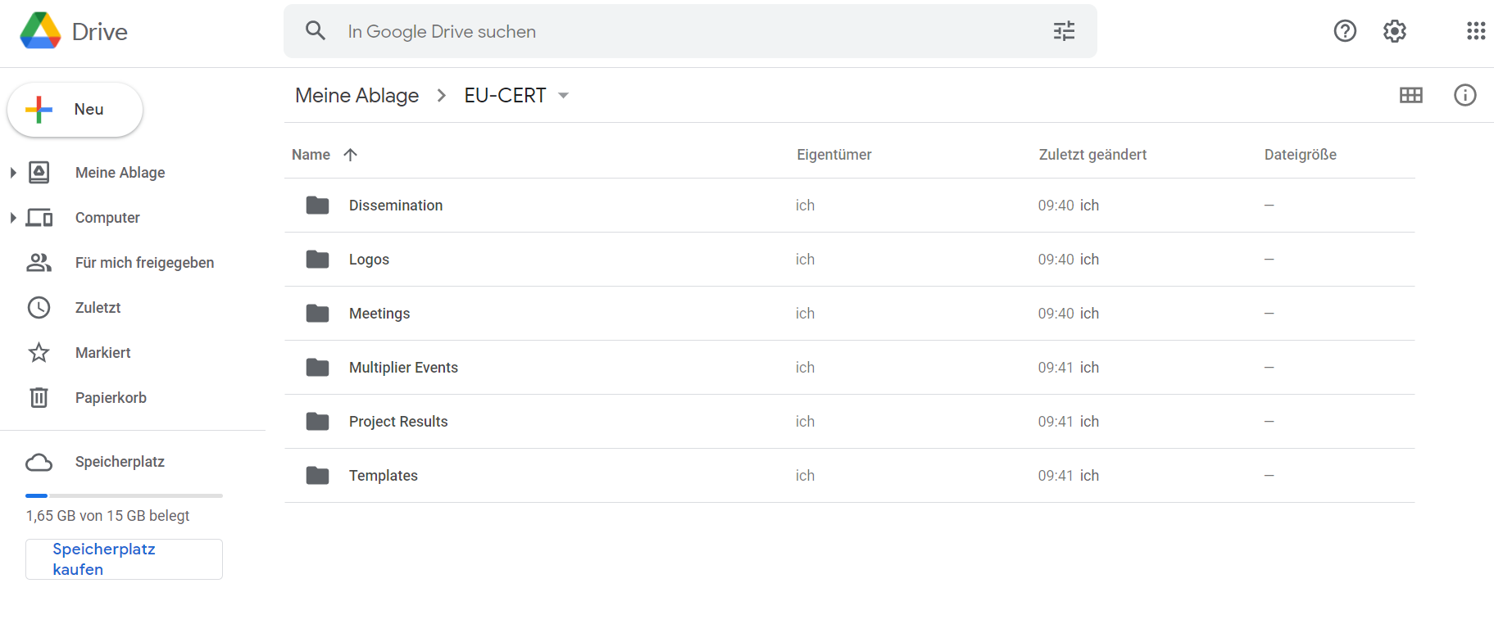
Google Drive Folders
EU-CERT – Google Drive
https://drive.google.com/drive/u/0/folders/1ZY5YviOC_gj46QIMw044dqKfwkQXJbWt

Slide 4
Dissemination Activities
Please, be so kind and translate the EU-CERT poster in your national language.
The posters are uploaded on the google drive folder.

Slide 5
Dissemination Activities
The EU-CERT website will be available soon.
We will notify you and invite you to translate the dissemination materials.

Slide 6
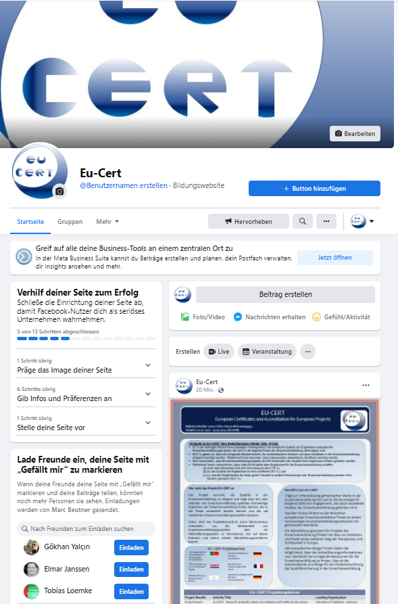
Social Media Accounts – Facebook
Please, send me your facebook account name
EU-CERT Facebook page:
https://www.facebook.com/Eu-Cert-104391385540756/?ref=pages_you_manage

Slide 7
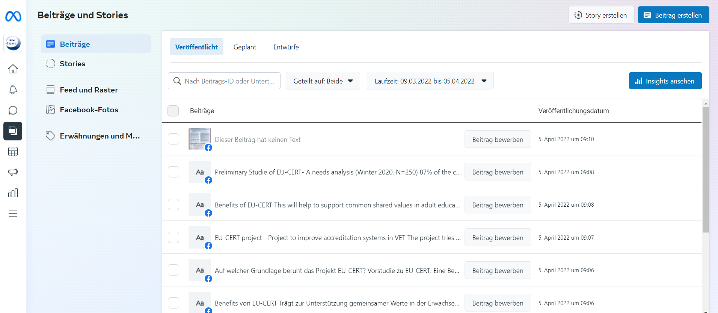
Social Media Accounts – Facebook
Be active on social media and plan your posts for the next weeks and months!
That makes it easier to communicate with your stakeholders!

Slide 8
EU-CERT Templates

Slide 9
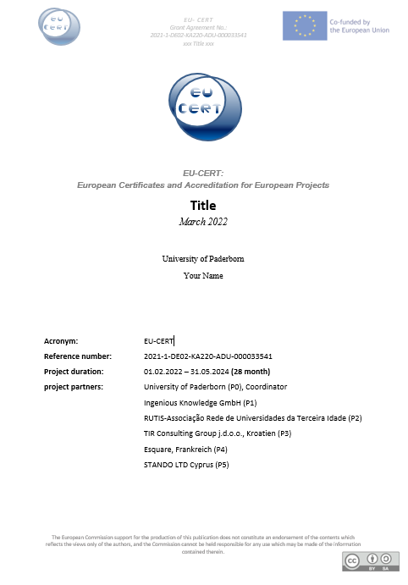
EU-CERT Templates
Please stick to this Word template!
Available on google drive

Slide 10
EU-CERT Templates
Please stick to this PowerPoint template!
Available on google drive

Slide 11
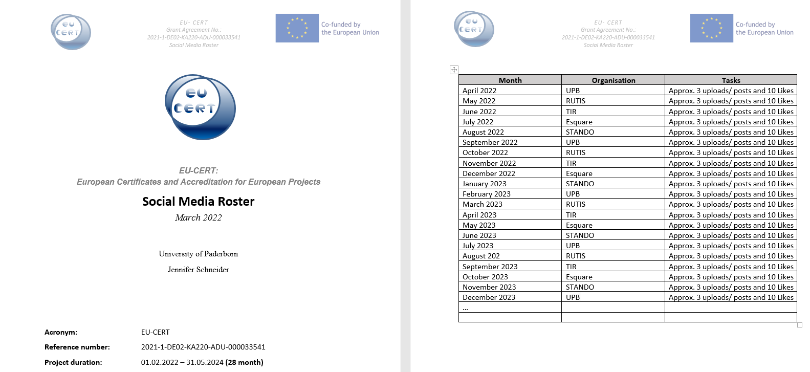
Social Media Roster

Slide 12
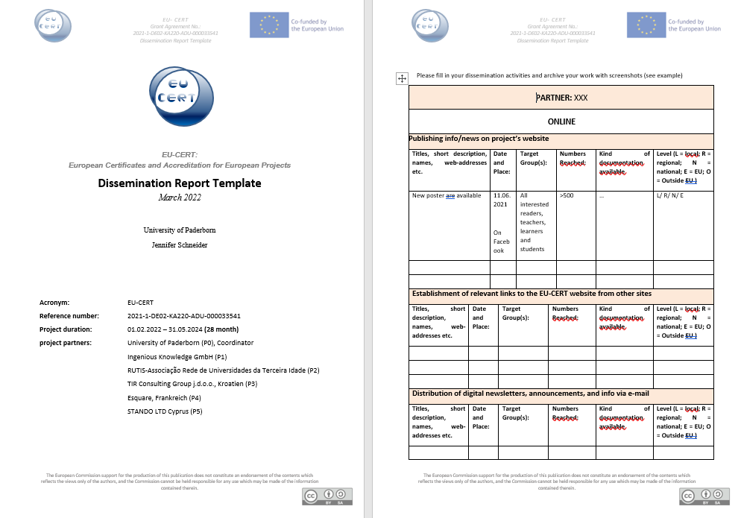
Dissemination activities - Documentation
Please,….
...use the documentation table as evidence for dissemination activities
The template will be available on EU-CERT website / Google Drive Folder for download

Slide 13
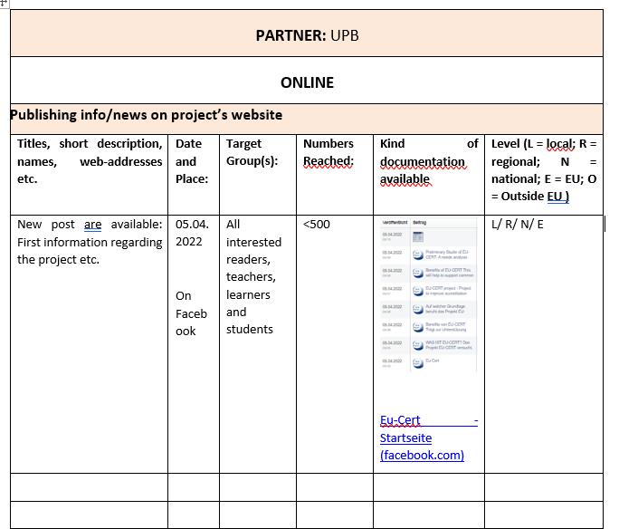
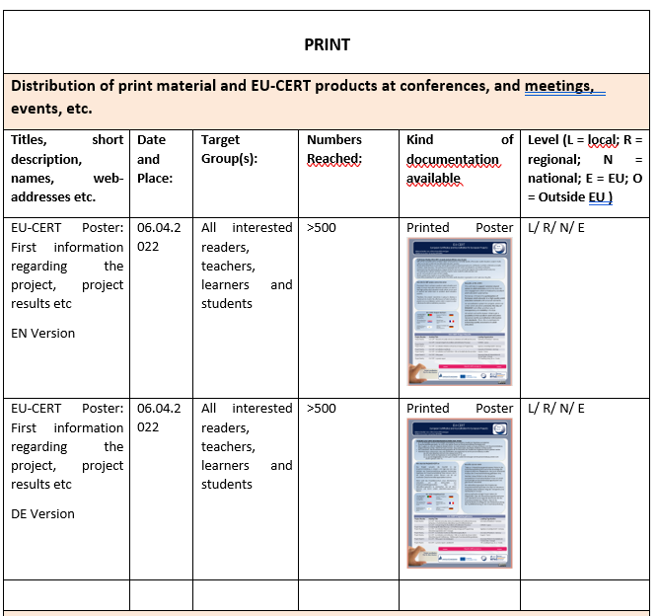
Dissemiantion Report Template – Example UPB

Slide 14
Universität Paderborn
Department Wirtschaftspädagogik Lehrstuhl Wirtschaftspädagogik II Warburger Str. 100
33098 Paderborn
http://www.upb.de/wipaed
Prof. Dr. Marc Beutner
Tel: +49 (0) 52 51 / 60 - 23 67
Fax: +49 (0) 52 51 / 60 - 35 63
E-Mail: marc.beutner@uni-paderborn.de

