Slide 1
EU-CERT: European Certificates and Accreditation for European Projects
EU-CERT: European Certificates and Accreditation for European Projects
University of Paderborn
Reference Number: 2021-1-DE02-KA220-ADU-000033541
Duration:
01.02.2022 – 31.05.2024 (28 month)

Slide 2
Partners of EU-CERT
Associação Rede de Universidades da Terceira Idade PortugalCentro
Esquare France Provence-Alpes-Côte d'Azur
University of Paderborn Germany
(Coordinator)
TIR Consulting Group j.d.o.o Croatia Grad Zagreb
STANDO LTD Cyprus Κύπρος (Kýpros) Nicosia
Ingenious Knowledge GmbH Germany
(Technical partner)
"Dieses Foto" von Unbekannter Autor ist lizenziert gemäß CC BY-SA
"Dieses Foto" von Unbekannter Autor ist lizenziert gemäß CC BY-NC
"Dieses Foto" von Unbekannter Autor ist lizenziert gemäß CC BY-SA

Slide 3
About EU-CERT
The EU-CERT project focuses on adult education.
Initial position:
One of the core ideas is to promote adult education results created within ERASMUS+ projects. Typically, there is no certification or accreditation of those.
Preliminary Studie of EU-CERT- A needs analysis (Winter 2020, N=250)
87% of the consulted users complain about intransparency and weak quality of European adult education project results which cannot be transferred into daily adult education practice.
86.5% stated that there is a strong need to get to evidence-based approaches to certification and that certificates are badly needed in adult education. The participant emphasized that the need is specifically for accredited certificates.
84% answered, that adult education projects of the EU were seen critical with regard to the quality of their outcomes
The participants underpinned that many EU projects create results for adult education but
(a) not many people are aware of them (79%),
(b) the quality of the results is not certified (87%), and
(c) and the possibilities for an good transfer into other adult education organisation is not made clear ( 89.5%).

Slide 4
About EU-CERT
→ Here the EU-CERT project comes into action: The project tries to enhance quality in adult education and helps to ensure that adult education providers are able to find high quality adult education results which can be used in practice and which base on excellent adult education projects.
Therefore, the project consortium is going to develop a mechanism to monitor the effectiveness of adult education project via an accreditation system which is based on clear criteria and a solid accreditation procedure.
Core project result is the accreditation system of EU-CERT

Slide 5
About EU-CERT
Benefits of EU-CERT:
This will help to support common shared values in adult education and is the basis for civic engagement which is fostered by excellent adult education approaches.
Moreover, it fosters the participation of European adult educator in a high quality adult education network with ensured standards.
An accreditation system for projects which run under adult education promotes the idea of ERAMUS+ and offers another way of transparency and visibility in Europe.
All seniors and all European citizens get a possibilty to find excellent adult education resources via the accreditation information and standards. This is the crucial basis for enhancing quality assureance in adult education.

Slide 6
Project Result 1
EU-CERT - Research on Quality criteria, Accreditation and Certificate Structures (Leading orga: University of Paderborn)

Slide 7
Project Result 1 – Mixed- Methods Design of the Research
Needs analysis (Nov./ Dec. 2021):
more than 80% of the participants asked for evidences concerning the situation with regard to certification and accreditation in adult education
→ To take this need for serious we designed this first project result which ones with evidence derived from research in the partner countries.

Slide 8
Project Result 1 – Mixed- Methods Design of the Research
This project result 1 (PR1) provides deep research on existing certificate and quality assureance structures in the partner countries of EU-CERT.
It basis on the already existing needs analysis which was done before applying for this projects. The needs analysis gave a general overview on the accreditation and certification structure in adult education with regard to ERASMUS+. It should that there exist several general quality assureance solutions in the partner countries but that there is no focus no general accreditation process which takes the ERASMUS+ results into account and fosters transparency of the ERASMUS+ adult education programme. Also it was clear after the needs analysis that there is a variety of quality assureance approaches.
Our needs analysis before this application was a formal, systematic process of identifying and evaluating the need for such an certification and accreditation process in the field of adult education. It also showed that just a PDCA-cycle (Plan, Do, Check, Act) cannot be an adeqaute basis for future quality assureance and accreditation in adult education. This means, to design a feasible approach within EU-CERT, we need more detailed information about the existing processes.
To make sure that there are no double works and that existing strutures will be taken under account the IO1 research of EU-CERT gathers the existing quality criteria and puts them together in a criteria matrix. Therefore, the certificate structures and quality criteria will be explained by experts in interviews to get a deeper insight and also existing accreditation processes are explained and documented.

Slide 9
Project Result 1 – Mixed- Methods Design of the Research
Qualitative Research:
(I) desktop research in each partner country and
(II) combines this with 5 expert interviews in each country
Quantitative Research:
(III) broad questionnaire on quality assurance with regard to ERASMUS+ and necessary quality criteria as well as exisiting certification elements
Project result 1 (PR1) - EU-CERT - Research on Quality criteria, Accreditation and Certificate Structures" comes with
This is a crucial basis for the concept design
in PR2 and the programming in PR3

Slide 10
Project Result 1 – Mixed- Methods Design of the Research
It makes sure that technical issues and critera related issues are addressed in adequate ways. Moreover this means that it it necessary to focus on how the organisations in the partner countries keep the documentation of an educational programme, how they evaluate the quality of an educational programme and adherence to the curriculum and its quality. In addtion to that it is useful to get deeper knowledge about existing equipment and personnel resources of educational programme compared with the educational measure that is the subject of accreditation.

Slide 11
Project Results 1 - Qualitative Research
(I) desktop research in each partner country
Deep research on existing certificate and quality assurance structures in the partner countries of EU-CERT.
1. What are the common existing certificates in your country?
2. How is the quality assurance structure of the certificates in your countries?

Slide 12
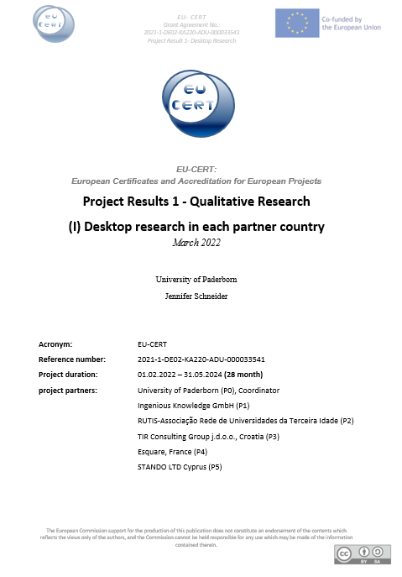
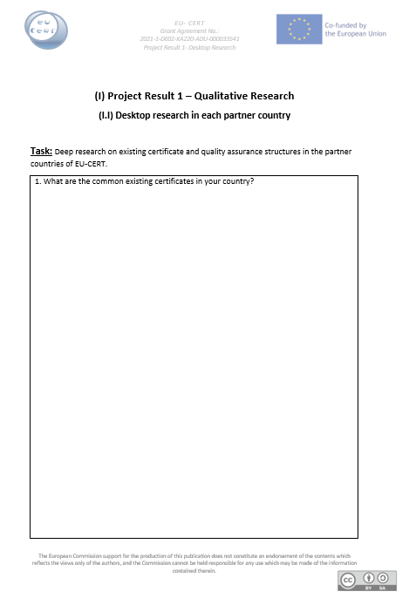
Project Results 1 - Qualitative Research
Document has to be translated in each partner language.
English version available

Slide 13
Project Results 1 - Qualitative Research
(II) 5 expert interviews in each country
Summary of potential semi- standard key questions:
How satisfied are you with the common existing certificates in your country?
What are necessary quality criteria for certificantes?
What is necessary to guarantee great transparency of certificates?
How satisfied are you with the quality assurance structure of the certificates in your countries?
What are necessary quality criteria for quality assurance structures?
What are benefits of certificates in educational environment?

Slide 14
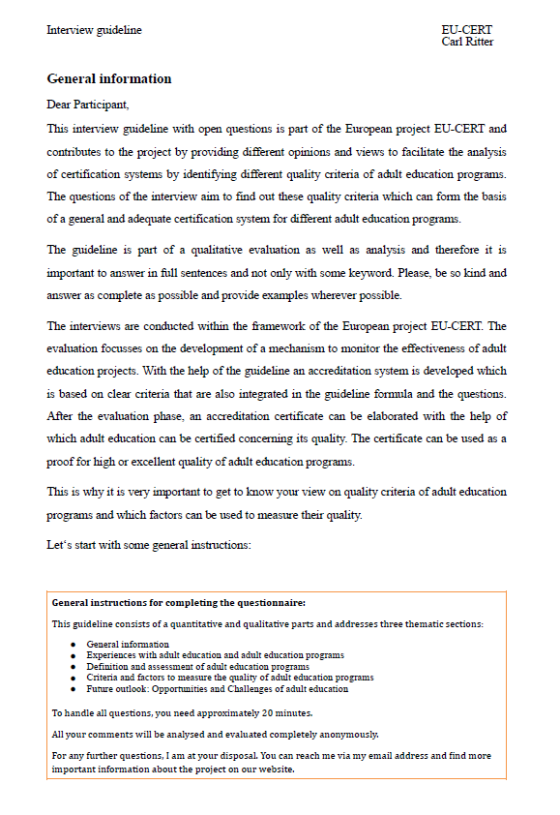
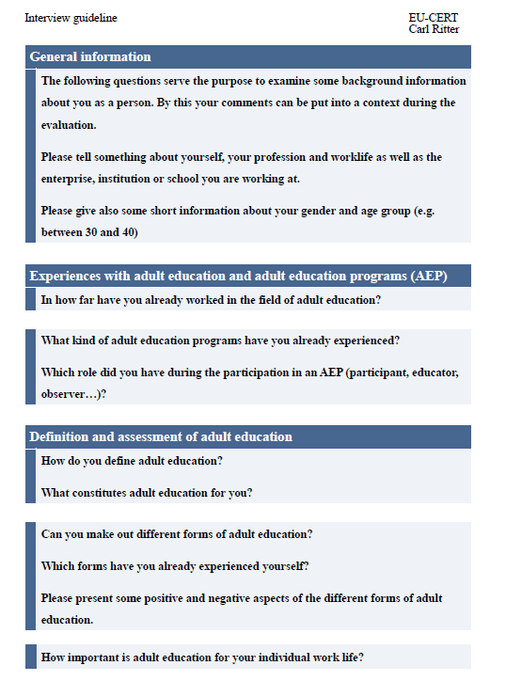
Project Results 1 - Qualitative Research
Interview guideline has to be translated in each partner language.
English version available

Slide 15
Project Results 1 – Quantitative Research
Quantitative Research:
(III) broad questionnaire on quality assurance with regard to ERASMUS+ and necessary quality criteria as well as exisiting certification elements
Based on the results of the qualitative research (I) and (II), we will create a standardise quantitaive questionnaire, which will be spread to experts as well as stakeholders
Herefore, we will use an online survey tool and spread the questionnaire link to all partner institutions
The survey will be available in all partner languages

Slide 16
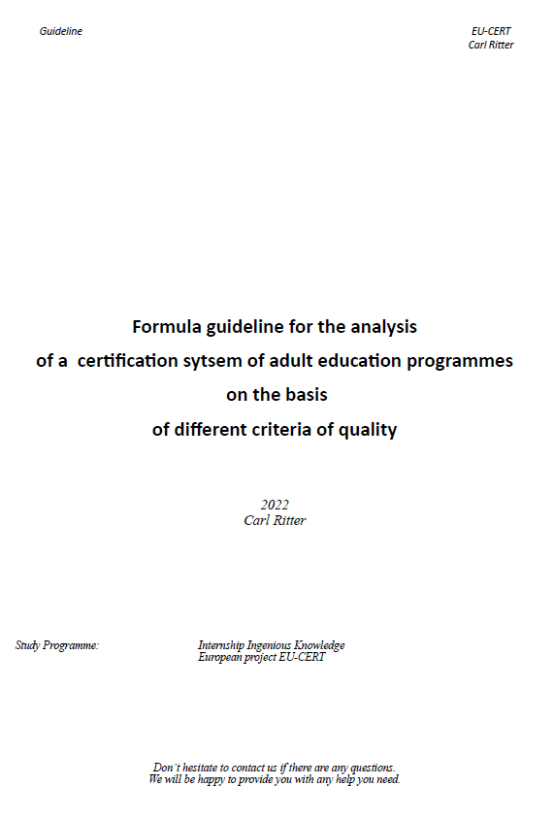
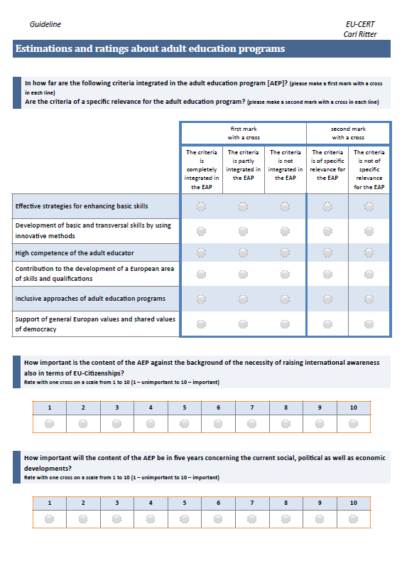
Project Results 1 – Quantitative Research
Quantitative questionnaire has to be translated in each partner language.
English version available

Slide 17
Project Result 1 – Research on Quality criteria, Accreditation and Certificate Structures
All Project Results 1 has to be translated in the following partner languages:
Croatian , German , English , French , Greek , Portuguese

Slide 18
Universität Paderborn
Department Wirtschaftspädagogik Lehrstuhl Wirtschaftspädagogik II Warburger Str. 100
33098 Paderborn
http://www.upb.de/wipaed
Prof. Dr. Marc Beutner
Tel: +49 (0) 52 51 / 60 - 23 67
Fax: +49 (0) 52 51 / 60 - 35 63
E-Mail: marc.beutner@uni-paderborn.de

