Slide 1
EU-CERT:
European Certificates and Accreditation for European Projects
First EU-CERT transnational partner meeting (TPM1)
in Germany, Cologne
The EU-CERT – Kick-off-Conference
11th - 13th of April 2022
Partner Presentation
University of Paderborn
Reference Number:
2021-1-DE02-KA220-ADU-000033541
Duration:
01.02.2022 – 31.05.2024 (28 month)

Slide 2
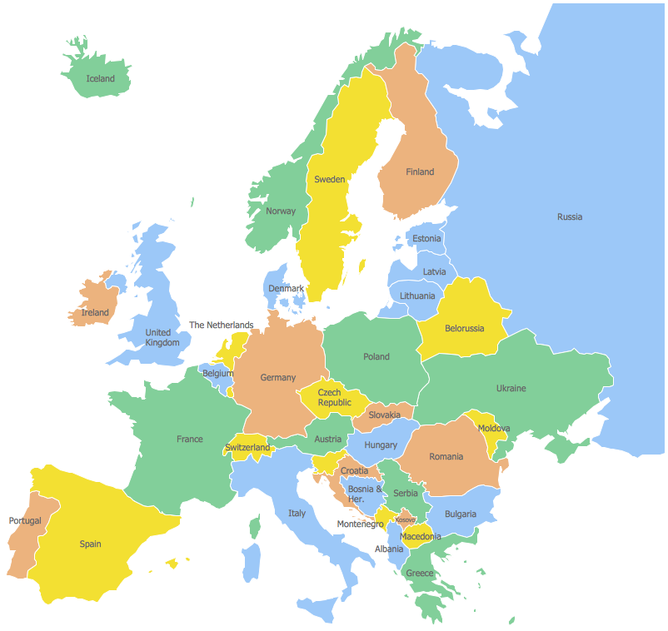

The Erasmus+ Project
Partners of CoopCities
Malta

Slide 3





Partners of EU-CERT
Associação Rede de Universidades da Terceira Idade PortugalCentro
Esquare France Provence-Alpes-Côte d'Azur
University of Paderborn Germany
(Coordinator)
TIR Consulting Group j.d.o.o Croatia Grad Zagreb
STANDO LTD Cyprus Κύπρος (Kýpros) Nicosia
Ingenious Knowledge GmbH Germany
(Technical partner)
"Dieses Foto" von Unbekannter Autor ist lizenziert gemäß CC BY-SA
"Dieses Foto" von Unbekannter Autor ist lizenziert gemäß CC BY-NC
"Dieses Foto" von Unbekannter Autor ist lizenziert gemäß CC BY-SA

Slide 4
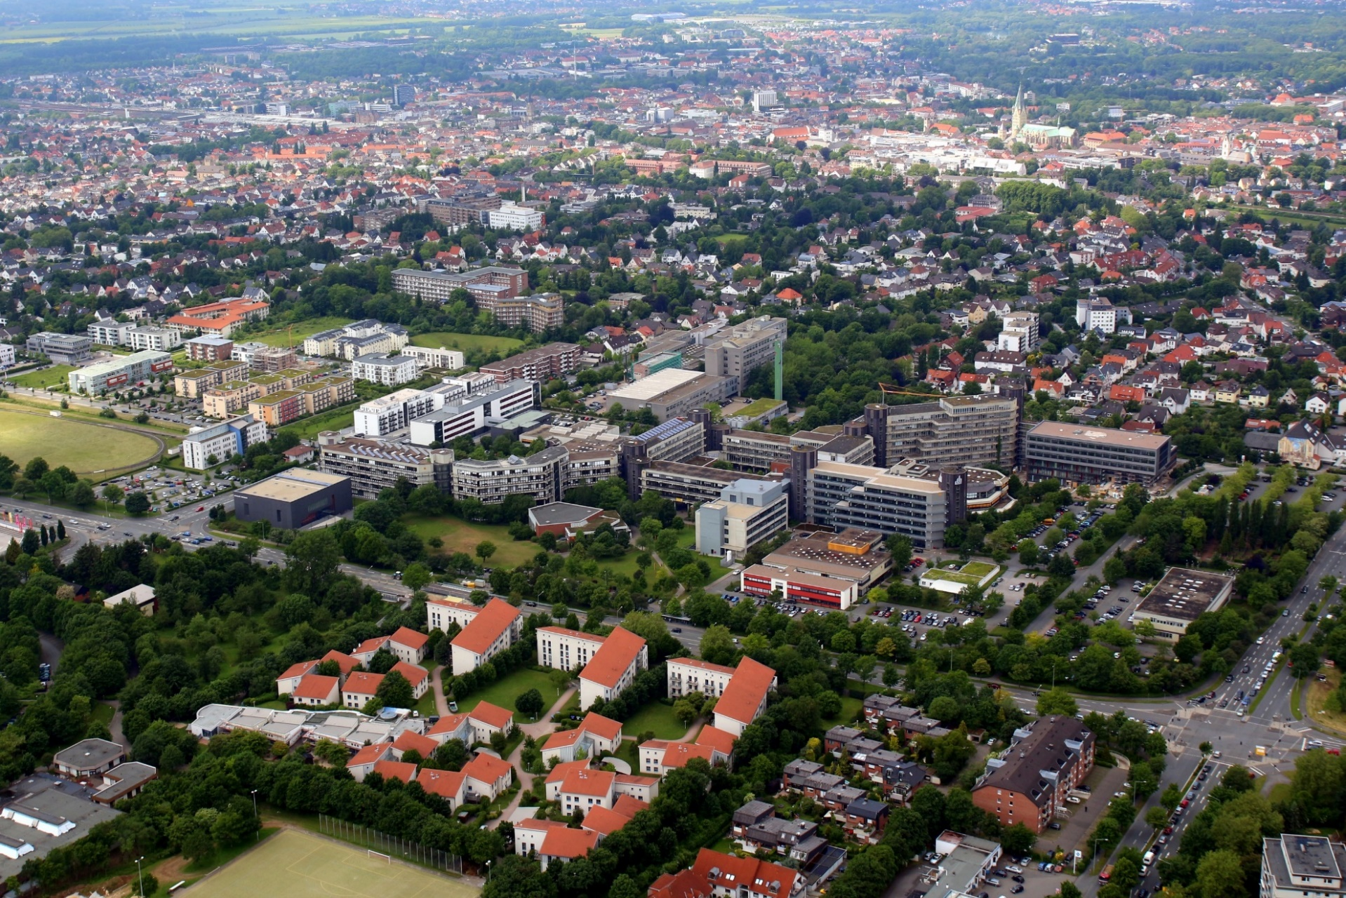
(University of Paderborn, Picture from Patrick Kleibold, 14.06.2013)

Slide 5
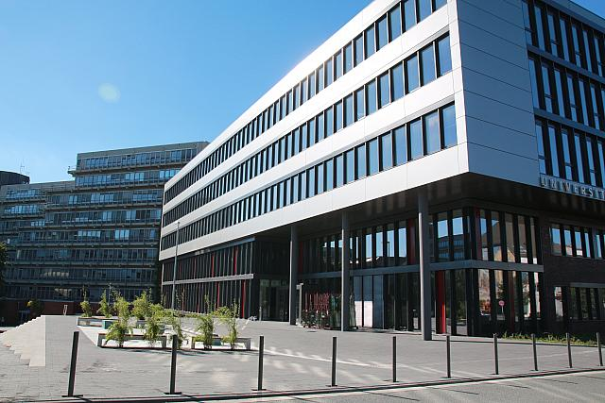
The University of Paderborn
Q-Building, University of Paderborn - Referat Presse und Kommunikation, 27.09.2013
5 faculties
64 different degree programmes
20.293 students WS 19/20
2.503 staff members Jan 20

Slide 6

The department and the chair
Chair of Business, Human Resource Education and Evaluation Research Prof. Dr. Marc Beutner

Slide 7

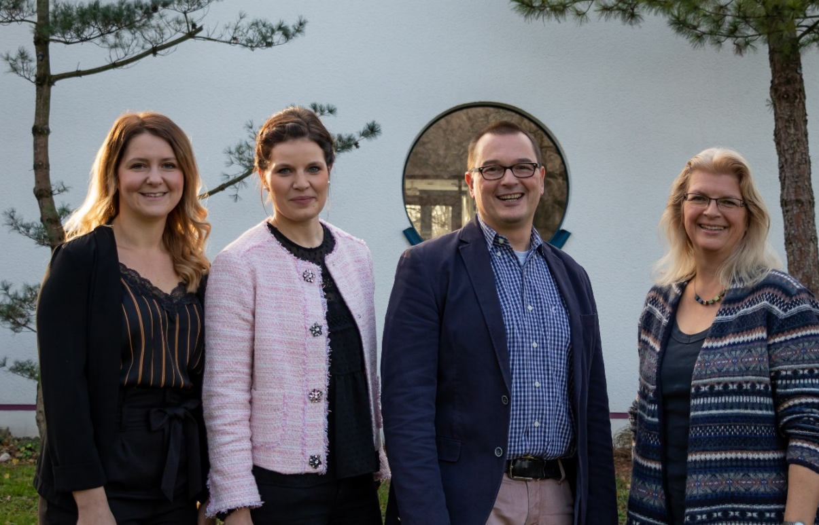
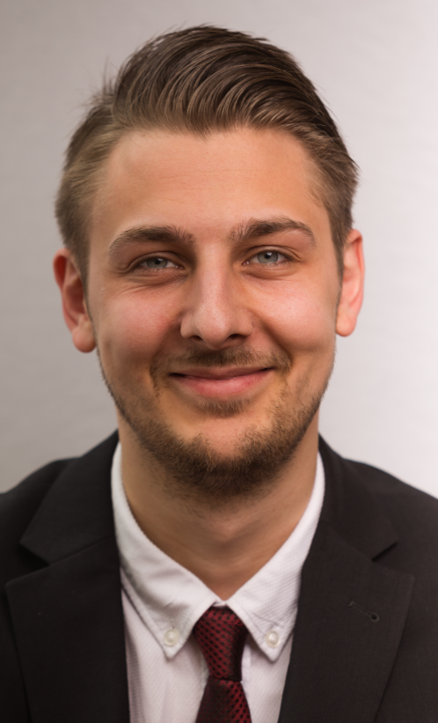
The Chair in portrait
Jennifer Schneider, Jana Stelzer, Marc Beutner, Vera Gockel and Sebastian Koppius

Slide 8
Research foci and fields of activity
  Education of students in the first phase (university phase) of teacher education in the field of adult education, vocational education and training
  Connection of teaching activities and research
  School education with focus on general and vocational schools
  Youth education, Adult education, vocational education and vocational teacher education
  European VET – Cultural differences and similarities
  Game-based-learning, Serious Games
  eLearning, mLearning
  Entrepreneurship Education and Career Orientation
  Evaluation in vocational education and evaluation research

Slide 9
Currently running or recently finished projects
  Green-4-Future: Greening the EntreComp Framework to Reconcile Economic
  Development and Environmental Security
  IDEAL- GAME: Improving didactics, education and learning in higher education
  with the Online Serious Game Creator
  VC BK: Virtual Classroom am Berufskolleg des Kreises Höxter- Brakel
  MeDiaPLUR: Fostering Media competences of Bloggers in Ukraine
  Aware: Personalentwicklung und Arbeit 4.0
  NGEnvironemt: Foster European Active Citizenship and Sustainability Through Ecological Thinking by NGOs
  DigI-VET: Fostering Digitization and Industry 4.0 in vocational education
  MATH: Mountains of absolutely terrifying height
  OPALESCE: Online Portal and Active Learning System for Senior Citizens in Europe
  SYNERGY: Harnessing the Learning Assets Within the SME Business Community
  SMART: Skill Matching Assistance and Reporting Tool
  YES: Youth Engagement in Society
  GET-UP: Green Entrepreneurship Training – underpinning prosperity
  Shadows: Supporting Entrepreneurs in the cultural and creative industry sector
  Learning Map: Webtool for Badges in Education
  GameON: Game-based learning in School Education
  GoMobile: Mobile Learning in Vocational Education

Slide 10



Insights into currently running project – Starting Periode 2022
DigiComConsumer
Integrating Digital Competence for Consumers in secondary education
through Digital Games Based Learning co creation approach
Projektnummer: 2021-1-BG01-KA220-SCH-000027951
Reliable Green
Remote work, telework and learning with innovative and accessible educational resources for businesses and labor markets in Europeans Green Economy
Projektnummer: 2021-1-RO01-KA220-VET-000025443
EU-CERT
European Certificates and Accreditation for European Projects
Projektnummer: 2021-1-DE02-KA220-ADU-00003354

Slide 11
Universität Paderborn
Department Wirtschaftspädagogik Lehrstuhl Wirtschaftspädagogik II Warburger Str. 100
33098 Paderborn
http://www.upb.de/wipaed
Prof. Dr. Marc Beutner
Tel: +49 (0) 52 51 / 60 - 23 67
Fax: +49 (0) 52 51 / 60 - 35 63
E-Mail: marc.beutner@uni-paderborn.de

