Slide 1
EU-CERT: European Certificates and Accreditation for European Projects
EU-CERT Transnational partner meeting (TPM3) in Antibes, France
The EU-CERT – Accreditation Structure and Tool Conference!
7th - 9th of March 2023
Current status of the partners University of Paderborn
Reference Number: 2021-1-DE02-KA220-ADU-000033541
Duration:
01.02.2022 – 31.05.2024 (28 month)

Slide 2
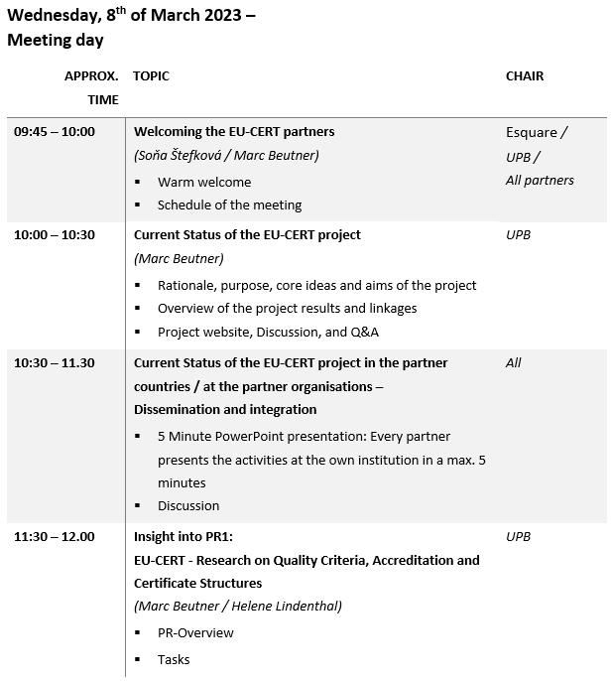
Meeting Agenda Wednesday, 8th of March

Slide 3
Current Status of the EU-CERT project in the partner countries
5 Minute PowerPoint presentation:
Every partner presents the activities at the own institution in a max. 5 minutes

Slide 4
Current Status of the EU-CERT project in the partner countries
Discussion

Slide 5
Project Results
Project Results | Starting period | End of period | Activity Title | Leading Organisation
Project Result 1 | 2022-02 | 2022- 10 | EU-CERT - Research on Quality criteria, Accreditation and Certificate Structures | University of Paderborn – Germany
Project Result 2 | 2022-02 | 2023-03 | EU-CERT - Concept Design for Accredition and Certification Processes | STANDO - Cyprus
Project Result 3 | 2022-05 | 2023-07 | EU-CERT - Accreditation Website and Data-base Design and Programming | Ingenious Knowledge GmbH - Germany
Project Result 4 | 2022-07 | 2023-07 | EU-CERT - Accreditation Handbook | University of Paderborn - Germany
Project Result 5 | 2022-03 | 2023-11 | EU-CERT - Accreditation and Certification - Roll-out to adult education providers | Esquare - France
Project Result 6 | 2022-02 | 2024-02 | EU-CERT - Policy paper | Associação Rede de Universidades da Terceira Idade - Portugal
Project Result 7 | 2202-02 | 2024-02 | EU-CERT - Layman ́s report | TIR Consulting Group j.d.o.o - Croatia

Slide 6
Project Result 1
EU-CERT - Research on Quality criteria, Accreditation and Certificate Structures (Leading orga: University of Paderborn)

Slide 7
Project Result 2
EU-CERT - Concept Design for Accredition and Certification Processes (Leading orga: STANDo)

Slide 8
Project Result 3
EU-CERT - Accreditation Website and Data-base Design and Programming (Leading orga: Ingenious Knowledge)

Slide 9
Project Result 4
EU-CERT - Accreditation Handbook
(Leading orga: University of Paderborn)

Slide 10
Project Result 5
EU-CERT - Accreditation and Certification - Roll-out to adult education providers
(Leading orga: ESQUARE)

Slide 11
Project Result 6
IO6 EU-CERT - Policy paper
(Leading orga: Associação Rede de Universidades da Terceira Idade - Portugal)

Slide 12
Project Result 7
IO6 EU-CERT – Layman´s Report (Leading orga: TIR Croatia)

Slide 13
Universität Paderborn
Department Wirtschaftspädagogik Lehrstuhl Wirtschaftspädagogik II Warburger Str. 100
33098 Paderborn
http://www.upb.de/wipaed
Prof. Dr. Marc Beutner
Tel: +49 (0) 52 51 / 60 - 23 67
Fax: +49 (0) 52 51 / 60 - 35 63
E-Mail: marc.beutner@uni-paderborn.de

