Slide 1
EU-CERT: European Certificates and Accreditation for European Projects
EU-CERT Transnational partner meeting (TPM4) in Zagreb, Croatia
The EU-CERT – Accreditation and Documentation Conference!
5th - 7th of December 2023
Welcome University of Paderborn
Reference Number: 2021-1-DE02-KA220-ADU-000033541
Duration:
01.02.2022 – 31.05.2024 (28 month)

Slide 2
Welcome to our 4th Transnational Partner Meeting within the EU-CERT Project!

Slide 3
Meeting Agenda

Slide 4
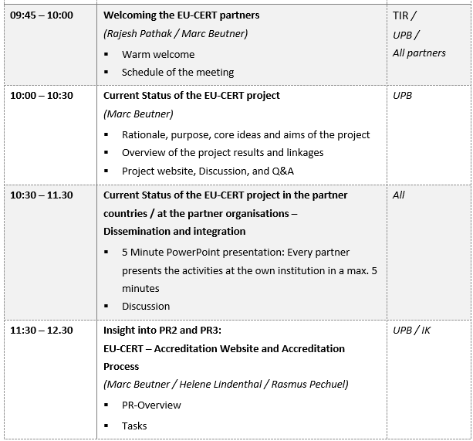
Meeting Agenda Wednesday, 6th of December

Slide 5
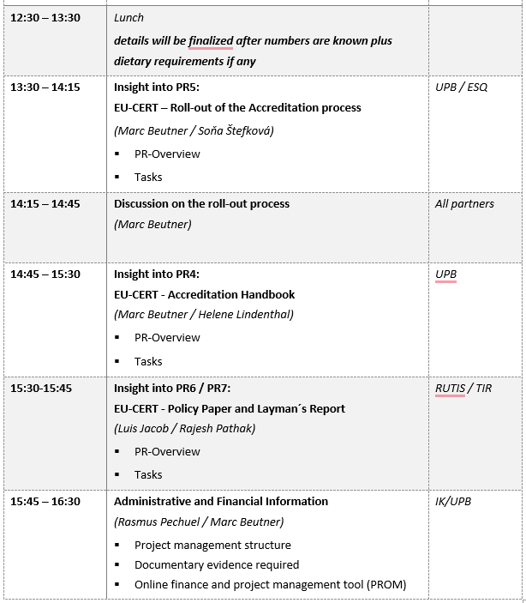
Meeting Agenda Wednesday, 6th of December

Slide 6
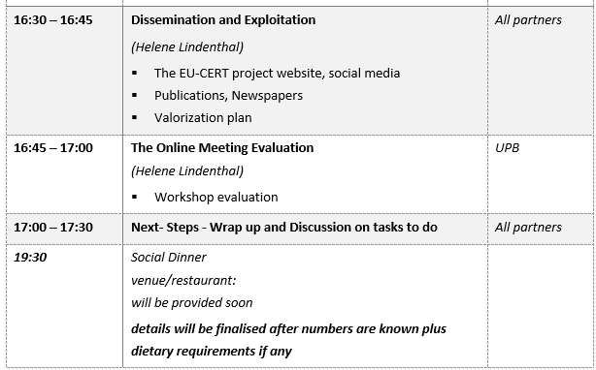
Meeting Agenda Wednesday, 6th of December

Slide 7
Universität Paderborn
Department Wirtschaftspädagogik Lehrstuhl Wirtschaftspädagogik II Warburger Str. 100
33098 Paderborn
http://www.upb.de/wipaed
Prof. Dr. Marc Beutner
Tel: +49 (0) 52 51 / 60 - 23 67
Fax: +49 (0) 52 51 / 60 - 35 63
E-Mail: marc.beutner@uni-paderborn.de

