Slide 1
EU-CERT: European Certificates and Accreditation for European Projects
EU-CERT Transnational partner meeting (TPM5) in Paderborn, Germany
The EU-CERT – Final Policy Recommendation Conference!
5th - 7th of March 2024
Current Status University of Paderborn
Reference Number: 2021-1-DE02-KA220-ADU-000033541
Duration:
01.02.2022 – 31.05.2024 (28 month)

Slide 2
Current Status of the EU-CERT project
5th - 7th of March 2024, Final Policy Recommendation Conference!

Slide 3
Project Results
Project Results | Starting period | End of period | Activity Title | Leading Organisation
Project Result 1 | 2022-02 | 2022- 10 | EU-CERT - Research on Quality criteria, Accreditation and Certificate Structures | University of Paderborn – Germany
Project Result 2 | 2022-02 | 2023-03 | EU-CERT - Concept Design for Accredition and Certification Processes | STANDO - Cyprus
Project Result 3 | 2022-05 | 2023-07 | EU-CERT - Accreditation Website and Data-base Design and Programming | Ingenious Knowledge GmbH - Germany
Project Result 4 | 2022-07 | 2023-07 | EU-CERT - Accreditation Handbook | University of Paderborn - Germany
Project Result 5 | 2022-03 | 2023-11 | EU-CERT - Accreditation and Certification - Roll-out to adult education providers | Esquare - France
Project Result 6 | 2022-02 | 2024-02 | IO6 EU-CERT - Policy paper | Associação Rede de Universidades da Terceira Idade - Portugal
Project Result 7 | 2202-02 | 2024-02 | IO6 EU-CERT - Layman ́s report | TIR Consulting Group j.d.o.o - Croatia

Slide 4
Project Result 1
EU-CERT - RESEARCH ON QUALITY CRITERIA, ACCREDITATION AND CERTIFICATE STRUCTURES (LEADING ORGA: UNIVERSITY OF PADERBORN)

Slide 5
Project Result 1 – Mixed- Methods Design of the Research
Project result 1 (PR1) - EU-CERT - Research on Quality criteria, Accreditation and Certificate Structures" comes with
Qualitative Research:
(I) desktop research in each partner country and
(II) combines this with 5 expert interviews in each country
Quantitative Research:
(III) broad questionnaire on quality assurance with regard to ERASMUS+ and necessary quality criteria as well as exisiting certification elements
This is a crucial basis for the concept design
in PR2 and the programming in PR3

Slide 6
Current Status of Project Result 1
All Project Results 1 has to be translated in the following partner languages:
Croatian , German , English , French , Greek , Portuguese
Project Results | Starting period | End of period | Activity Title | Leading Organisation | Completed? | Translation completed?
Project Result 1 | 2022-02 | 2022- 10 | EU-CERT - Research on Quality criteria, Accreditation and Certificate Structures | University of Paderborn – Germany | missing: RUTIS | missing: all

Slide 7
Project Result 2
EU-CERT - CONCEPT DESIGN FOR ACCREDITATION AND CERTIFICATION PROCESSES (LEADING ORGA: STANDO)

Slide 8
Project Result 2 – EU-CERT - CONCEPT DESIGN FOR ACCREDITATION AND CERTIFICATION PROCESSES
Needs Analysis
Concept for the Accreditation System
Criteria based certificates

Slide 9
Current Status of Project Result 2
All Project Results 2 has to be translated in the following partner languages:
Croatian , German , English , French , Greek , Portuguese
Project Results | Starting period | End of period | Activity Title | Leading Organisation | Completed? | Translation completed?
Project Result 2 | 2022-02 | 2023-03 | EU-CERT - Concept Design for Accredition and Certification Processes | STANDO - Cyprus | Yes | missing: RUTIS, TIR

Slide 10
Project Result 3
EU-CERT - ACCREDITATION WEBSITE AND DATA-BASE DESIGN AND PROGRAMMING (LEADING ORGA: INGENIOUS KNOWLEDGE)

Slide 11
Project Result 3 – EU-CERT - ACCREDITATION WEBSITE AND DATA-BASE DESIGN AND PROGRAMMING
Information part
Accreditation Website
User / participants part
Evaluator / Accreditation part
communication part
Data-based part

Slide 12
Current Status of Project Result 3
All Project Results 3 has to be translated in the following partner languages:
Croatian , German , English , French , Greek , Portuguese
Project Results | Starting period | End of period | Activity Title | Leading Organisation | Completed? | Translation completed?
Project Result 3 | 2022-05 | 2023-07 | EU-CERT - Accreditation Website and Data-base Design and Programming | Ingenious Knowledge GmbH - Germany | no, ongoing process | missing: all

Slide 13
Project Result 4
EU-CERT - ACCREDITATION HANDBOOK
(LEADING ORGA: UNIVERSITY OF PADERBORN)

Slide 14
Accreditation Handbook
All Project Results 4 has to be translated in the following partner languages:
Croatian , German , English , French , Greek , Portuguese
Project Results | Starting period | End of period | Activity Title | Leading Organisation | Completed? | Translation completed?
Project Result 4 | 2022-07 | 2023-07 | EU-CERT - Accreditation Handbook | University of Paderborn - Germany | no waiting for tool to be completed | no

Slide 15
Accreditation Handbook
The handbook will be assessable in a:
short version - Guideline A: which steers the user through the accreditation process and the website, etc.

Slide 16
Accreditation Handbook
The handbook will be assessable in a
Detailed version- Guideline B: which provides the provides help and hints for the accreditations/evaluators.
It will be also assessable in a complete book version which addresses the following aspects:
General introduction into accreditation, certification and certificates
The need for accreditation, certification and certificates in adult education
EU-CERT - Overview on the project, its aims and objectives
The Accreditation and Certification processes of EU-CERT
The quality criteria of EU-CERT
User guideline through the accreditation process and the website
Accreditators/evaluator guideline
Results of the EU-CERT Research on Accreditation and Certification in EUROPEAN adult education

Slide 17
Accreditation Handbook
Further information regarding the
accreditation handbook coming soon…

Slide 18
Project Result 5
EU-CERT - ACCREDITATION AND CERTIFICATION - ROLL-OUT TO ADULT EDUCATION PROVIDERS
(LEADING ORGA: ESQUARE)

Slide 19
Project Result 5 – EU-CERT - ACCREDITATION AND CERTIFICATION - ROLL-OUT TO ADULT EDUCATION PROVIDERS
15 adult education providers
Testing of the certification process
Testing of the accreditation process
Roll-out

Slide 20
ACCREDITATION AND CERTIFICATION - ROLL-OUT TO ADULT EDUCATION PROVIDERS
All Project Results 5 has to be translated in the following partner languages:
Croatian , German , English , French , Greek , Portuguese
Project Results | Starting period | End of period | Activity Title | Leading Organisation | Completed? | Translation completed?
Project Result 5 | 2022-03 | 2023-11 | EU-CERT - Accreditation and Certification - Roll-out to adult education providers | Project Result 5

Slide 21
Project Result 6
IO6 EU-CERT - POLICY PAPER
(LEADING ORGA: ASSOCIAÇÃO REDE DE UNIVERSIDADES DA TERCEIRA IDADE - PORTUGAL)

Slide 22
Project Result 6 – EU-CERT - Policy Paper
4 key issues
Importance of high quality training
Explanation of certification and accreditation processes
Importance of accreditation in adult education
Importance of development exchange and certification in adult education

Slide 23
POLICY PAPER
All Project Results 6 has to be translated in the following partner languages:
Croatian , German , English , French , Greek , Portuguese
Project Results | Starting period | End of period | Activity Title | Leading Organisation | Completed? | Translation completed?
Project Result 6 | 2022-02 | 2024-02 | IO6 EU-CERT - Policy paper | Project Result 6

Slide 24
Project Result 7
IO6 EU-CERT – LAYMAN´S REPORT (LEADING ORGA: TIR CROATIA)

Slide 25
Project Result 6 – EU-CERT - Laymen Report
Recommen- dations
Easy to read
European broad audience

Slide 26
LAYMAN´S REPORT
All Project Results 7 has to be translated in the following partner languages:
Croatian , German , English , French , Greek , Portuguese
Project Results | Starting period | End of period | Activity Title | Leading Organisation | Completed? | Translation completed?
Project Result 6 | 2022-02 | 2024-02 | IO6 EU-CERT - Policy paper | Project Result 6

Slide 27
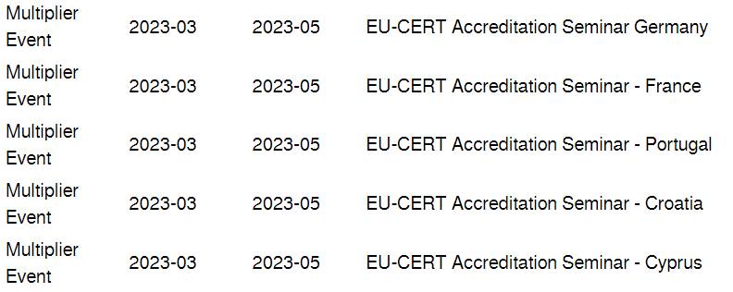
Multiplier Events
March - April 2024
There will be a timeshift for the Multiplier Event, because of the shifted starting periode of EU-CERT (01.02.2022 – 31.05.2024 (28 month)!

Slide 28
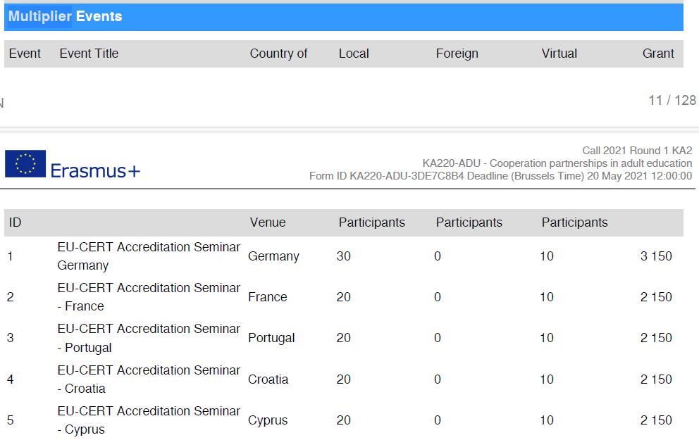
Multiplier Events

Slide 29
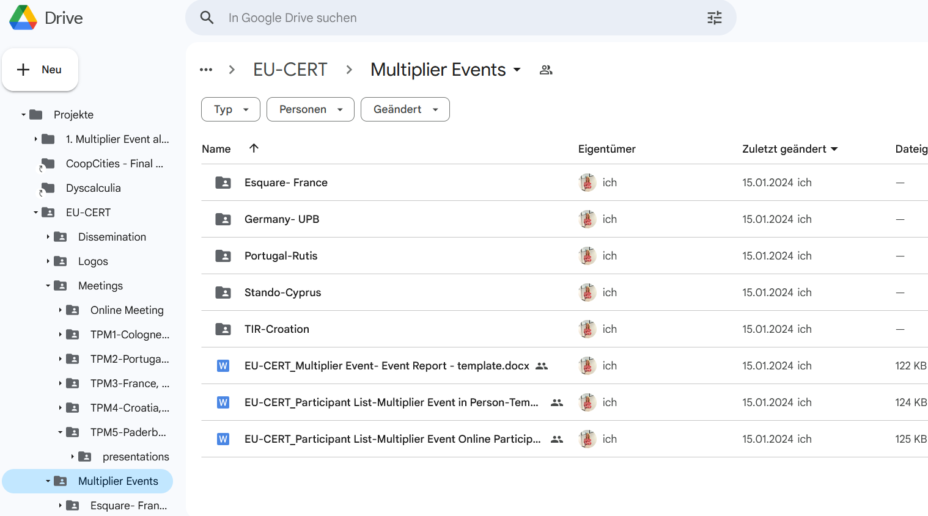
Multiplier Events
On Google.Drive you can find the necessary documents to document and evaluate the Multiplier Event. Don´t forget to take some pictures of the session
Link: https://drive.google.com/drive/folders/1cc7496syxKSt7OsGRqGyJrvrJtuRKy_G

Slide 30
Transnational Partner Meetings (TPM)
TPM | Leading Organisation | Meeting Title | Country of Venue | Starting Period
TPM1 | Ingenious Knowledge | EU-CERT - Kick-off Conference | Germany | 2022-02 11. – 13.04.2022
TPM2 | Associação Rede de Universidades da Terceira Idade | EU-CERT - Research and Certificate Conference | Portugal | Oktober, 2022
TPM3 | Esquare | EU-CERT - Accreditation Tool Conference | France | March, 2023
TPM4 | TIR Consulting Group j.d.o.o | EU-CERT - Implementation, Testing and Handbook Design Conference | Croatia | December, 2023
TPM5 | University of Paderborn | EU-CERT - Final Policy Recommendation Conference | Germany | March, 2024

Slide 31
Final Report of EU-CERT

Slide 32
EU-CERT Reports
Grant period: 02/01/2022 - 05/31/2024 Duration: 28 months
Progress Report (until the 30th of November 2022)
Interim Report (until the 30th of April 2023)
Final Report (within 60 days after the end of the project) as required by the European Commission.
The Partner shall provide the Coordinator with the documents necessary for the preparation of the progress report no later than 31st of May 2024.
Please enter your workdays into the Prom tool and verify that the stated workdays align with those approved in the application. Please do not exceed the approved number of workdays, but make sure to report all workdays you have completed.Create timesheets on PROM and check the claimed amount with the number in the proposal!

Slide 33
Universität Paderborn
Department Wirtschaftspädagogik Lehrstuhl Wirtschaftspädagogik II Warburger Str. 100
33098 Paderborn
http://www.upb.de/wipaed
Prof. Dr. Marc Beutner
Tel: +49 (0) 52 51 / 60 - 23 67
Fax: +49 (0) 52 51 / 60 - 35 63
E-Mail: marc.beutner@uni-paderborn.de

