Slide 1
EU-CERT: European Certificates and Accreditation for European Projects
EU-CERT Transnational partner meeting (TPM4) in Zagreb, Croatia
The EU-CERT – Accreditation and Documentation Conference!
5th - 7th of December 2023
Current status University of Paderborn
Reference Number: 2021-1-DE02-KA220-ADU-000033541
Duration:
01.02.2022 – 31.05.2024 (28 month)

Slide 2
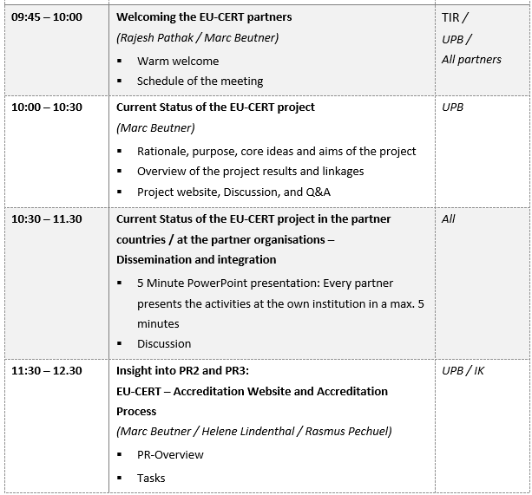
Meeting Agenda Wednesday, 6th of December

Slide 3
Project Results
Project Results | Starting period | End of period | Activity Title | Leading Organisation
Project Result 1 | 2022-02 | 2022- 10 | EU-CERT - Research on Quality criteria, Accreditation and Certificate Structures | University of Paderborn – Germany
Project Result 2 | 2022-02 | 2023-03 | EU-CERT - Concept Design for Accredition and Certification Processes | STANDO - Cyprus
Project Result 3 | 2022-05 | 2023-07 | EU-CERT - Accreditation Website and Data-base Design and Programming | Ingenious Knowledge GmbH - Germany
Project Result 4 | 2022-07 | 2023-07 | EU-CERT - Accreditation Handbook | University of Paderborn - Germany
Project Result 5 | 2022-03 | 2023-11 | EU-CERT - Accreditation and Certification - Roll-out to adult education providers | Esquare - France
Project Result 6 | 2022-02 | 2024-02 | EU-CERT - Policy paper | Associação Rede de Universidades da Terceira Idade - Portugal
Project Result 7 | 2202-02 | 2024-02 | EU-CERT - Layman ́s report | TIR Consulting Group j.d.o.o - Croatia

Slide 4
Project Results
Project Results | Starting period | End of period | Activity Title | Leading Organisation
Project Result 1 | 2022-02 | 2022- 10 | EU-CERT - Research on Quality criteria, Accreditation and Certificate Structures | University of Paderborn – Germany
Project Result 2 | 2022-02 | 2023-03 | EU-CERT - Concept Design for Accredition and Certification Processes | STANDO - Cyprus
Project Result 3 | 2022-05 | 2023-07 | EU-CERT - Accreditation Website and Data-base Design and Programming | Ingenious Knowledge GmbH - Germany
Project Result 4 | 2022-07 | 2023-07 | EU-CERT - Accreditation Handbook | University of Paderborn - Germany
Project Result 5 | 2022-03 | 2023-11 | EU-CERT - Accreditation and Certification - Roll-out to adult education providers | Esquare - France
Project Result 6 | 2022-02 | 2024-02 | EU-CERT - Policy paper | Associação Rede de Universidades da Terceira Idade - Portugal
Project Result 7 | 2202-02 | 2024-02 | EU-CERT - Layman ́s report | TIR Consulting Group j.d.o.o - Croatia

Slide 5
Project Result 2
EU-CERT - Concept Design for Accreditation and Certification Processes (Leading orga: STANDo)

Slide 6
Project Results
Project Result 2 | 2022-02 | 2023-03 | EU-CERT - Concept Design for Accredition and Certification Processes | STANDO - Cyprus
Create concept design Accreditation process will be designed to be supportive, consistent, and objective Accreditation process ensures that the EU-CERT certification practices are acceptable, transparent and comprehensible accreditation is the formal declaration provided by a neutral third party which documents that a process or a certification meets the relevant norms or standards certification itself is an evaluation with regard to existing norms or standards, an issued document of evidence or a written testimony which attests the truth of the facts stated Quality criteria EU-CERT – Concept Design for Accreditation and Certification Processes EU-CERT – Concept Design for first automated feedback on the website

Slide 7
Project Result 3
EU-CERT - Accreditation Website and Data-base Design and Programming (Leading orga: Ingenious Knowledge)

Slide 8
Project Results
Project Result 3 | 2022-05 | 2023-07 | EU-CERT - Accreditation Website and Data-base Design and Programming | Ingenious Knowledge GmbH - Germany
Accreditation Website Easy to access Get information on the accreditation and certification processes Transparency concerning the procedures the steps of the accreditation process have to be designed to be selected and used by the applicant organisation in the accreditation process as well as by the accreditation organisation of EU-CERT and the working evaluators Parts of the website: 1) Information, 2) User/Participants, 3) Evaluator/Accreditation, 4) Communication, 5) Data-base EU-CERT Accreditation Tool Website in progress (https://eucert-tool.eduproject.eu/auth/login) Questionnaire about the website

Slide 9
Project Result 4
EU-CERT - Accreditation Handbook
(Leading orga: University of Paderborn)

Slide 10
Project Results
Project Result 4 | 2022-07 | 2023-07 | EU-CERT - Accreditation Handbook | University of Paderborn - Germany
Accreditation Handbook explanation of the processes and the criteria within a detailed handbook which provided a compilation of all information needed a book which will be accessible in a printed and an online version accreditation handbook provides general information on accreditation for adult education and the accreditation and certification processes within EU-CERT addresses the quality criteria and explains them and their use Guideline A, which steers the user through the accreditation process and the website Guideline B, which provides provides help and hints for the accreditation/evaluators complete book version which addresses the following aspects: (a) General introduction into accreditation, certification and certificates (b) The need for accreditation, certification and certificates in adult education (c) EU-CERT - Overview of the project, its aims and objectives (d) The Accreditation and Certification processes of EU-CERT (e) The quality criteria of EU-CERT (f) User guidelines through the accreditation process and the website (g) Accreditators/evaluator guideline (h) Results of the EU-CERT Research on Accreditation and Certification in EUROPEAN adult education EU-CERT Accreditation Handbook in progress, waiting for the website to be finalized

Slide 11
Current status of UPB
PR1 finished
PR 2 finished
Website created
First automated feedback (scoring system) created
Information on the project introduced into study modules at the University of Paderborn
Contact with chambers and projects as a basis for later accreditation
Information to FBH – German Head Institute for adult education and vocational education in the craft sector

Slide 12
Discussion and Q&A

Slide 13
Universität Paderborn
Department Wirtschaftspädagogik Lehrstuhl Wirtschaftspädagogik II Warburger Str. 100
33098 Paderborn
http://www.upb.de/wipaed
Prof. Dr. Marc Beutner
Tel: +49 (0) 52 51 / 60 - 23 67
Fax: +49 (0) 52 51 / 60 - 35 63
E-Mail: marc.beutner@uni-paderborn.de

