Slide 1
EU-CERT: European Certificates and Accreditation for European Projects
EU-CERT Transnational partner meeting (TPM4) in Zagreb, Croatia
The EU-CERT – Accreditation and Documentation Conference!
5th - 7th of December 2023
Current status of the partners University of Paderborn
Reference Number: 2021-1-DE02-KA220-ADU-000033541
Duration:
01.02.2022 – 31.05.2024 (28 month)

Slide 2
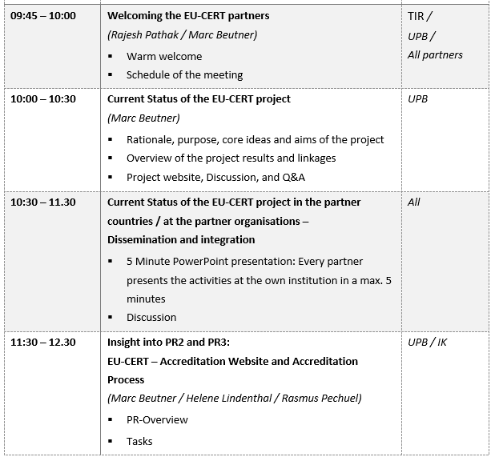
Meeting Agenda Wednesday, 6th of December

Slide 3
Current Status of the EU-CERT project in the partner countries
5 Minute PowerPoint presentation:
Every partner presents the activities at the own institution in a max. 5 minutes

Slide 4
Discussion and Q&A

Slide 5
Universität Paderborn
Department Wirtschaftspädagogik Lehrstuhl Wirtschaftspädagogik II Warburger Str. 100
33098 Paderborn
http://www.upb.de/wipaed
Prof. Dr. Marc Beutner
Tel: +49 (0) 52 51 / 60 - 23 67
Fax: +49 (0) 52 51 / 60 - 35 63
E-Mail: marc.beutner@uni-paderborn.de

