Slide 1
EU-CERT: European Certificates and Accreditation for European Projects
EU-CERT Transnational partner meeting (TPM5) in Paderborn, Germany
The EU-CERT – Final Policy Recommendation Conference!
5th - 7th of March 2024
Tool University of Paderborn
Reference Number: 2021-1-DE02-KA220-ADU-000033541
Duration:
01.02.2022 – 31.05.2024 (28 month)

Slide 2
Insight into PR3: EU-CERT Accreditation Tool Simulation
User perspective
Evaluator perspective

Slide 3
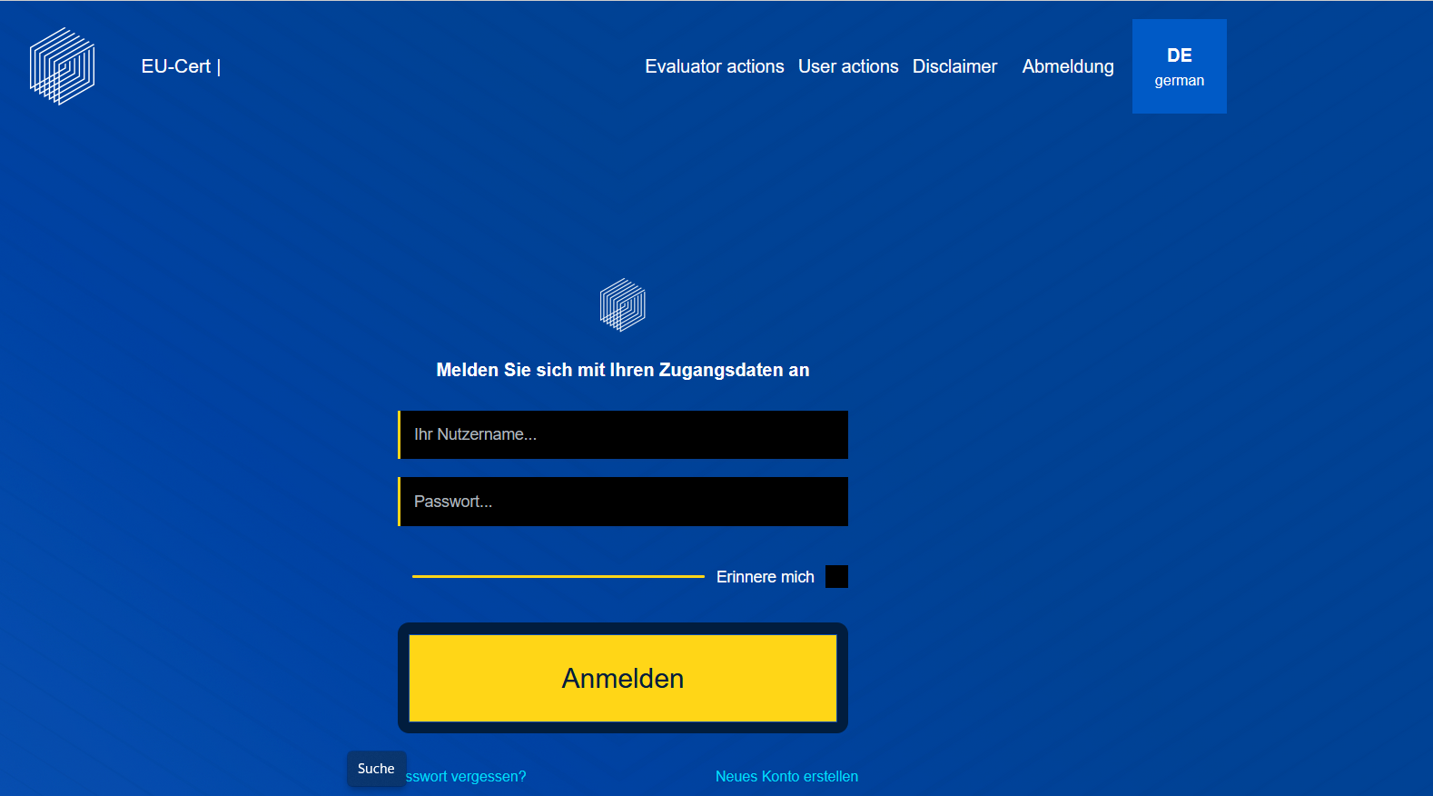
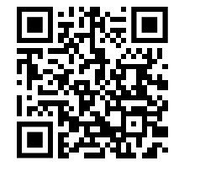
EU-CERT – Accreditation Website Tool
Scan for EU-CERT Accreditation Website Tool
Link to the Accreditation Website Tool: https://eucert-tool.eduproject.eu/auth/login

Slide 4
Universität Paderborn
Department Wirtschaftspädagogik Lehrstuhl Wirtschaftspädagogik II Warburger Str. 100
33098 Paderborn
http://www.upb.de/wipaed
Prof. Dr. Marc Beutner
Tel: +49 (0) 52 51 / 60 - 23 67
Fax: +49 (0) 52 51 / 60 - 35 63
E-Mail: marc.beutner@uni-paderborn.de

