Slide 1
EU-CERT: European Certificates and Accreditation for European Projects
EU-CERT Transnational partner meeting (TPM4) in Zagreb, Croatia
The EU-CERT – Accreditation and Documentation Conference!
5th - 7th of December 2023
Insights into PR2 and PR3 University of Paderborn
Reference Number: 2021-1-DE02-KA220-ADU-000033541
Duration:
01.02.2022 – 31.05.2024 (28 month)

Slide 2
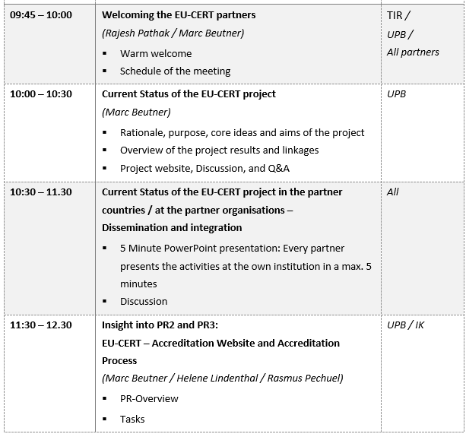
Meeting Agenda Wednesday, 6th of December

Slide 3
EU-CERT: Concept for an accreditation and certification system
PR2

Slide 4
The EU-CERT Accreditation - Process
Registration on WEAS
Webbased Electronic Application System
Selection of Accreditation Type
Answering questions related to Formal criteria
Answering questions related to Subject- / content-related criteria
Upload of material
Self- Assessment
Material Assessment
Expert analysis
Expert feedback
Expert assignment
Accreditation report
Accreditation decision
Quality seal of EU-CERT / Certificate
First automated Feedback
Possibility to eliminate weaknesses
VISIT EUCERT Accreditation website and
Purchase /download Accreditation materials / criteria information
Examine your institution or programme

Slide 5
The two basic concepts of EU-CERT accreditation
System / Institutional Accreditation
Product, Material, OER and Course Accreditation
In the case of a positive accreditation decision, the adult education provider bears the quality seal of EU-CERT.
In the case of a positive accreditation decision, a product, resources and teaching materials, OER or a course in the field of adult education bears the quality seal of EU-CERT.

Slide 6
System / Institutional Accreditation
evaluations of the educational offers and measures.
System / Institutional Accreditation
The object of System / Institutional Accreditation is the internal quality assurance system of an adult education provider.
The formal and subject- / content-related criteria must be systematically implemented or fulfilled. For this purpose, the quality management system of the adult education provider must provide regular evaluations of the educational offers and measures.

Slide 7
System / Institutional Accreditation
evaluations of the educational offers and measures.
Product, Material, OER and Course Accreditation
The object of Product, Material, OER and Course Accreditation
are specific resources for adult education.
Criteria must be systematically fulfilled by resources. For this purpose, the resources of a project, an adult education provider etc. must ensure the fulfillment of quality criteria.

Slide 8
Suggestions for criteria for the System / Institutional Accreditation
Formal criteria
Description of institution / adult education provider
Mission statement
Service Areas
Description of the quality management system
Staff Training & Qualifications
Stakeholder Communication

Slide 9
Suggestions for criteria for the System / Institutional Accreditation
Subject- / content-related criteria
Decision-making processes, competencies and responsibilities
Independence of the quality assessments
Resource allocation
Ensureance and continous development of functionality and effectiveness in relation to adult eduaction quality
Impact
Types of used documentation
Cooperations

Slide 10
Suggestions for criteria for the Product, Material, OER and Course Accreditation
Formal criteria
Institution
Type of Product, Material, OER and Course
Target group
Transparency
timeliness
Interdisciplinary learning opportunities
Openness
Aims and clarity of purpose
Usability
Cost
International/national/regional/local embedding
Learning outcomes
Gender equality
Staff Training & Qualifications
Stakeholder Communication

Slide 11
Suggestions for criteria for the Product, Material, OER and Course Accreditation
Subject- / content-related criteria
Living orientation
Action orientation
Promotion of a personal attitude
Promotion of networked thinking
Promotion of values
Quality assureance
Course: Curriculum, Aim, Target group, Profile/concept, Topic, Capacity, Frequency, Duration, Certification, Degree designation, Admission requirements and transitions between courses, Modularisation, Assessment, Didactic setting, Staff resources Addressed compectences/skills, Digital support
Product, Material, OER: Aim, Target group, Scope, Topic, Addressed compectences/skills, Didactic setting, Digital support

Slide 12
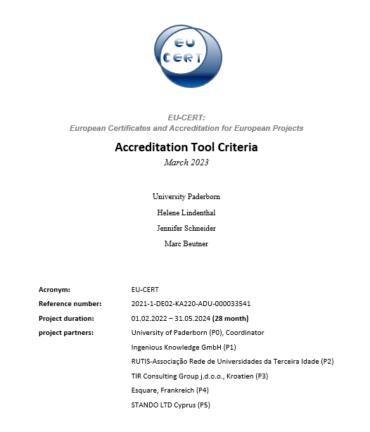
Quality Criteria
Have a look at the file on Google Drive

Slide 13
EU-CERT - Accreditation Website and Data-base Design and Programming
PR3

Slide 14
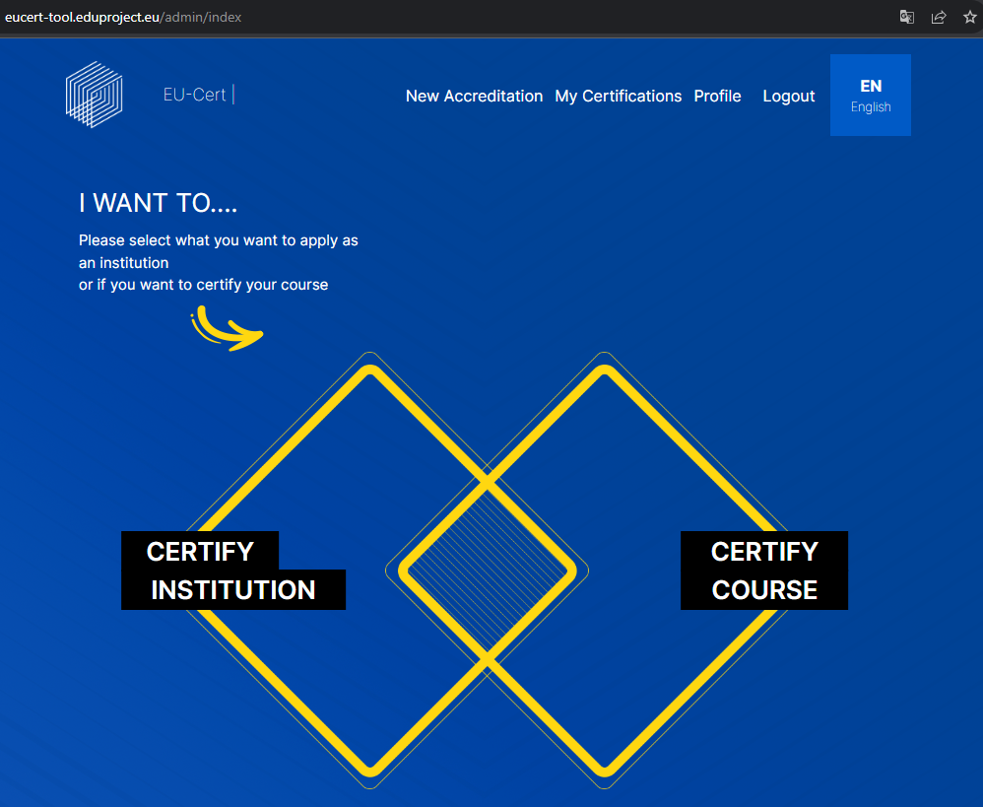
Insight into the Accreditation Tool Website

Slide 17
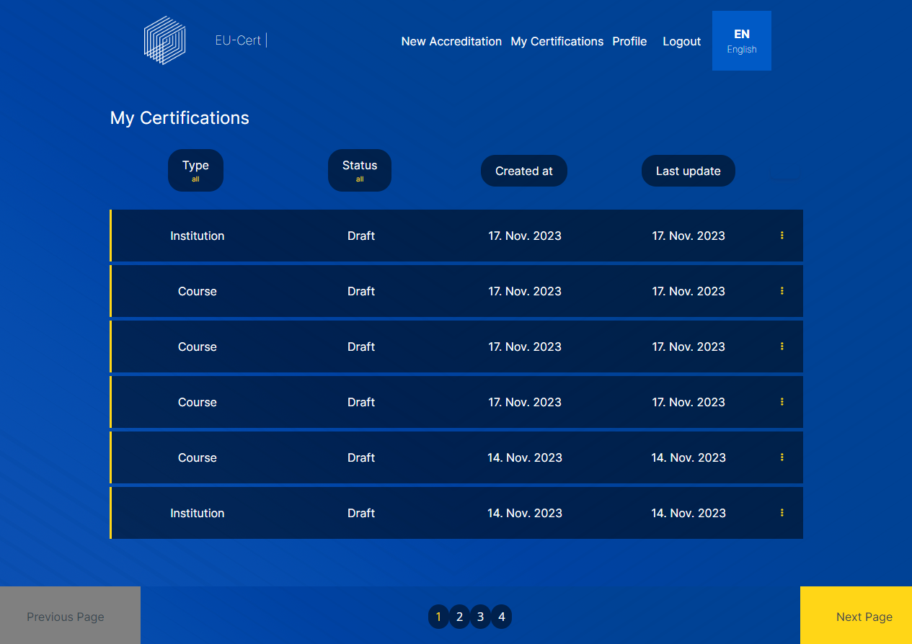
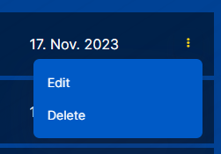
My Certifications

Slide 19
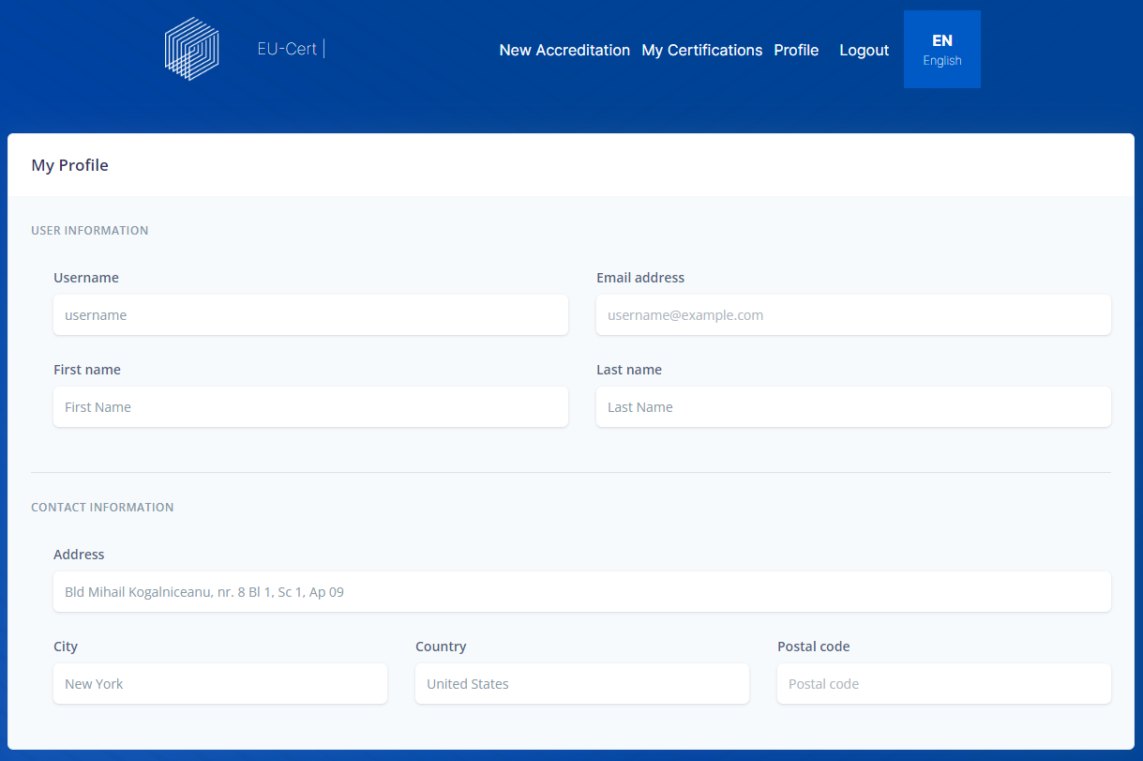
Profile

Slide 20
Logout

Slide 21
Languages

Slide 22
The EU-CERT Accreditation - Process
Registration on WEAS
Webbased Electronic Application System
Selection of Accreditation Type
Answering questions related to Formal criteria
Answering questions related to Subject- / content-related criteria
Upload of material
Self- Assessment
Material Assessment
Expert analysis
Expert feedback
Expert assignment
Accreditation report
Accreditation decision
Quality seal of EU-CERT / Certificate
First automated Feedback
Possibility to eliminate weaknesses
VISIT EUCERT Accreditation website and
Purchase /download Accreditation materials / criteria information
Examine your institution or programme

Slide 23
The EU-CERT Accreditation - Process
Registration on WEAS
Webbased Electronic Application System
Selection of Accreditation Type
Answering questions related to Formal criteria
Answering questions related to Subject- / content-related criteria
Upload of material
Self- Assessment
Material Assessment
Expert analysis
Expert feedback
Expert assignment
Accreditation report
Accreditation decision
Quality seal of EU-CERT / Certificate
First automated Feedback
Possibility to eliminate weaknesses
VISIT EUCERT Accreditation website and
Purchase /download Accreditation materials / criteria information
Examine your institution or programme

Slide 25
The EU-CERT Accreditation - Process
Registration on WEAS
Webbased Electronic Application System
Selection of Accreditation Type
Answering questions related to Formal criteria
Answering questions related to Subject- / content-related criteria
Upload of material
Self- Assessment
Material Assessment
Expert analysis
Expert feedback
Expert assignment
Accreditation report
Accreditation decision
Quality seal of EU-CERT / Certificate
First automated Feedback
Possibility to eliminate weaknesses
VISIT EUCERT Accreditation website and
Purchase /download Accreditation materials / criteria information
Examine your institution or programme

Slide 26
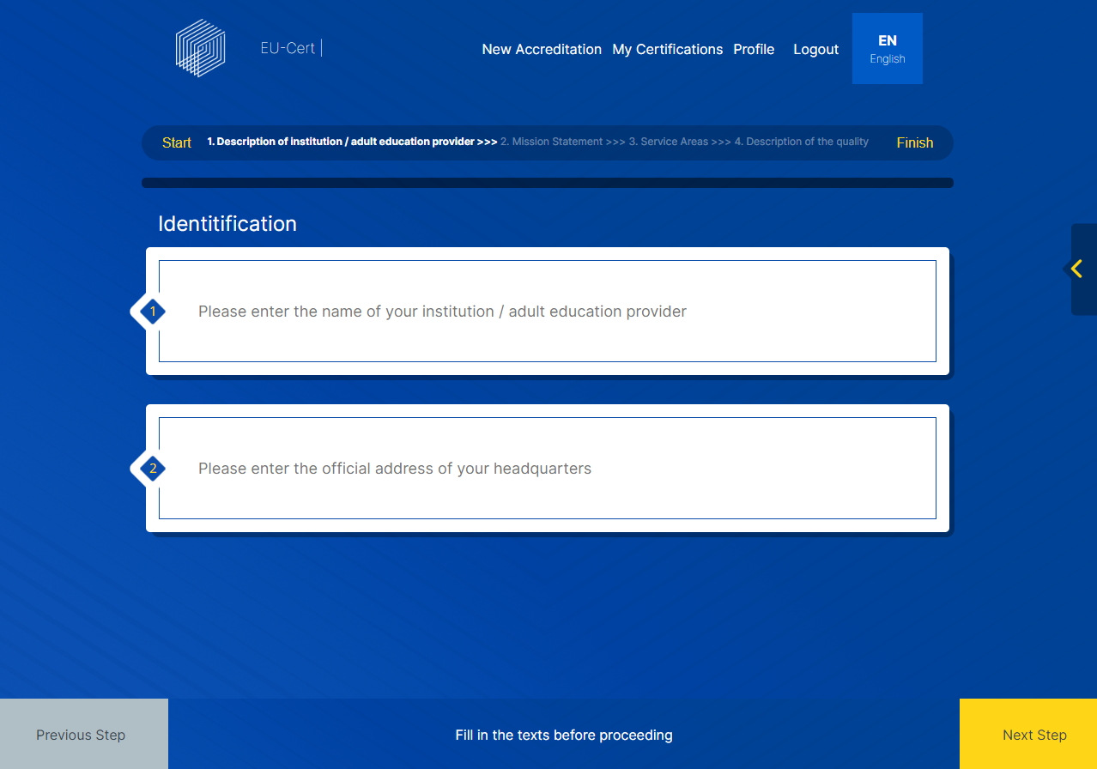
Certify Institution

Slide 27
The EU-CERT Accreditation - Process
Registration on WEAS
Webbased Electronic Application System
Selection of Accreditation Type
Answering questions related to Formal criteria
Answering questions related to Subject- / content-related criteria
Upload of material
Self- Assessment
Material Assessment
Expert analysis
Expert feedback
Expert assignment
Accreditation report
Accreditation decision
Quality seal of EU-CERT / Certificate
First automated Feedback
Possibility to eliminate weaknesses
VISIT EUCERT Accreditation website and
Purchase /download Accreditation materials / criteria information
Examine your institution or programme

Slide 29
The EU-CERT Accreditation - Process
Registration on WEAS
Webbased Electronic Application System
Selection of Accreditation Type
Answering questions related to Formal criteria
Answering questions related to Subject- / content-related criteria
Upload of material
Self- Assessment
Material Assessment
Expert analysis
Expert feedback
Expert assignment
Accreditation report
Accreditation decision
Quality seal of EU-CERT / Certificate
First automated Feedback
Possibility to eliminate weaknesses
VISIT EUCERT Accreditation website and
Purchase /download Accreditation materials / criteria information
Examine your institution or programme

Slide 30
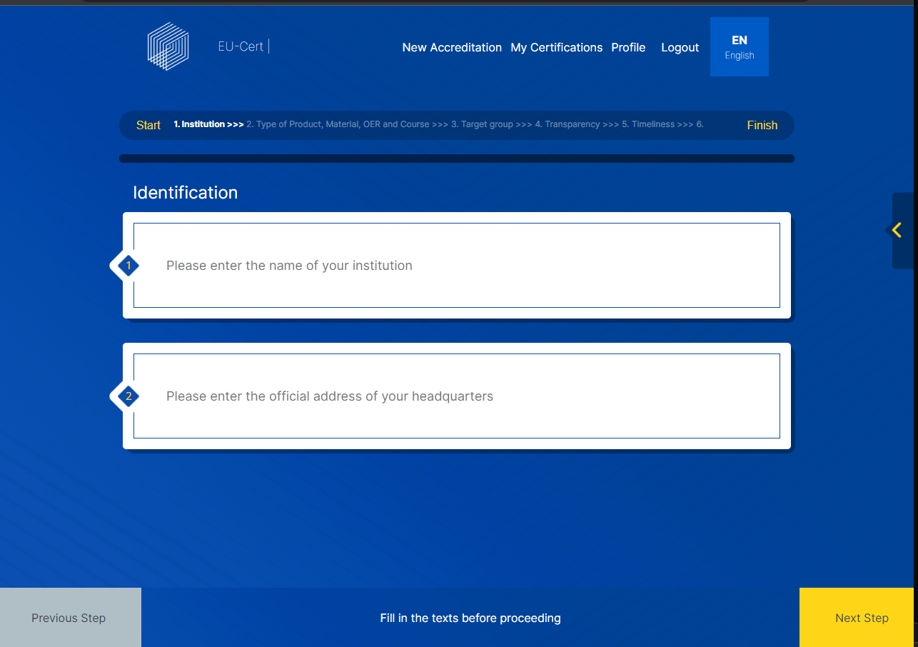
Certify Course

Slide 31
The EU-CERT Accreditation - Process
Registration on WEAS
Webbased Electronic Application System
Selection of Accreditation Type
Answering questions related to Formal criteria
Answering questions related to Subject- / content-related criteria
Upload of material
Self- Assessment
Material Assessment
Expert analysis
Expert feedback
Expert assignment
Accreditation report
Accreditation decision
Quality seal of EU-CERT / Certificate
First automated Feedback
Possibility to eliminate weaknesses
VISIT EUCERT Accreditation website and
Purchase /download Accreditation materials / criteria information
Examine your institution or programme

Slide 32
System/Institutional Accreditation

Slide 33
System/Institutional Accreditation
Formal Criteria
Description of institution/adult education provider
Mission Statement
Service Areas
Description of the quality management system
Staff Training & Qualifications
Stakeholder Communication

Slide 34
System/Institutional Accreditation
Subject-/content-related Criteria
Decision-making processes, competencies and responsibilities
Independence of the quality assessments
Resource allocation
Assurance and continuous development of functionality and effectiveness in relation to adult education quality
Impact
Types of used documentation
Cooperation
Resources and facilities

Slide 35
System/Institutional Accreditation Page 1
Answers of:
Question 1: Please enter the name of your institution/adult education provider.
Question 3: Type of institution: What type of institution does your institution/adult education provider belong to? What is the primary focus?
Question 5: In which country are you headquartered?
Answer of Question 1: Name
Answer of Question 3: Type
Answer of Question 5: Headquarter

Slide 36
System/Institutional Accreditation Page 2: Formal Criteria
Formal Criteria
Description of institution/adult education provider
Mission Statement
Service Areas
Description of the quality management system
Staff Training & Qualifications
Stakeholder Communication
Score of 1.
Score of 2.
Score of 3.
Score of 4.
Score of 5.
Score of 6.
Total Score
Formal Criteria Total Score of max. 100

Slide 37
System/Institutional Accreditation Page 3: Subject-related Criteria
Score of 1.
Subject-related Criteria
Decision-making processes, competencies and responsibilities
Independence of the quality assessments
Resource allocation
Assurance and continuous development of functionality and effectiveness in relation to adult education quality
Impact
Types of used documentation
Cooperation
Resources and facilities
Score of 2.
Score of 3.
Score of 4.
Score of 5.
Score of 6.
Score of 7.
Score of 8.
Total Score
Formal Criteria Total Score of max. 225

Slide 38
System/Institutional Accreditation Page 4: Feedback: Total Score
Formal Criteria
Subject-related Criteria
of max. 100
Total Score Formal Criteria
Total Score Subject-related Criteria
of max. 232
Total Score
Total Score of max. 332
X
%
PDF
End

Slide 39
Product, Material, OER, and Course Accreditation

Slide 40
Product, Material, OER, and Course Accreditation
Formal Criteria
Institution/Type of Product, Material, OER, and Course
Target group/Transparency
Interdisciplinary learning opportunities/Openness/Aims and clarity of purpose
Usability
Cost
International/national/regional/local embedding
Learning Outcomes/Gender equality
Staff Training & Qualifications
Stakeholder Communication

Slide 41
Product, Material, OER, and Course Accreditation
Subject-/content-related Criteria
Living orientation
Action orientation
Promotion of a personal attitude
Promotion of networked thinking
Promotion of values
Quality assurance
Course: Curriculum, Aim, Target group, Profile/Concept, Topic, Capacity, Frequency, Duration, Certification, Degree designation, Admission requirements and transitions between courses, Assessment, Didactic setting, Staff resources, Addressed competencies/skills, Digital support
Product, Material, OER: Aim, Target group, Scope, Topic, Addressed competencies/skills, Didactic setting, Digital support

Slide 42
Product, Material, OER, and Course Accreditation Page 1
Answers of:
Question 1: Please enter the name of your institution/adult education provider.
Question 3: Type of institution: What type of institution does your institution/adult education provider belong to? What is the primary focus?
Question 5: In which country are you headquartered?
Answer of Question 1: Name
Answer of Question 3: Type
Answer of Question 5: Headquarter

Slide 43
Product, Material, OER, and Course Accreditation Page 2: Formal Criteria
Formal Criteria
Institution/Type of Product, Material, OER, and Course
Target group/Transparency
Interdisciplinary learning opportunities/Openness/Aims and clarity of purpose
Usability
Cost
International/national/regional/local embedding
Learning Outcomes/Gender equality
Staff Training & Qualifications
Stakeholder Communication
Score of 1.
Score of 2.
Score of 3.
Score of 4.
Score of 5.
Score of 6.
Score of 7.
Score of 8.
Score of 9.
Total Score
Formal Criteria Total Score of max. 100

Slide 44
Product, Material, OER, and Course Accreditation Page 3: Subject-related Criteria
Subject-related Criteria
Living orientation
Action orientation
Promotion of a personal attitude
Promotion of networked thinking
Promotion of values
Quality assurance
Course: Curriculum, Aim, Target group, Profile/Concept, Topic, Capacity, Frequency, Duration, Certification, Degree designation, Admission requirements and transitions between courses, Assessment, Didactic setting, Staff resources, Addressed competencies/skills, Digital support
Product, Material, OER: Aim, Target group, Scope, Topic, Addressed competencies/skills, Didactic setting, Digital support
Score of 1.
Score of 2.
Score of 3.
Score of 4.
Score of 5.
Score of 6.
Score of 7.
Score of 8.
Total Score
Subject-related Criteria Total Score of max. 70

Slide 45
Product, Material, OER, and Course Accreditation Page 4: Feedback: Total Score
Formal Criteria
Subject-related Criteria
of max. 100
Total Score Formal Criteria
Total Score Subject-related Criteria
of max. 70
Total Score
Total Score of max. 170
X
%
PDF
End

Slide 46
The website is still under construction…

Slide 47
Discussion and Q&A

Slide 48
Universität Paderborn
Department Wirtschaftspädagogik Lehrstuhl Wirtschaftspädagogik II Warburger Str. 100
33098 Paderborn
http://www.upb.de/wipaed
Prof. Dr. Marc Beutner
Tel: +49 (0) 52 51 / 60 - 23 67
Fax: +49 (0) 52 51 / 60 - 35 63
E-Mail: marc.beutner@uni-paderborn.de

