Slide 1
EU-CERT: European Certificates and Accreditation for European Projects
EU-CERT Transnational partner meeting (TPM5) in Paderborn, Germany
The EU-CERT – Final Policy Recommendation Conference!
5th - 7th of March 2024
Tool University of Paderborn
Reference Number: 2021-1-DE02-KA220-ADU-000033541
Duration:
01.02.2022 – 31.05.2024 (28 month)

Slide 2
Insight into PR3: EU-CERT Accreditation Tool Simulation
REAL CASES
User perspective
Evaluator perspective

Slide 3
User Perspective

Slide 4
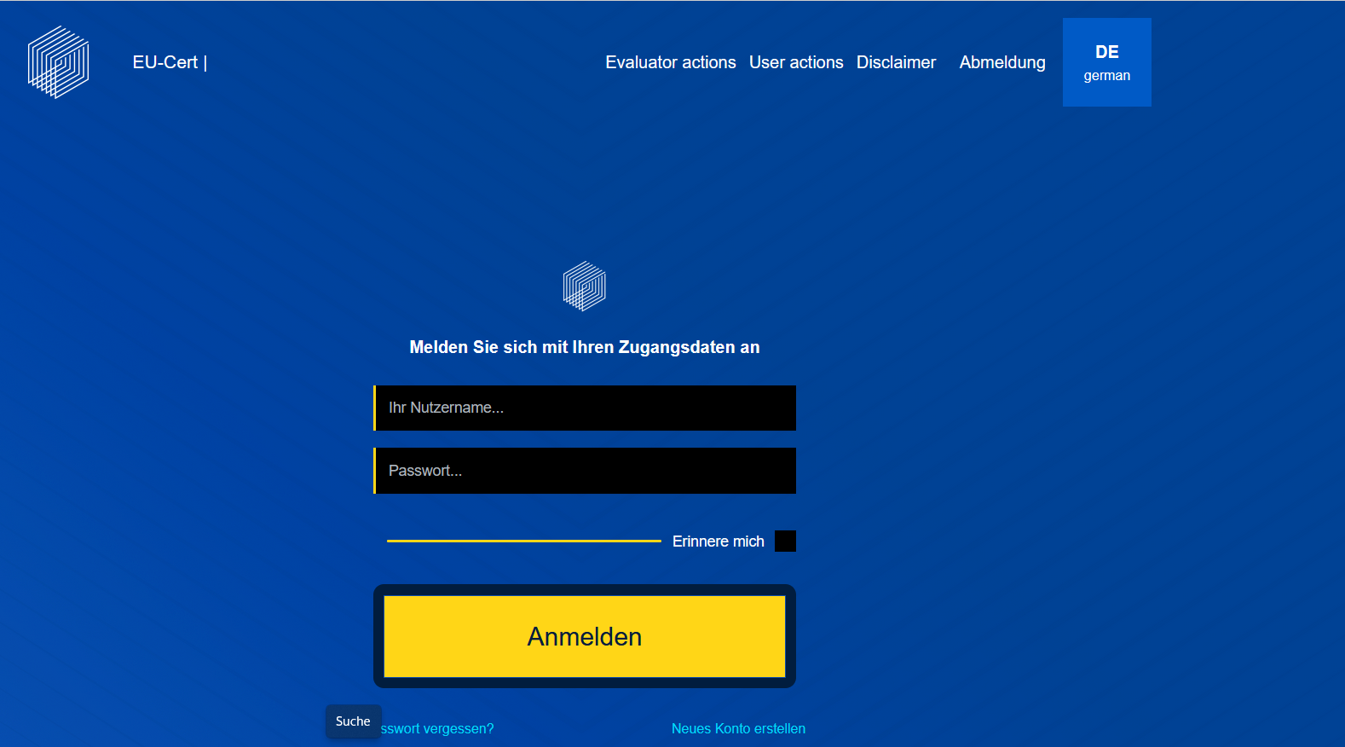
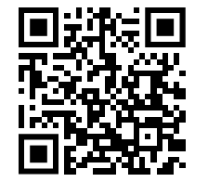
EU-CERT – Accreditation Website Tool
Scan for EU-CERT Accreditation Website Tool
Link to the Accreditation Website Tool: https://eucert-tool.eduproject.eu/auth/login

Slide 5
Testing phase - user perspective
Step 1: Create a user account.
Step 2: Once you have received your access, enter the courses, documents, or other materials you have brought into the accreditation tool.
Step 3: Once you have completed entering the documents, you can finalize the process.
Scan for EU-CERT Accreditation Website Tool

Slide 6
(2) Evaluator Perspective

Slide 7
EU-CERT – Accreditation Website Tool
Scan for EU-CERT Accreditation Website Tool
Link to the Accreditation Website Tool: https://eucert-tool.eduproject.eu/auth/login

Slide 8
Testing phase - evaluator perspective
Step 1: Create an evaluator account.
Step 2: Once you have received your access, go ahead with the evaluation process.
Have a look at the authorized feedback of the tool.
Create comments for the user, so they can improve their work.
Step 3: Once you have completed entering the tool, you can finalize the process.
Scan for EU-CERT Accreditation Website Tool

Slide 9
Universität Paderborn
Department Wirtschaftspädagogik Lehrstuhl Wirtschaftspädagogik II Warburger Str. 100
33098 Paderborn
http://www.upb.de/wipaed
Prof. Dr. Marc Beutner
Tel: +49 (0) 52 51 / 60 - 23 67
Fax: +49 (0) 52 51 / 60 - 35 63
E-Mail: marc.beutner@uni-paderborn.de

