Slide 1
EU-CERT: European Certificates and Accreditation for European Projects
EU-CERT Transnational partner meeting (TPM4) in Zagreb, Croatia
The EU-CERT – Accreditation and Documentation Conference!
5th - 7th of December 2023
Insights into PR5 University of Paderborn
Reference Number: 2021-1-DE02-KA220-ADU-000033541
Duration:
01.02.2022 – 31.05.2024 (28 month)

Slide 2
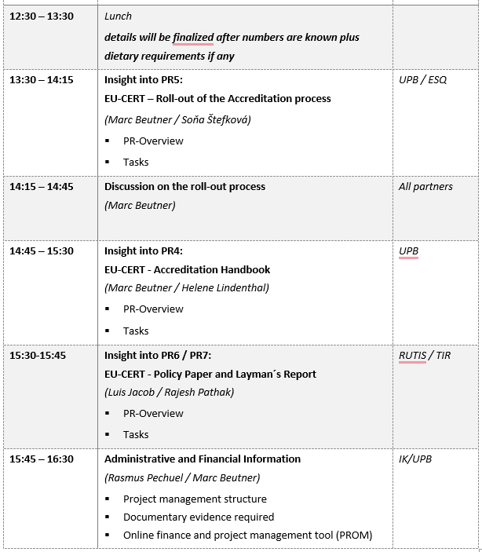
Meeting Agenda Wednesday, 6th of December

Slide 3
Project Result 5
EU-CERT – ROLL-OUT OF THE ACCREDITATION PROCESS TO ADULT EDUCATION PROVIDERS
(LEADING ORGA: ESQUARE)

Slide 4
Project Results
Project Result 5 | 2022-03 | 2023-11 | EU-CERT - Accreditation and Certification - Roll-out to adult education providers | Esquare - France
15 adult education providers all over Europe within the testing phase Ensure transferability testing if the certification and accreditation process brings the innovation of the certification into action Test the impact and to address chances and problems target group: are the adult educators and ERSAMUS+ projects who will take part in the testing gather real-life experiences with the certificates as well as with the accreditation process testing will be a basis for adjustments and lead to a final version of the EU-CERT Accreditation process and the online tool for it 20 ERASMUS+ projects or adult education measures (at least 120 accredited organisations until the end of the project) only 2 institutional, rest material statements about the accreditation which will be used as testimonials on the EU-CERT website documented by a qualitative evaluation and a quantitative questionnaire at least 5 videos to document the process and to disseminate the process information as well as experiences and impressions of users and evaluators

Slide 5
Discussion and Q&A

Slide 6
Universität Paderborn
Department Wirtschaftspädagogik Lehrstuhl Wirtschaftspädagogik II Warburger Str. 100
33098 Paderborn
http://www.upb.de/wipaed
Prof. Dr. Marc Beutner
Tel: +49 (0) 52 51 / 60 - 23 67
Fax: +49 (0) 52 51 / 60 - 35 63
E-Mail: marc.beutner@uni-paderborn.de

