Slide 1
EU-CERT: European Certificates and Accreditation for European Projects
EU-CERT Transnational partner meeting (TPM5) in Paderborn, Germany
The EU-CERT – Final Policy Recommendation Conference!
5th - 7th of March 2024
Financial Administration University of Paderborn
Reference Number: 2021-1-DE02-KA220-ADU-000033541
Duration:
01.02.2022 – 31.05.2024 (28 month)

Slide 2
Agenda
Part I – General information
Part II – Financial reporting
Part III – The Project Management Tool - PROM

Slide 3
Part I – General information

Slide 4
Responsibilities of the beneficiaries
„All beneficiaries
are jointly and severally responsible for proper implementation of the project and for complying with any legal obligation each beneficiary
informs the coordinator of any change with effects on the project
submits to the coordinator:
- data needed for reports and financial statements
- documents needed for audits, checks, evaluation
- any other information to be provided to the NA“
(Presentation Strategische Partnerschaften Administrative und finanzielle Projektbegleitung Jürgen van Capelle / Katarzyna Sena)

Slide 5
Responsibilites of the coordinator
„The coordinators*
monitor the implementation
intermediate the communications between beneficiaries and NA
provide NA with information related to substantial changes in the project
establish requests for payment / ensures payments to the other beneficiaries
provides necessary documents for checks, audits, evaluations. * Grant agreement, II,1.3“
(Presentation Strategische Partnerschaften Administrative und finanzielle Projektbegleitung Jürgen van Capelle / Katarzyna Sena)

Slide 6
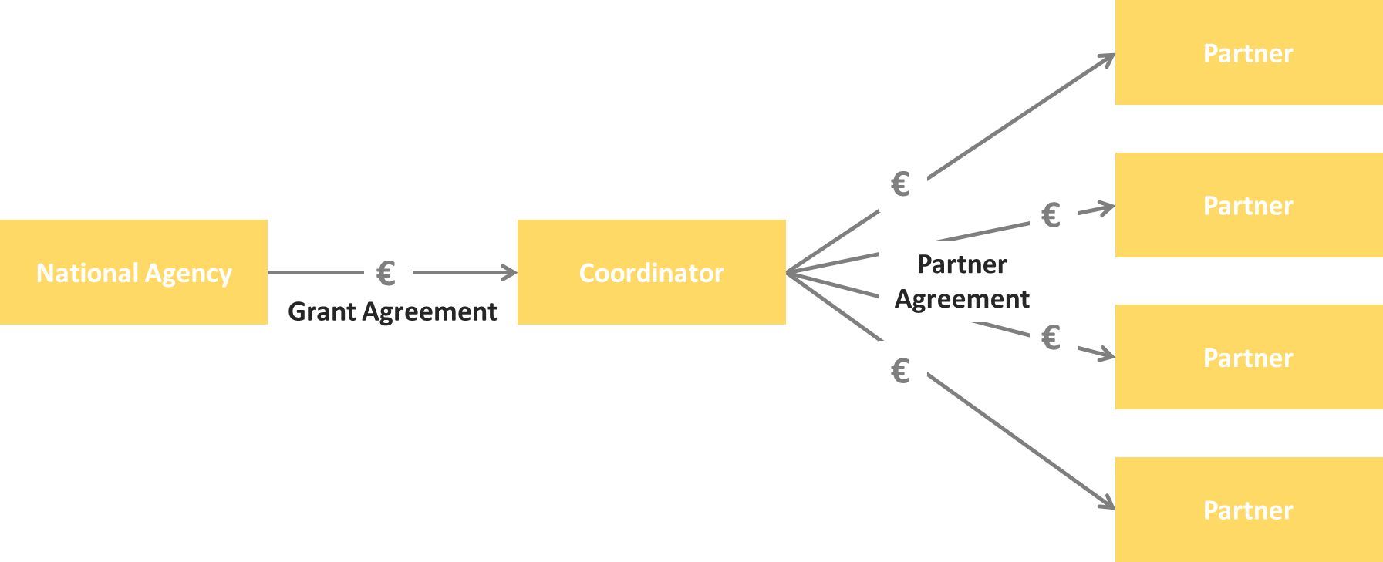
Scheme of the money-transfer

Slide 7
Eligible costs
“Eligible Costs (1) (PG, p. 200)
Incurred during the lifetime of the project
Indicated in the estimated overall budget of the project
Necessary for the implementation of the project
Identifiable and verifiable (recorded in the accounting records with regular cost accounting practices)
Compliant with the requirements of applicable tax and social legislation
Reasonable, justified, and comply with sound financial management (regarding economy and efficiency)
Always beware: VAT”
(Presentation Strategische Partnerschaften Administrative und finanzielle Projektbegleitung Jürgen van Capelle / Katarzyna Sena)

Slide 8
Cost types
Unit costs
Project Results
Project Management and Implementation
Transnational Project Meetings
Multiplier Events
Learning, Teaching and Training Activities
Actual Costs
Exceptional Costs
Relevant in INTERFACE
for all partners
Not in the INTERFACE project

Slide 9
Unit costs
What are unit costs?
Unit costs...
occur within the period of eligibility
are necessary to realise and implement the project
have to be reported 🡪 Financial documentation
Could be identified and verified by financial documentation
Project Management and Implementation
Coordinator 🡪 €500 per month
Partners 🡪 €250 per month

Slide 10
Annex II of the GA - Budget of the INTERFACE project

Slide 11
Project Management and Implementation
Could be used for...
general project management tasks / coordination
communication / planning / calculation purposes
project and Intellectual Output implementation purposes
dissemination and evaluation
Could be identified and verified through...
produced dissemination material / products
explanation and description in the progress and the final report
Development of a dissemination list

Slide 12
Project Results (1)
Project Results...
will be developed by staff members in specific staff categories
produces staff costs that could be characterised by 4 different staff categories:
Manager
Teacher/Trainer/Researcher
Technician
Administrative staff
are calculated on unit costs per day

Slide 13
Project Results (2)
You provide evidence about the working days with your time sheets! –
Use the PROM TOOL!
Please make sure that you do not claim more or less days than granted!
http://prom.eduproject.eu/

Slide 14
Project Results (3)
Documentation of staff costs
Timesheets
Payslips
Staff employment contracts
Additional documentation (in your own project folder)
Invoices (for example: boarding passes, accommodation invoice etc.)
Proof of payment
Receipts for costs incurred (for example: printing costs for dissemination material, hosting partner meeting etc.)

Slide 15
Travel Costs (1)
Transnational Project Meetings costs…
are calculated on a unit cost basis according to the distance of travel per meeting
Online distance calculator:
http://ec.europa.eu/programmes/erasmus-plus/resources_en#tab-1-4
are based on the place of origin and the place of the meeting venue
needs to have a direct link to project meetings

Slide 16
Travel Costs (2)
Transnational Project Meetings costs…
575,00 € per person distance 100-1999km
760,00 € per person distance >= 2000km
Make sure that you have the correct number of participants.

Slide 17
Travel costs (3)
Documentation
Certificate/declaration of attendance
The hosting institution has to provide the participants with a certificate/declaration of attendance signed by the hosting organisation
🡪 Template will be available on the project website
🡪 Please provide us with a scanned version
Travel cost invoices (in your own folder)
Flight invoices, boarding passes
accommodation invoices
Taxi, train, car hire and/or bus receipts
Mileage costs at a maximum rate of 0.22 cent per km

Slide 18
Part II – Financial Reporting

Slide 19
Financial Reporting
Please…
provide all financial and supporting documents every 4 months (first year) and every 3 months (second year).
use the PROM Tool to create your financial documentation.
stick on the working days per Intellectual Output and staff category.
create one timesheet per month.
ensure that you only report one staff category per month.
don`t report Saturdays, Sundays, holidays and sick days.
sign timesheets for every month.
send all documents of a reporting period in one package via e-mail and the originals via post.

Slide 20
Part III – The Project Management Tool - PROM

Slide 21
PROM – Project Management Tool
The Login Area - http://eduproject.eu/prom/login.php

Slide 22
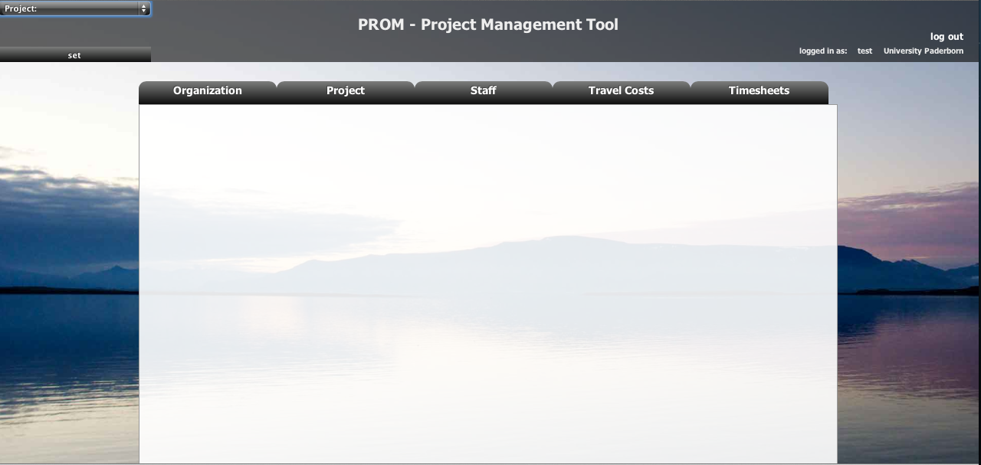
PROM – Project Management Tool
The PROM Start Page (1)

Slide 23
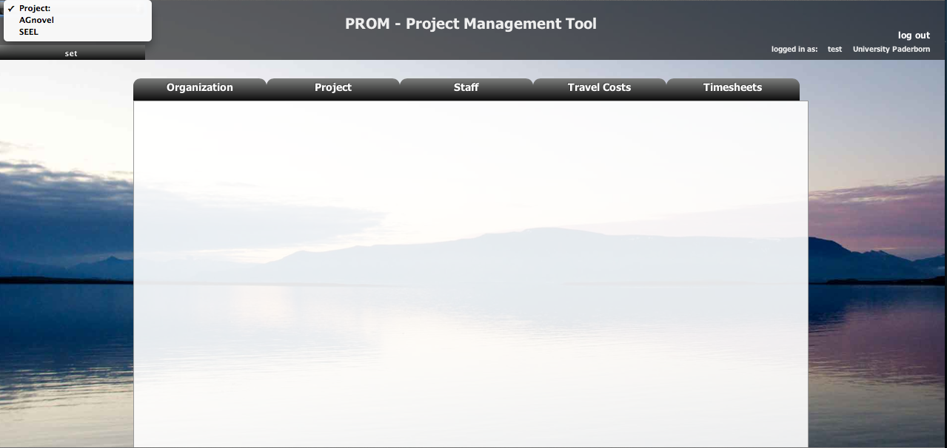
PROM – Project Management Tool
The PROM Start Page (2) – Set the project

Slide 24
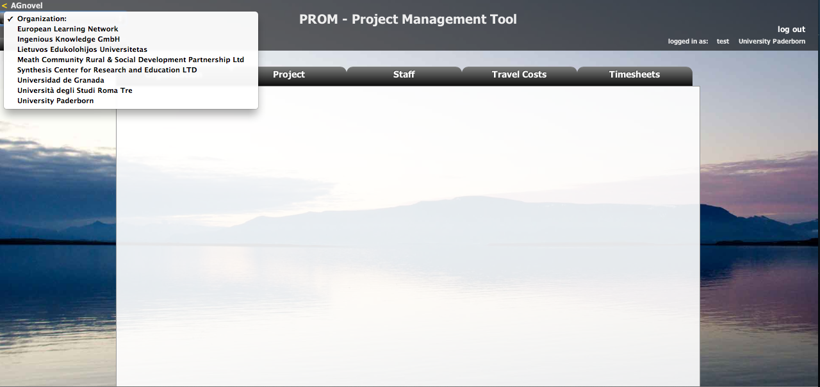
PROM – Project Management Tool
The PROM Start Page (3) – Set the organization

Slide 25
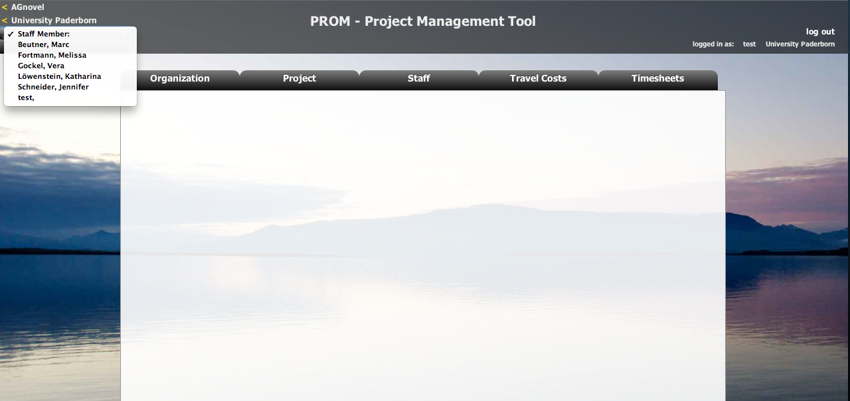
PROM – Project Management Tool
The PROM Start Page (4) – Set the staff member

Slide 26
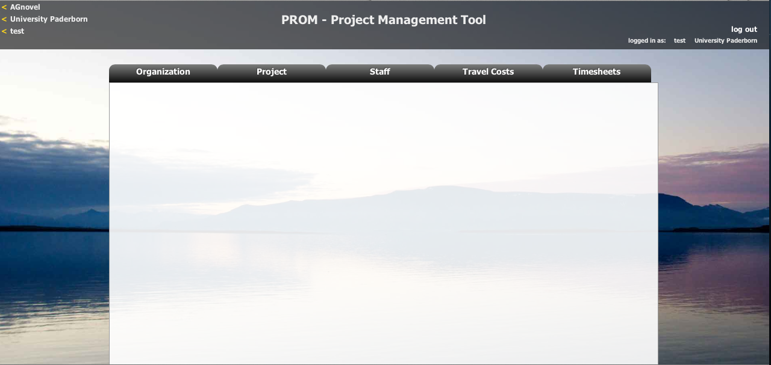
PROM – Project Management Tool
The PROM Start Page (5) – Start

Slide 27
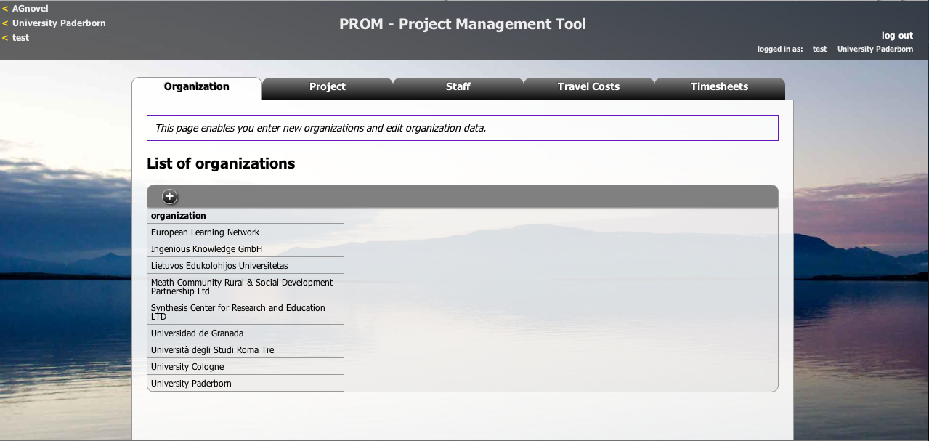
PROM – Project Management Tool
The PROM Tool – List of organizations

Slide 28
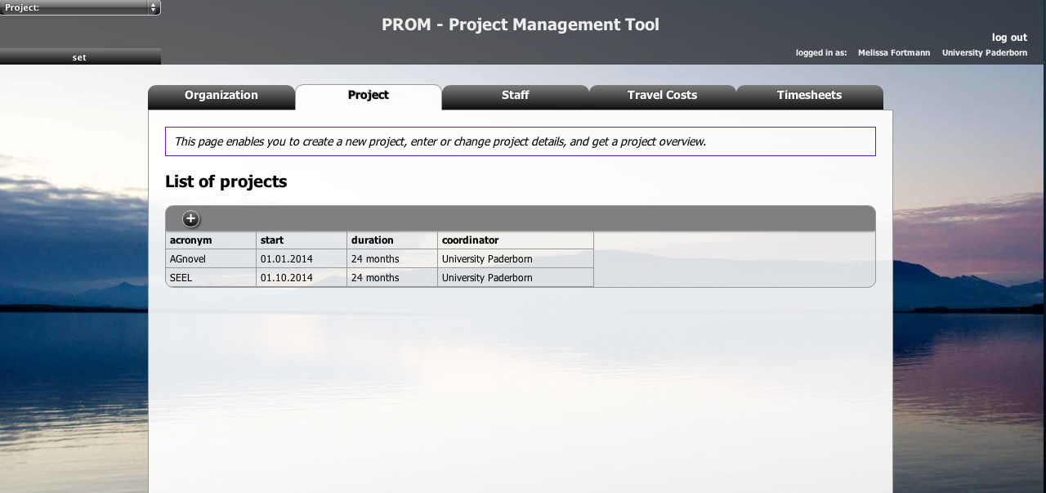
PROM – Project Management Tool
The PROM Tool – List of projects

Slide 29
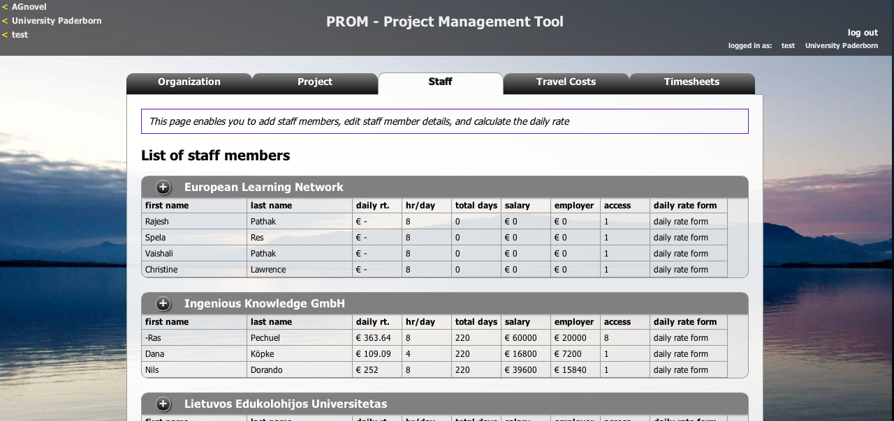
PROM – Project Management Tool
The PROM Tool – List of staff members

Slide 30
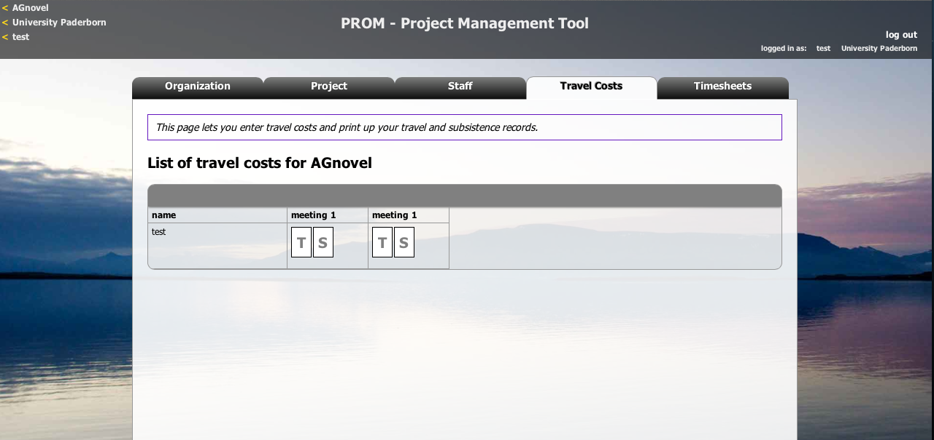
PROM – Project Management Tool
The PROM Tool – Travel costs (1)

Slide 31
PROM – Project Management Tool
The PROM Tool – Travel costs (2) – Travel record I

Slide 32
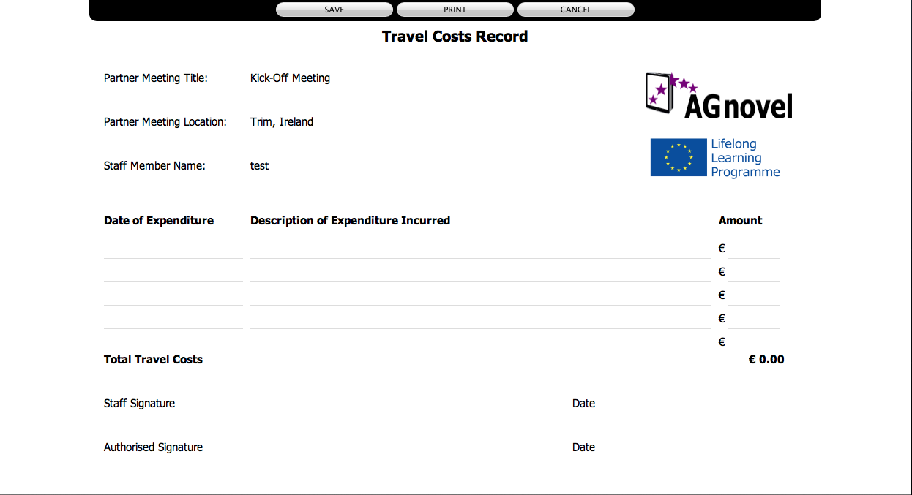
PROM – Project Management Tool
The PROM Tool – Travel costs (3) – Travel record II

Slide 33
PROM – Project Management Tool
The PROM Tool – Travel costs (4) – Subsistence costs I

Slide 34
PROM – Project Management Tool
The PROM Tool – Travel costs (5) – Subsistence costs II

Slide 35
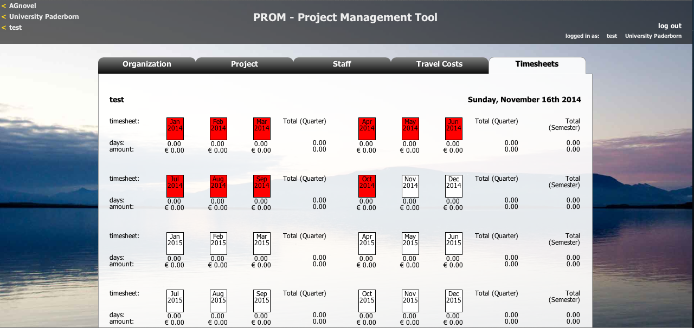
PROM – Project Management Tool
The PROM Tool – Timesheets (1) – Select the month

Slide 36
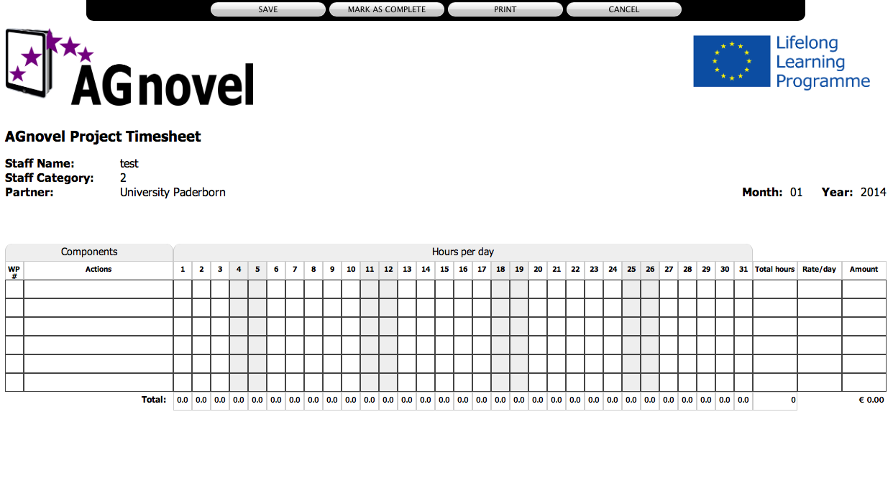
PROM – Project Management Tool
The PROM Tool – Timesheets (2) – Fill in the form I

Slide 37
PROM – Project Management Tool
The PROM Tool – Timesheets (3) – Fill in the form II

Slide 38
PROM – Project Management Tool
The PROM Tool – Timesheets (4) - Overview

Slide 39
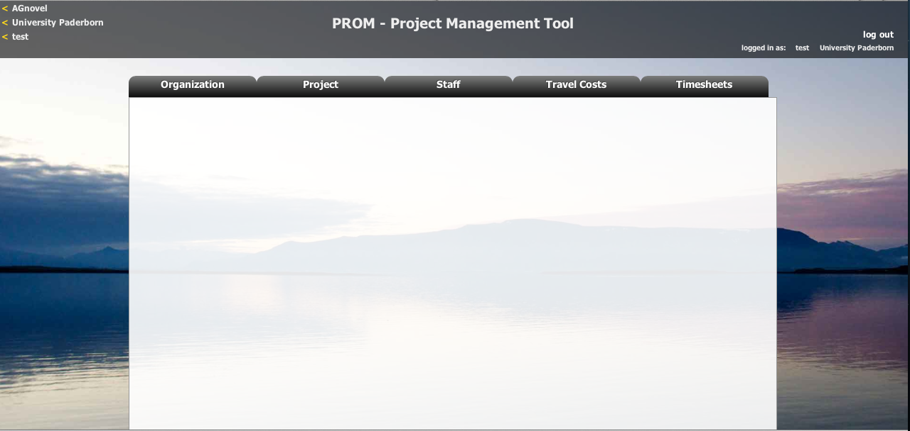
PROM – Project Management Tool
The PROM Tool – Log out

Slide 40
Thank you very much for
your attention!

Slide 41
Universität Paderborn
Department Wirtschaftspädagogik Lehrstuhl Wirtschaftspädagogik II Warburger Str. 100
33098 Paderborn
http://www.upb.de/wipaed
Prof. Dr. Marc Beutner
Tel: +49 (0) 52 51 / 60 - 23 67
Fax: +49 (0) 52 51 / 60 - 35 63
E-Mail: marc.beutner@uni-paderborn.de

