Slide 1
EU-CERT: European Certificates and Accreditation for European Projects
EU-CERT Transnational partner meeting (TPM4) in Zagreb, Croatia
The EU-CERT – Accreditation and Documentation Conference!
5th - 7th of December 2023
Insights into PR4 University of Paderborn
Reference Number: 2021-1-DE02-KA220-ADU-000033541
Duration:
01.02.2022 – 31.05.2024 (28 month)

Slide 2
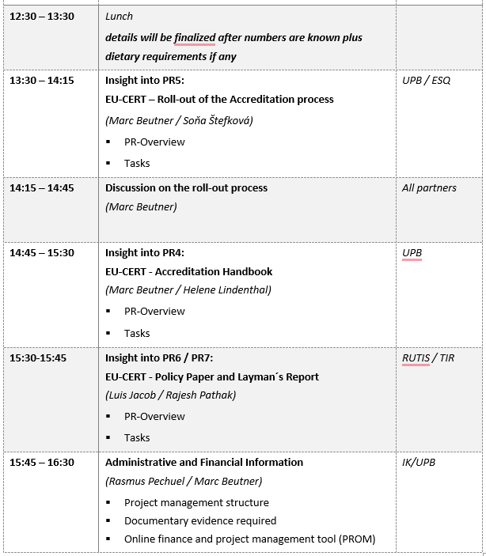
Meeting Agenda Wednesday, 6th of December

Slide 3
Project Result 4
EU-CERT - Accreditation Handbook
(Leading orga: University of Paderborn)

Slide 4
Project Results
Project Result 4 | 2022-07 | 2023-07 | EU-CERT - Accreditation Handbook | University of Paderborn - Germany
Accreditation Handbook explanation of the processes and the criteria within a detailed handbook which provided a compilation of all information needed a book which will be accessible in a printed and an online version accreditation handbook provides general information on accreditation for adult education and the accreditation and certification processes within EU-CERT addresses the quality criteria and explains them and their use Guideline A, which steers the user through the accreditation process and the website Guideline B, which provides provides help and hints for the accreditation/evaluators complete book version which addresses the following aspects: (a) General introduction into accreditation, certification and certificates (b) The need for accreditation, certification and certificates in adult education (c) EU-CERT - Overview of the project, its aims and objectives (d) The Accreditation and Certification processes of EU-CERT (e) The quality criteria of EU-CERT (f) User guidelines through the accreditation process and the website (g) Accreditators/evaluator guideline (h) Results of the EU-CERT Research on Accreditation and Certification in EUROPEAN adult education EU-CERT Accreditation Handbook in progress, waiting for the website to be finalized

Slide 5
Accreditation Handbook
The accreditation handbook will be a best practice guidelines/ report offers in a book format
To get in touch with the EU-CERT accreditation and certification system it is helpful to get an explanation of the processes and the criteria within a detailed handbook which provided a compilation of all information needed.
This offers more transparency to the target groups of the users of result in adult education but also to the target groups of coordinators of adult education project who want to get their project results accredited.
The impact of such a handbook is directly at all users. They get accustomed to the processes and can transfer these experiences also to future use of certificates.

Slide 6
Accreditation Handbook
The book will be assessable in a printed and an online version.
The accreditation handbook provides generell information on acccreditation for adult education and the accreditation and certification processes within EU-CERT:
addresses the quality criteria and
explains them and
their use.

Slide 7
Handbook core information
The handbook provides a rough overview on the project.
The handbook comes basic information on accreditation and certification processes.
The handbook helps to understand the accreditation criteria
The handbook offers a step-by-step approach how to handle two accreditation types
The translation in the partner languages will be done with DEEPL and after that checked by the partners.
System / Institutional Accreditation
Product, Material, OER and Course Accreditation

Slide 8
Accreditation Handbook
The handbook will be assessable in a:
short version - Guideline A: which steers the user through the accreditation process and the website, etc.

Slide 9
Accreditation Handbook
The handbook will be assessable in a
Detailed version- Guideline B: which provides the provides help and hints for the accreditations/evaluators.
It will be also assessable in a complete book version which addresses the following aspects:
General introduction into accreditation, certification and certificates
The need for accreditation, certification and certificates in adult education
EU-CERT - Overview on the project, its aims and objectives
The Accreditation and Certification processes of EU-CERT
The quality criteria of EU-CERT
User guideline through the accreditation process and the website
Accreditators/evaluator guideline
Results of the EU-CERT Research on Accreditation and Certification in EUROPEAN adult education

Slide 10
Accreditation Handbook
Further information regarding the
accredition handbook coming soon…
when the programming is done.

Slide 11
Discussion and Q&A

Slide 12
Universität Paderborn
Department Wirtschaftspädagogik Lehrstuhl Wirtschaftspädagogik II Warburger Str. 100
33098 Paderborn
http://www.upb.de/wipaed
Prof. Dr. Marc Beutner
Tel: +49 (0) 52 51 / 60 - 23 67
Fax: +49 (0) 52 51 / 60 - 35 63
E-Mail: marc.beutner@uni-paderborn.de

