Slide 1
EU-CERT:
European Certificates and Accreditation for European Projects
EU-CERT
Transnational partner meeting (TPM4)
in Zagreb, Croatia
The EU-CERT – Accreditation and Documentation Conference!
5th - 7th of December 2023
Administrative and Financial Information
University of Paderborn
Reference Number:
2021-1-DE02-KA220-ADU-000033541
Duration:
01.02.2022 – 31.05.2024 (28 month)

Slide 2
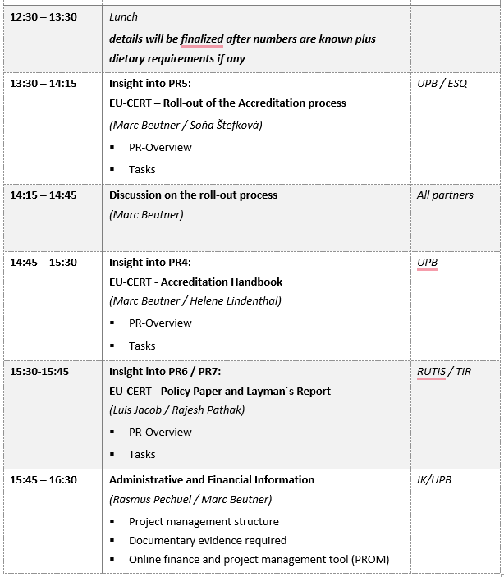
Meeting Agenda
Wednesday, 6th of December

Slide 3
Administrative and Financial Information

Slide 4
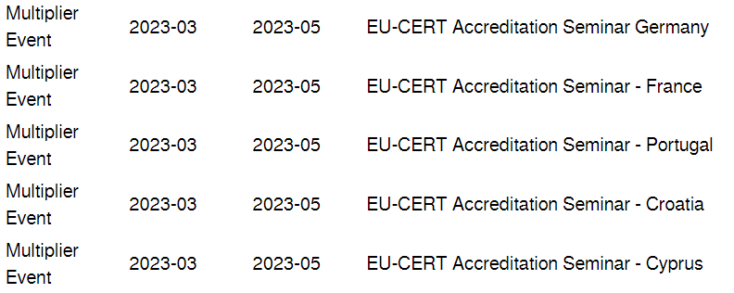
Multiplier Events
2024-01 till 2024-04
There will be a timeshift for the Multiplier Event, because of the shifted starting periode of EU-CERT (01.02.2022 – 31.05.2024 (28 month)!

Slide 5
Transnational Partner Meetings (TPM)
TPM | Leading Organisation | Meeting Title | Country of Venue | Starting Period
TPM1 | Ingenious Knowledge | EU-CERT - Kick-off Conference | Germany | 2022-02 11. – 13.04.2022
TPM2 | Associação Rede de Universidades da Terceira Idade | EU-CERT - Research and Certificate Conference | Portugal | 26.- 28.-10.2022
TPM3 | Esquare | EU-CERT - Accreditation Tool Conference | France | 07.-09.03.2023
TPM4 | TIR Consulting Group j.d.o.o | EU-CERT - Implementation, Testing and Handbook Design Conference | Croatia | September, 2023 suggested date: 26.-28.09.2023
TPM5 | University of Paderborn | EU-CERT - Final Policy Recommendation Conference | Germany | March, 2024 suggested date: 05.-07.03.2024

Slide 6
EU-CERT Reports
Progress Report (until the 31th of October 2022)
Interim Report (until the 30th of April 2023)
Final Report (within 60 days after the end of the project) as required by the European Commission.
The Partner shall provide the Coordinator with the documents necessary for the preparation of the progress report no later than 1st of October 2022.
The Partner shall provide the Coordinator with the documents necessary for the preparation of the interim report no later than 31st of March 2023.
The Partner shall provide the Coordinator with the documents necessary for the preparation of the final report no later than 15.06.2024.

Slide 7
The Project Management Tool - PROM
You provide evidence about the working days with your time sheets! –
Use the PROM TOOL!
Please make sure that you do not claim more or less days than granted!
http://prom.eduproject.eu/

Slide 8

PROM – Project Management Tool
The Login Area - http://eduproject.eu/prom/login.php

Slide 9

Current Status of PROM
Partner | PR1 | PR2 | PR3
Esquare
Ingenious Knowledge
RUTIS
STANDO
TIR

Slide 10
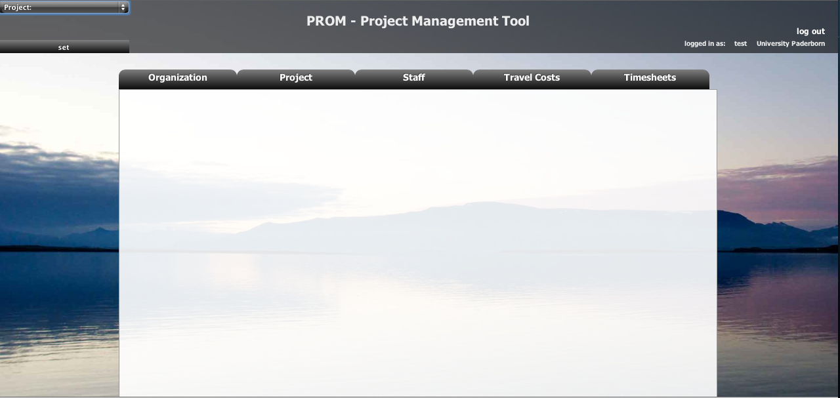
PROM – Project Management Tool
The PROM Start Page (1)

Slide 11
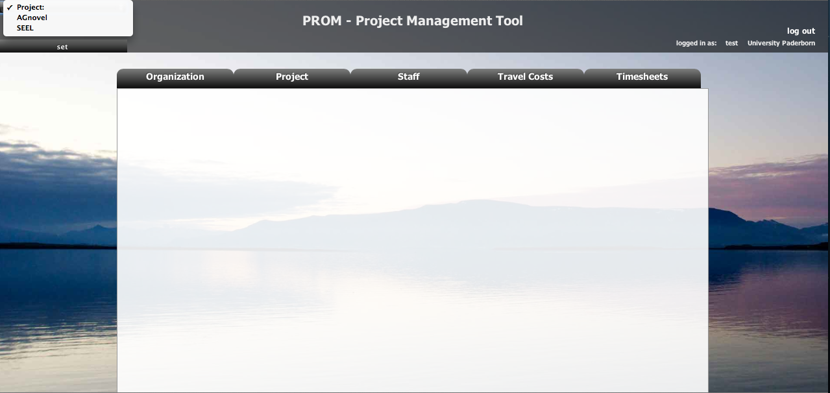
PROM – Project Management Tool
The PROM Start Page (2) – Set the project

Slide 12
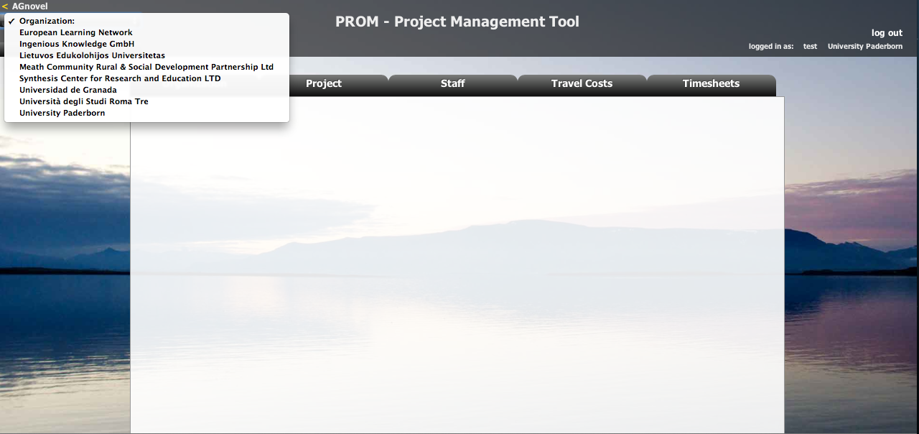
PROM – Project Management Tool
The PROM Start Page (3) – Set the organization

Slide 13
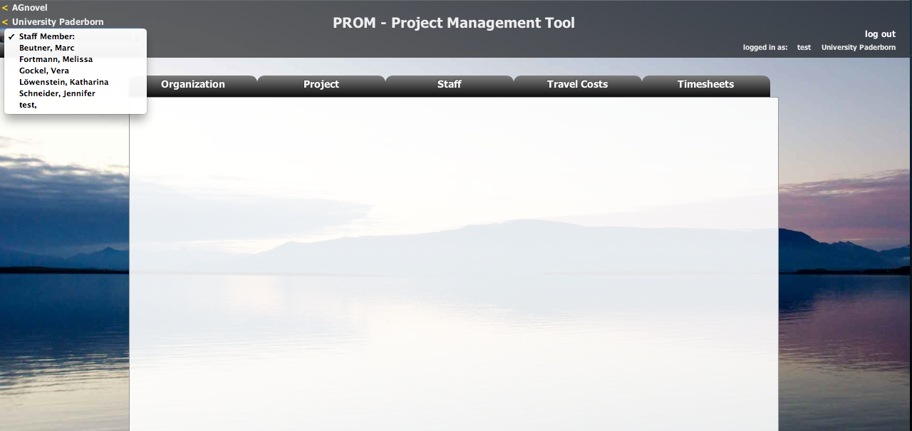
PROM – Project Management Tool
The PROM Start Page (4) – Set the staff member

Slide 14
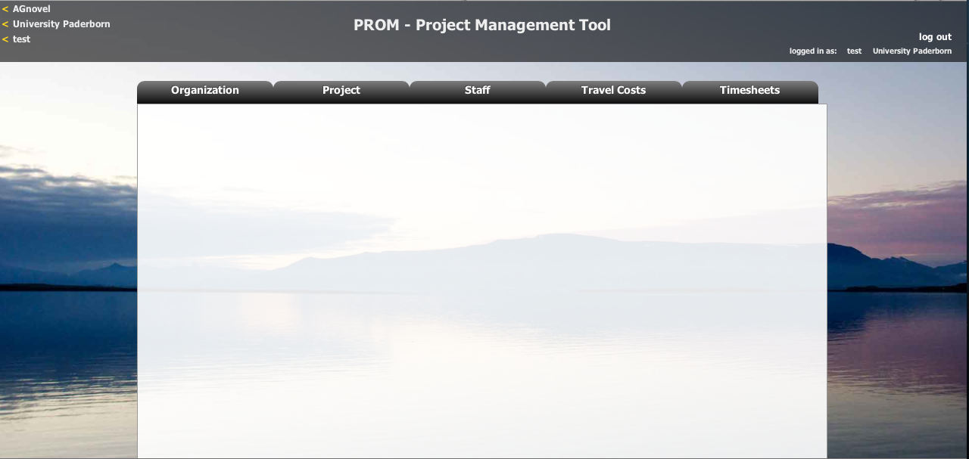
PROM – Project Management Tool
The PROM Start Page (5) – Start

Slide 15
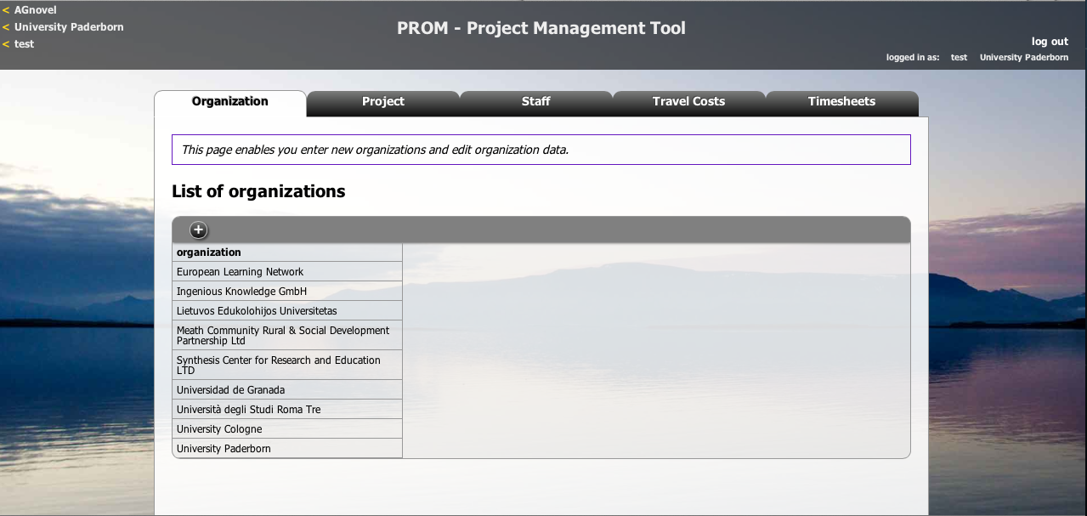
PROM – Project Management Tool
The PROM Tool – List of organizations

Slide 16
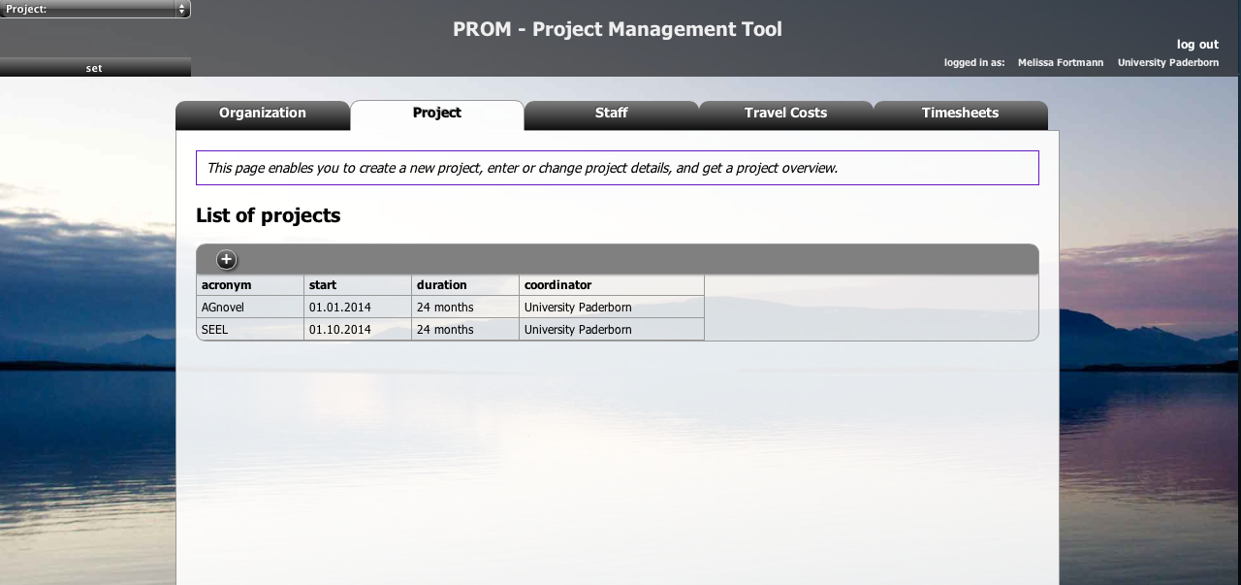
PROM – Project Management Tool
The PROM Tool – List of projects

Slide 17
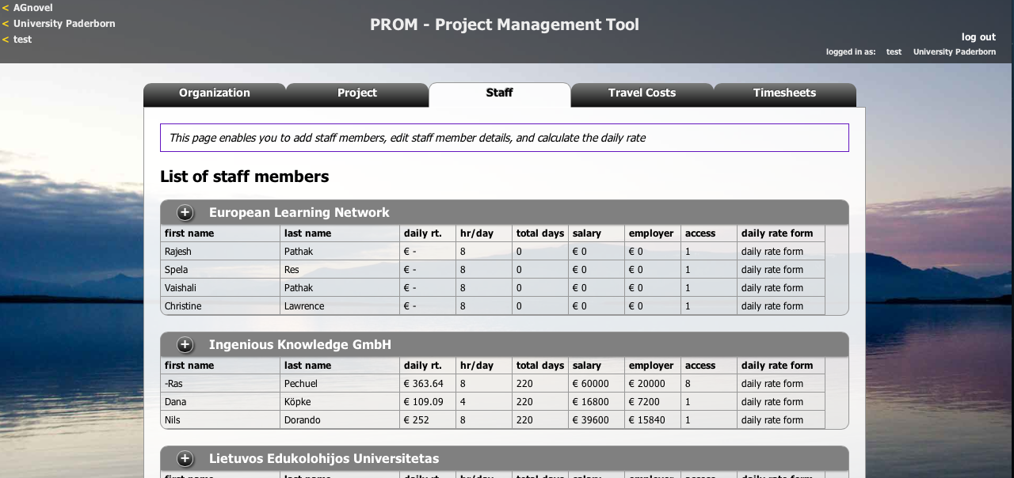
PROM – Project Management Tool
The PROM Tool – List of staff members

Slide 18
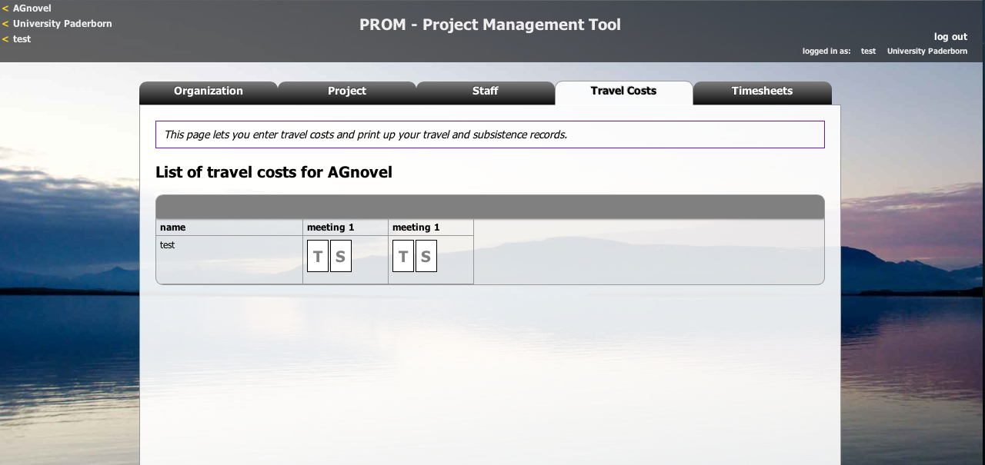
PROM – Project Management Tool
The PROM Tool – Travel costs (1)

Slide 19
PROM – Project Management Tool
The PROM Tool – Travel costs (2) – Travel record I

Slide 20
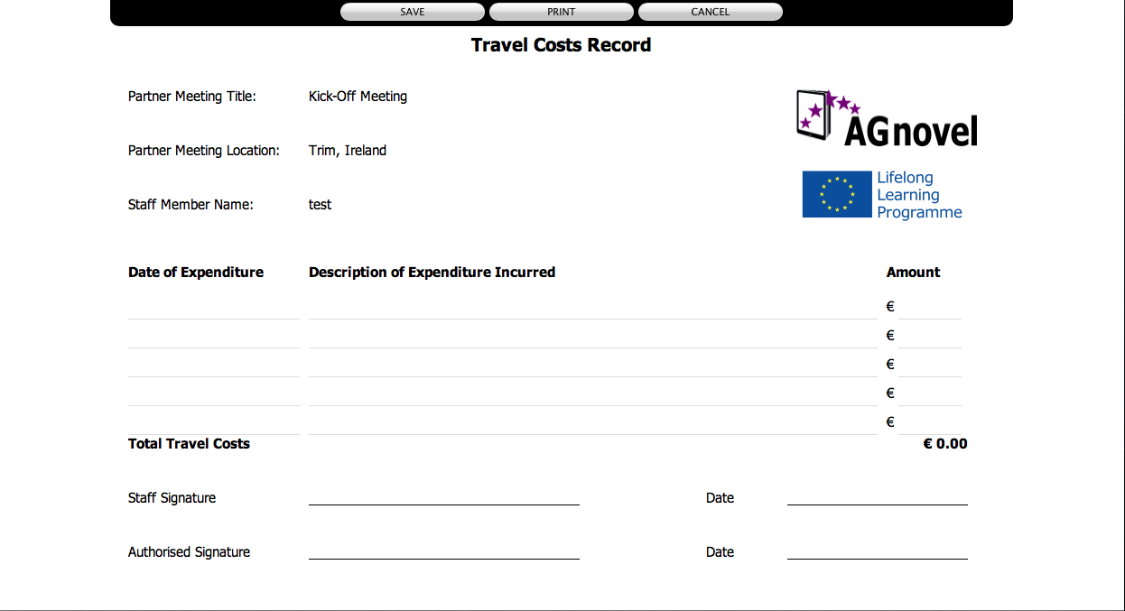
PROM – Project Management Tool
The PROM Tool – Travel costs (3) – Travel record II

Slide 21

PROM – Project Management Tool
The PROM Tool – Travel costs (4) – Subsistence costs I

Slide 22

PROM – Project Management Tool
The PROM Tool – Travel costs (5) – Subsistence costs II

Slide 23
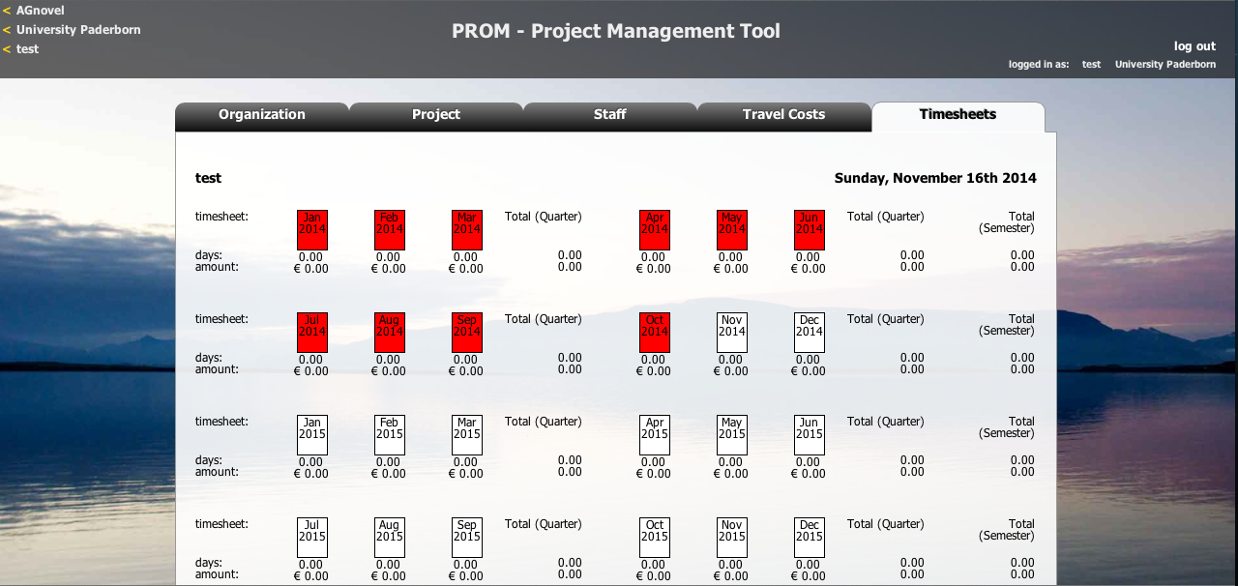
PROM – Project Management Tool
The PROM Tool – Timesheets (1) – Select the month

Slide 24
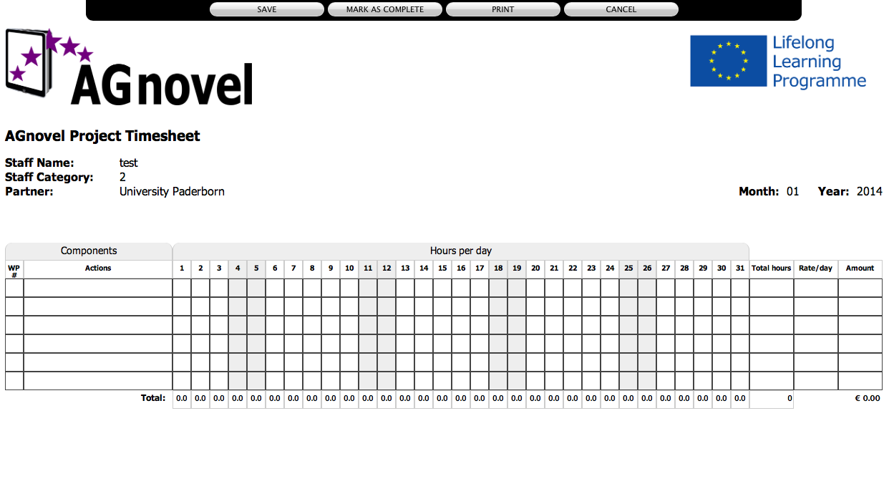
PROM – Project Management Tool
The PROM Tool – Timesheets (2) – Fill in the form I

Slide 25
PROM – Project Management Tool
The PROM Tool – Timesheets (3) – Fill in the form II

Slide 26

PROM – Project Management Tool
The PROM Tool – Timesheets (4) - Overview

Slide 27
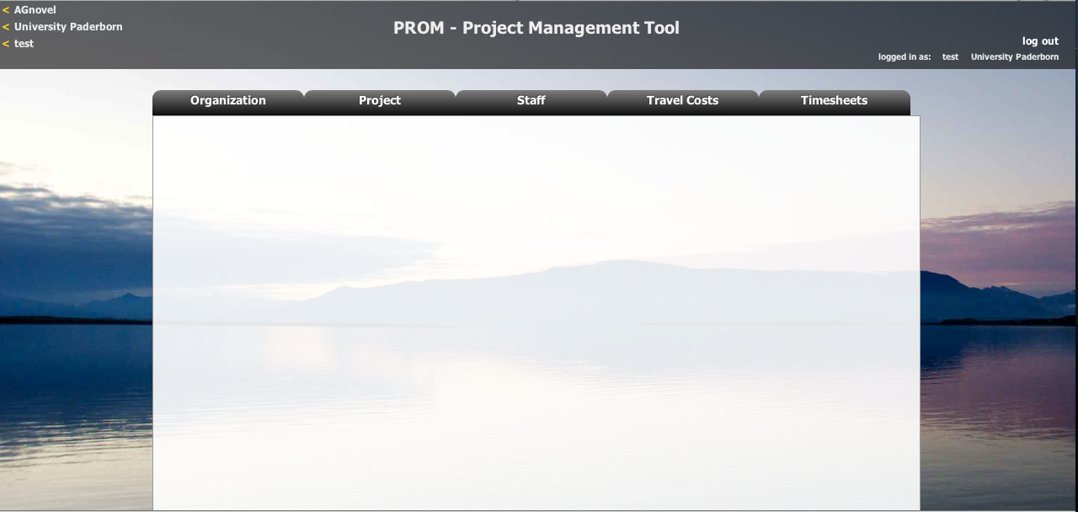
PROM – Project Management Tool
The PROM Tool – Log out

Slide 28
Documentation
Documentation of staff costs
  Timesheets
  Payslips
  Staff employment contracts
Additional documentation (in your own project folder)
  Invoices (for example: boarding passes, accommodation invoice etc.)
  Proof of payment
  Receipts for costs incurred (for example: printing costs for dissemination material, hosting partner meeting etc.)

Slide 29
Travel Costs (1)
Transnational Project Meetings costs…
are calculated on a unit cost basis according to the distance of travel per meeting
  Online distance calculator:
  http://ec.europa.eu/programmes/erasmus-plus/resources_en#tab-1-4
are based on the place of origin and the place of the meeting venue
needs to have a direct link to project meetings

Slide 30
Travel Costs (2)
Transnational Project Meetings costs…
575,00 € per person distance 100-1999km
760,00 € per person distance >= 2000km
Make sure that you have the correct number of participants.

Slide 31
Travel costs (3)
Documentation
Certificate/declaration of attendance
The hosting institution has to provide the participants with a
certificate/declaration of attendance signed by the hosting organisation
→ Template will be available on the project website
→ Please provide us with a scanned version
Travel cost invoices (in your own folder)
  Flight invoices, boarding passes
  accommodation invoices
  Taxi, train, car hire and/or bus receipts
  Mileage costs at a maximum rate of 0.22 cent per km

Slide 32




Discussion and Q&A

Slide 33
Universität Paderborn
Department Wirtschaftspädagogik Lehrstuhl Wirtschaftspädagogik II Warburger Str. 100
33098 Paderborn
http://www.upb.de/wipaed
Prof. Dr. Marc Beutner
Tel: +49 (0) 52 51 / 60 - 23 67
Fax: +49 (0) 52 51 / 60 - 35 63
E-Mail: marc.beutner@uni-paderborn.de

