Slide 1
EU-CERT:
European Certificates and Accreditation for European Projects
EU-CERT
Transnational partner meeting (TPM4)
in Zagreb, Croatia
The EU-CERT – Accreditation and Documentation Conference!
5th - 7th of December 2023
Dissemination and Exploitation
University of Paderborn
Reference Number:
2021-1-DE02-KA220-ADU-000033541
Duration:
01.02.2022 – 31.05.2024 (28 month)

Slide 2
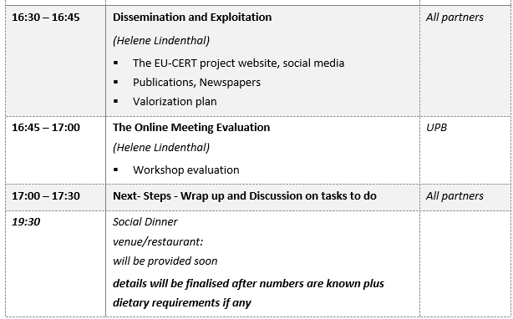
Meeting Agenda
Wednesday, 6th of December

Slide 3
Dissemination activities
Dissemination activities should be done regularly by each partner during the project:
Posts on Facebook, posts on school website etc.
Printed materials: Flyer, Posters, Brochures, Newsletters etc.
Articles about the project in local newspapers or online article etc.
Face-to-face meetings with interested people etc.
Please, use the dissemination table for documentation
Please, see social media roster for EU-CERT Facebook page

Slide 4
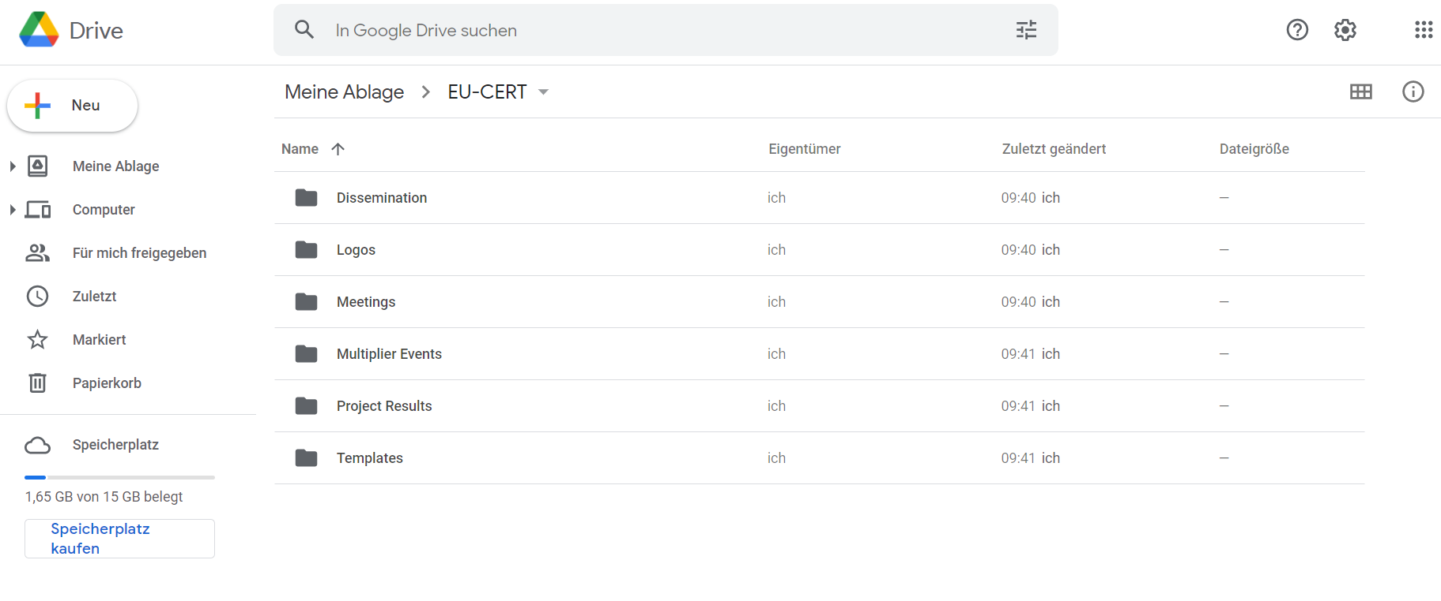
Google Drive Folders
EU-CERT – Google Drive
https://drive.google.com/drive/u/0/folders/1ZY5YviOC_gj46QIMw044dqKfwkQXJbWt

Slide 5
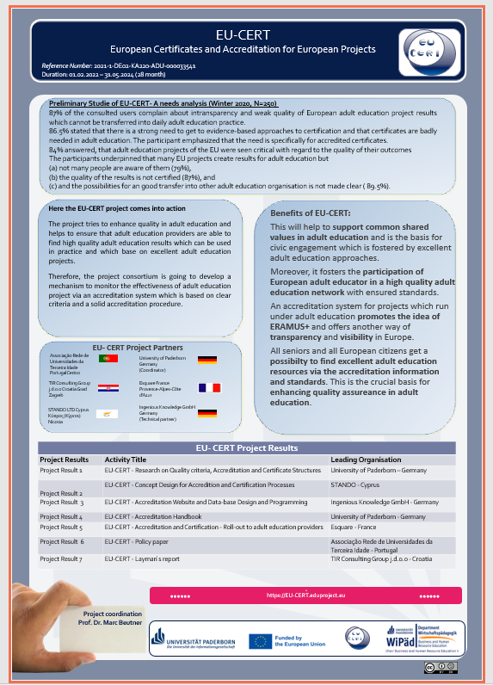
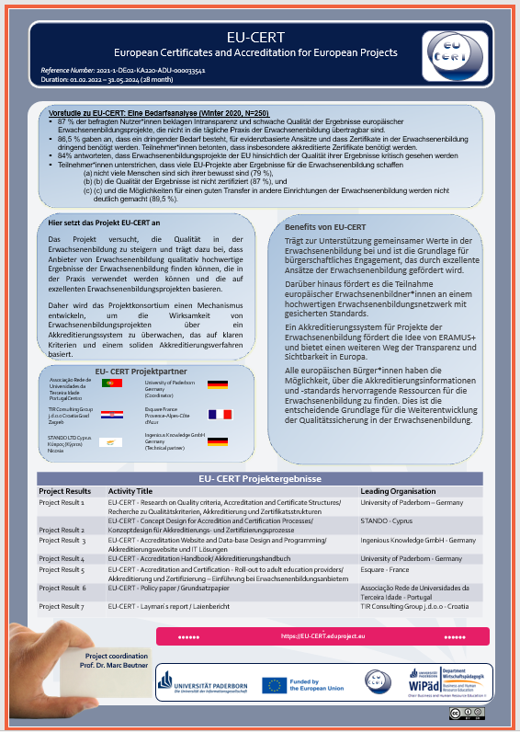
Dissemination Activities
Please, be so kind and translate the EU-CERT poster in your national language.
The posters are uploaded on the google drive folder.

Slide 6

Dissemination Activities
The EU-CERT website
Link: https://eucert.eduproject.eu/

Slide 7
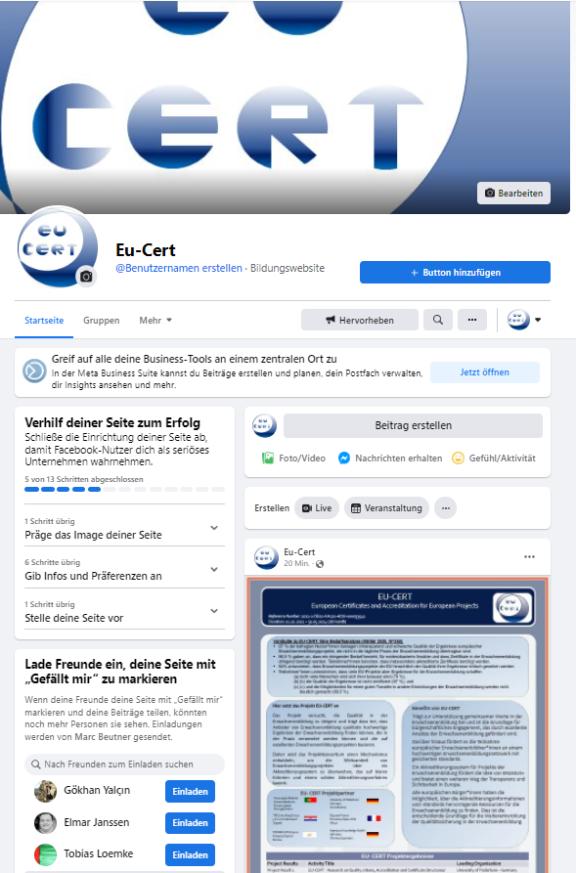
Social Media Accounts – Facebook
Please, send me your facebook account name
EU-CERT Facebook page:
https://www.facebook.com/Eu-Cert-104391385540756/?ref=pages_you_manage

Slide 8
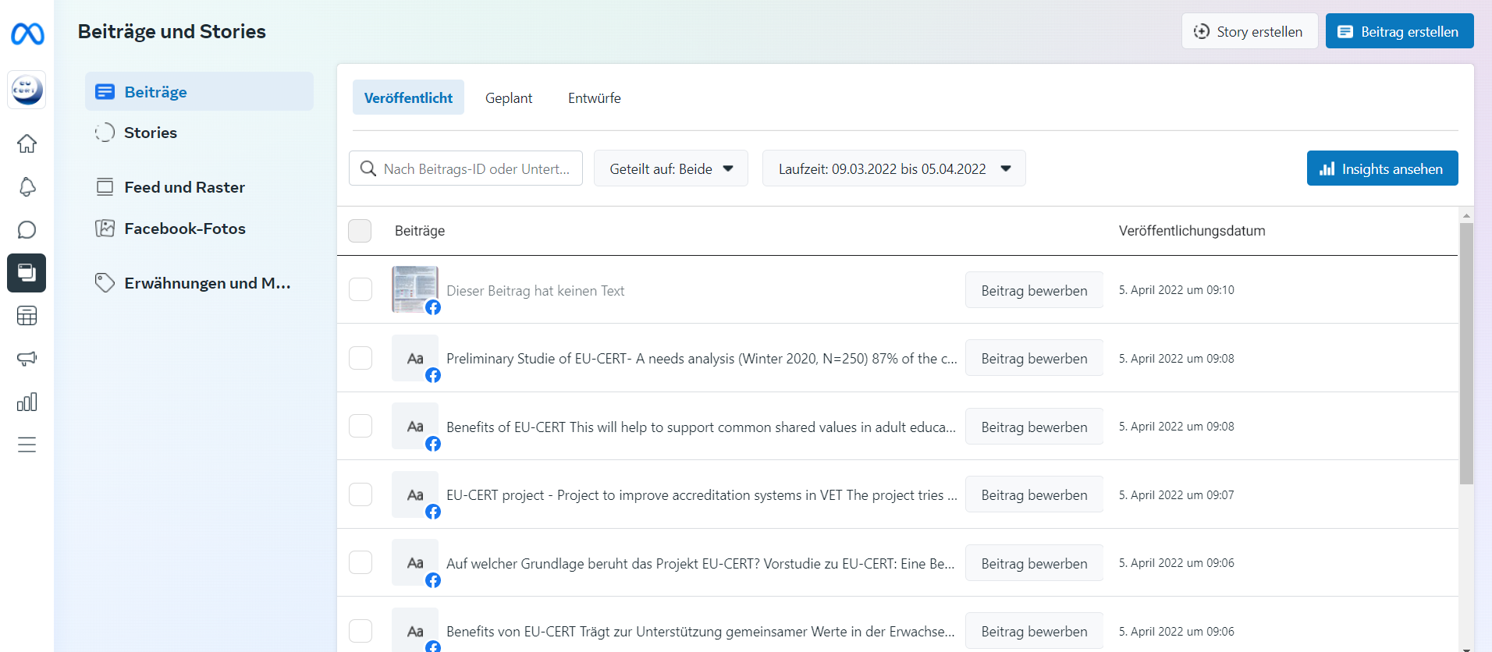
Social Media Accounts – Facebook
Be active on social media and plan your posts for the next weeks and months!
That makes it easier to communicate with your stakeholders!

Slide 9
EU-CERT Templates

Slide 10
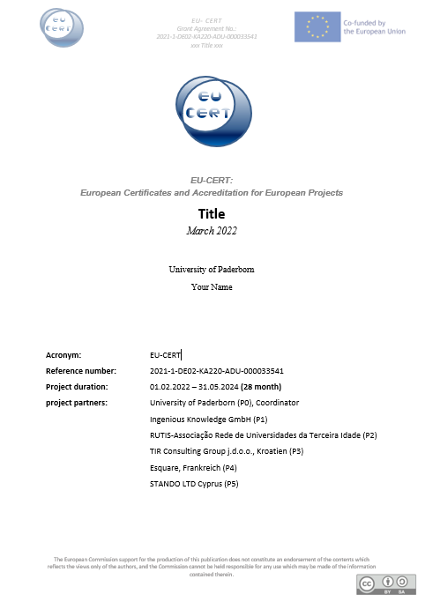
EU-CERT Templates
Please stick to this Word template!
Available on google drive

Slide 11
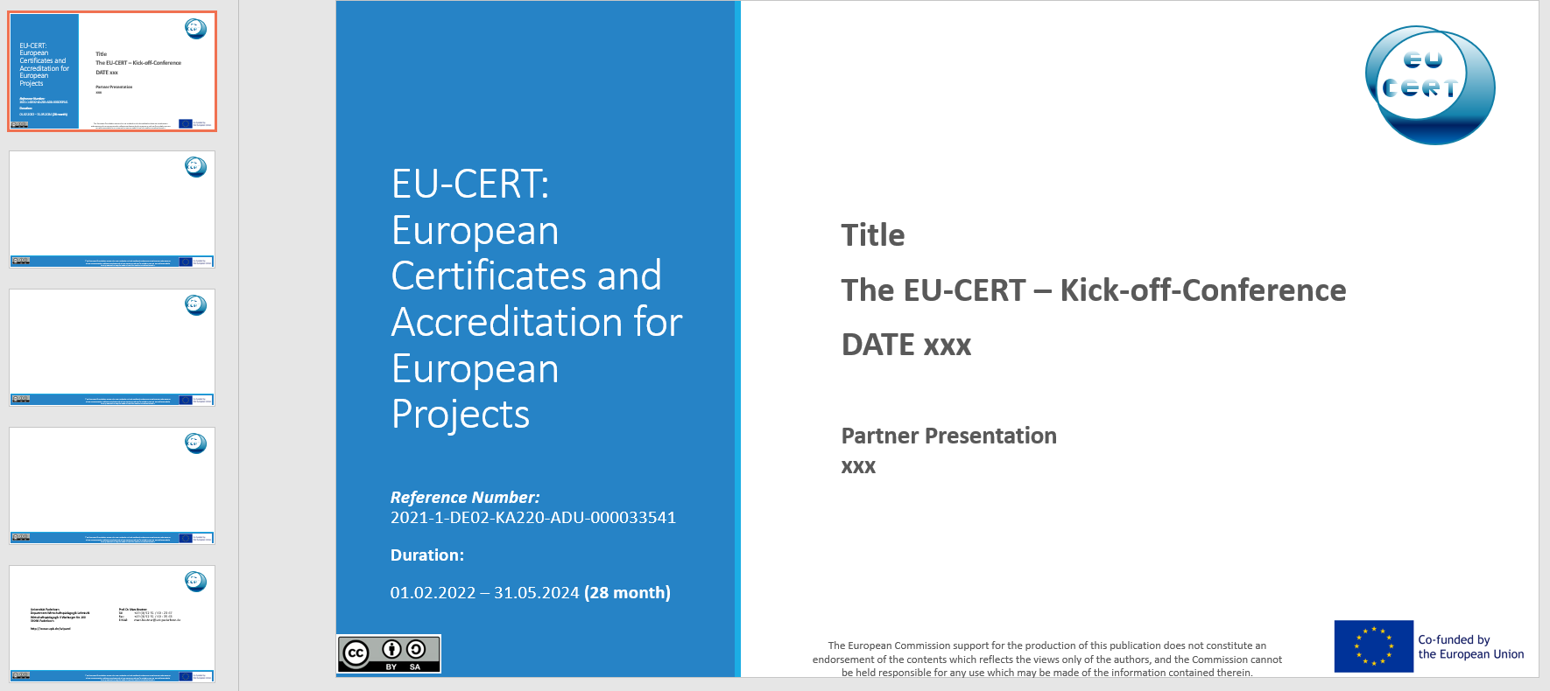
EU-CERT Templates
Please stick to this PowerPoint template!
Available on google drive

Slide 12
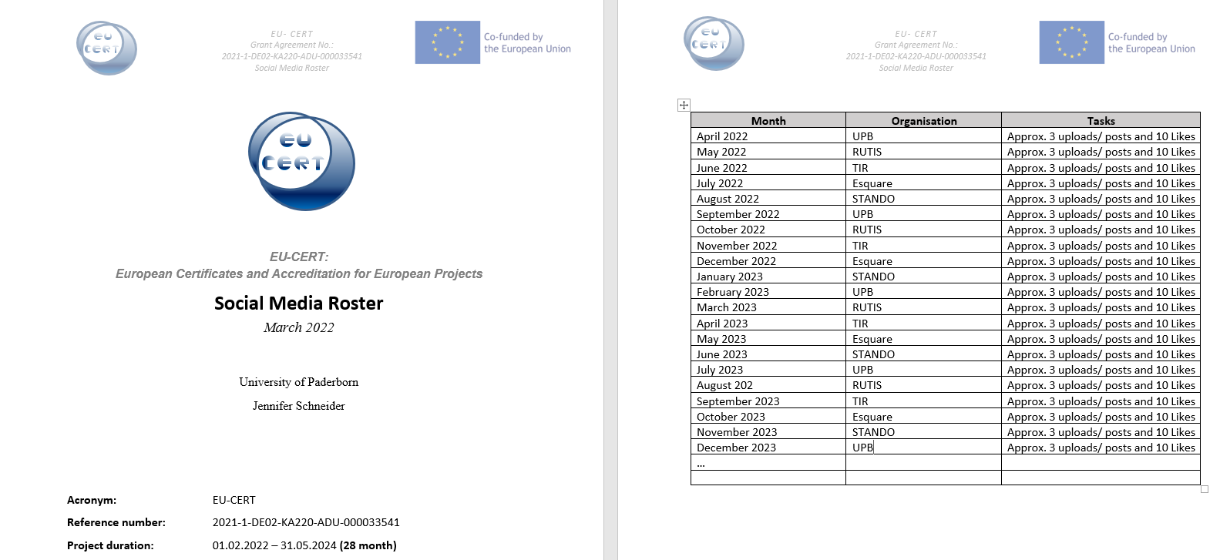
Social Media Roster

Slide 13
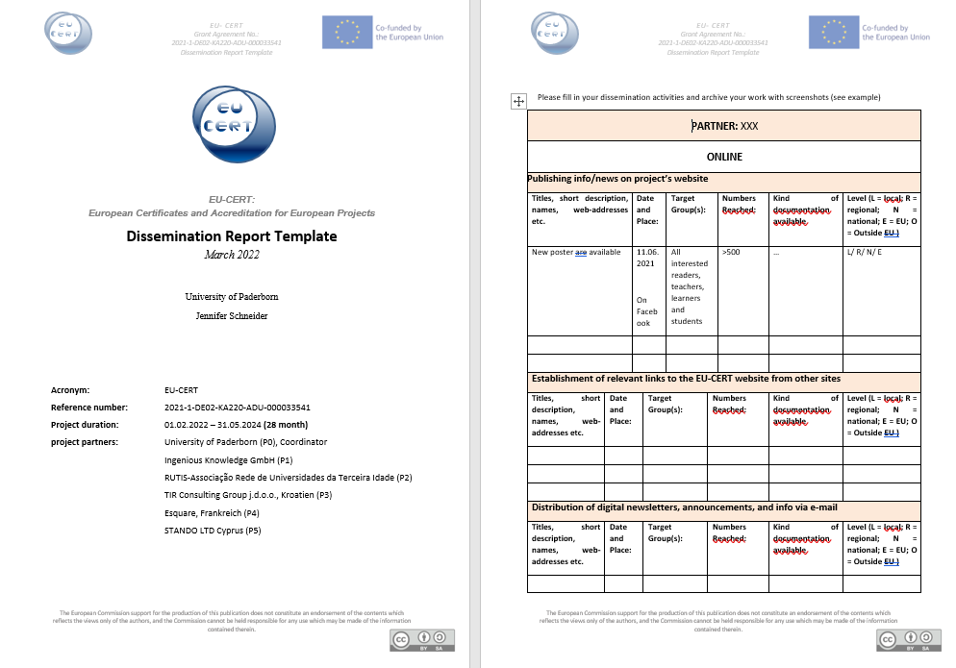
Dissemination activities - Documentation
Please,….
...use the documentation table as evidence for dissemination activities
The template will be available on EU-CERT website / Google Drive Folder for download

Slide 14
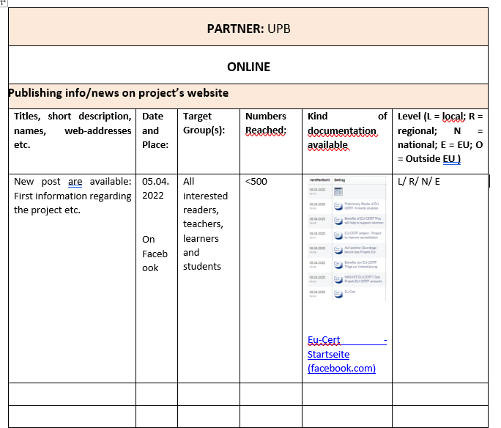
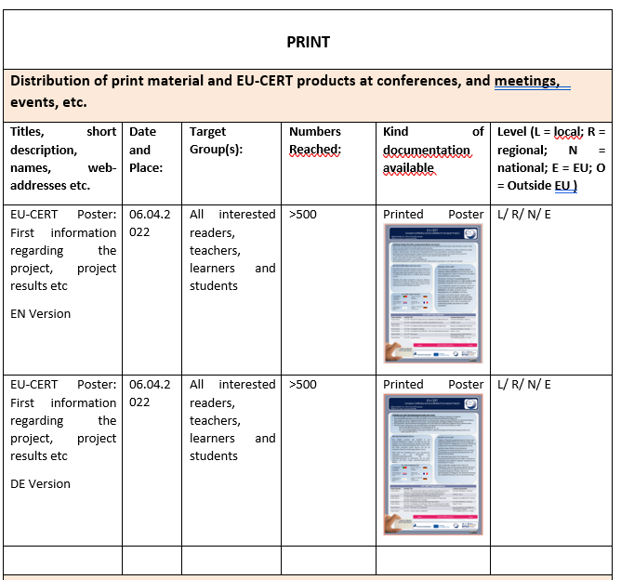
Dissemiantion Report Template – Example UPB

Slide 15

Newsletter
"Dieses Foto" von Unbekannter Autor ist lizenziert gemäß CC BY-SA-NC

Slide 16




Discussion and Q&A

Slide 17
Universität Paderborn
Department Wirtschaftspädagogik Lehrstuhl Wirtschaftspädagogik II Warburger Str. 100
33098 Paderborn
http://www.upb.de/wipaed
Prof. Dr. Marc Beutner
Tel: +49 (0) 52 51 / 60 - 23 67
Fax: +49 (0) 52 51 / 60 - 35 63
E-Mail: marc.beutner@uni-paderborn.de

