Slide 1
EU-CERT: European Certificates and Accreditation for European Projects
EU-CERT Transnational partner meeting (TPM4) in Zagreb, Croatia
The EU-CERT – Accreditation and Documentation Conference!
5th - 7th of December 2023
Current status University of Paderborn
Reference Number: 2021-1-DE02-KA220-ADU-000033541
Duration:
01.02.2022 – 31.05.2024 (28 month)

Slide 2
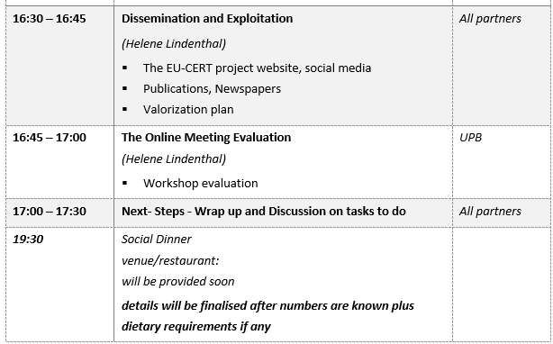
Meeting Agenda Wednesday, 6th of December

Slide 3
Meeting Evaluation
FOURTH TPM IN ZAGREB, CROATIA

Slide 4
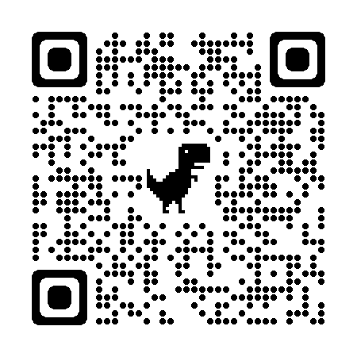
Your opinion is important to us!
Please, follow the link to access the online survey:
https://umfragen.uni-paderborn.de/index.php/255318?lang=en
Until 17.12.2023 23:59

Slide 5
Universität Paderborn
Department Wirtschaftspädagogik Lehrstuhl Wirtschaftspädagogik II Warburger Str. 100
33098 Paderborn
http://www.upb.de/wipaed
Prof. Dr. Marc Beutner
Tel: +49 (0) 52 51 / 60 - 23 67
Fax: +49 (0) 52 51 / 60 - 35 63
E-Mail: marc.beutner@uni-paderborn.de

