Slide 1
EU-CERT: European Certificates and Accreditation for European Projects
The EU-CERT – Accreditation and Documentation Conference
4th TPM in Croatia
06/12/2023
Partner Presentation STANDO
Reference Number: 2021-1-DE02-KA220-ADU-000033541
Duration:
01.02.2022 – 31.05.2024 (28 month)

Slide 2
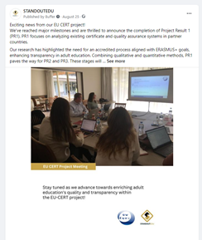
Dissemination since last TPM (March 2023)
Posts on our social account platforms (Instagram, Facebook, Linkedin)

Slide 3
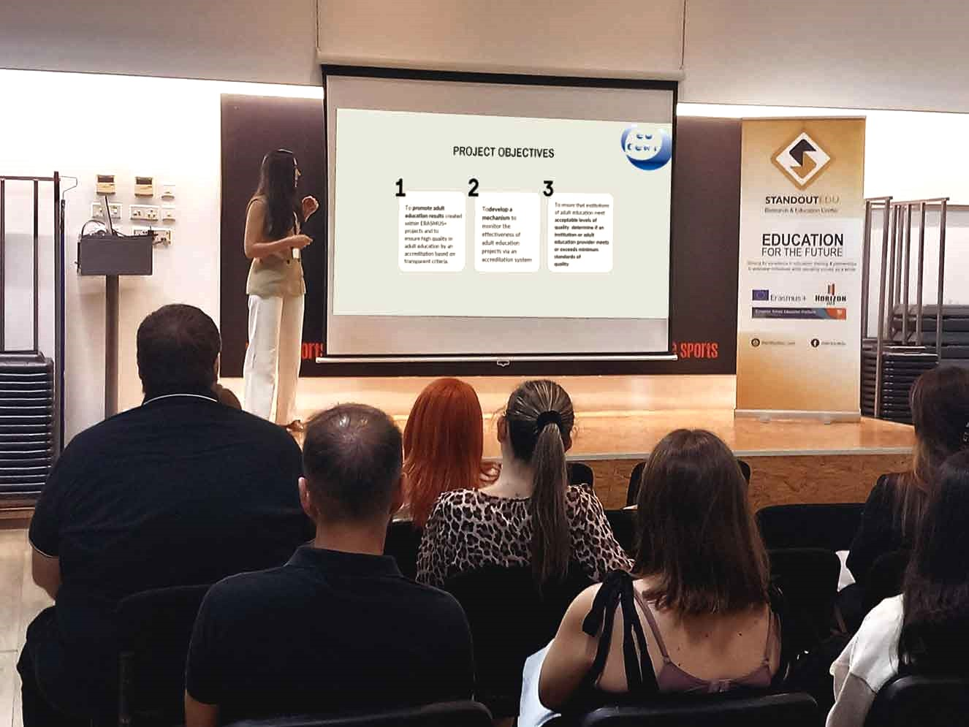
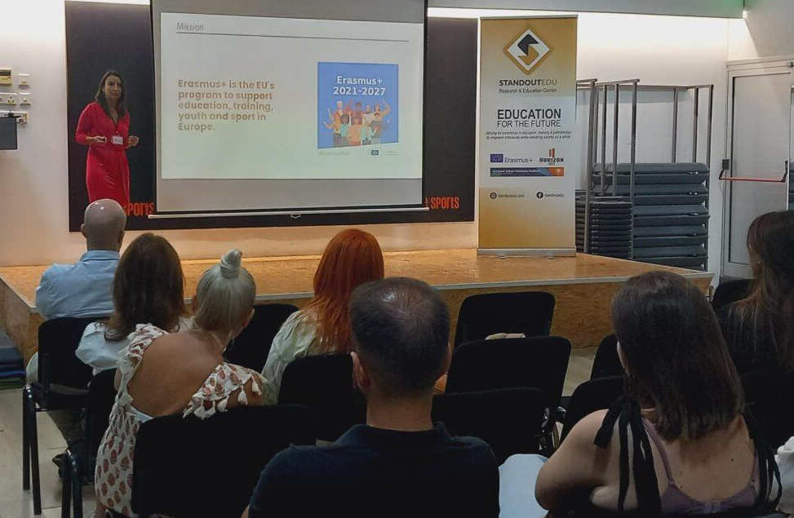
Erasmus Day at STANDO

Slide 4
Dissemination Plan
Newsletter
Post on social platforms for TPM and next steps
ME at STANDO’s premices
EPALE

Slide 5
Universität Paderborn
Department Wirtschaftspädagogik Lehrstuhl Wirtschaftspädagogik II Warburger Str. 100
33098 Paderborn
http://www.upb.de/wipaed
Prof. Dr. Marc Beutner
Tel: +49 (0) 52 51 / 60 - 23 67
Fax: +49 (0) 52 51 / 60 - 35 63
E-Mail: marc.beutner@uni-paderborn.de

