Slide 1
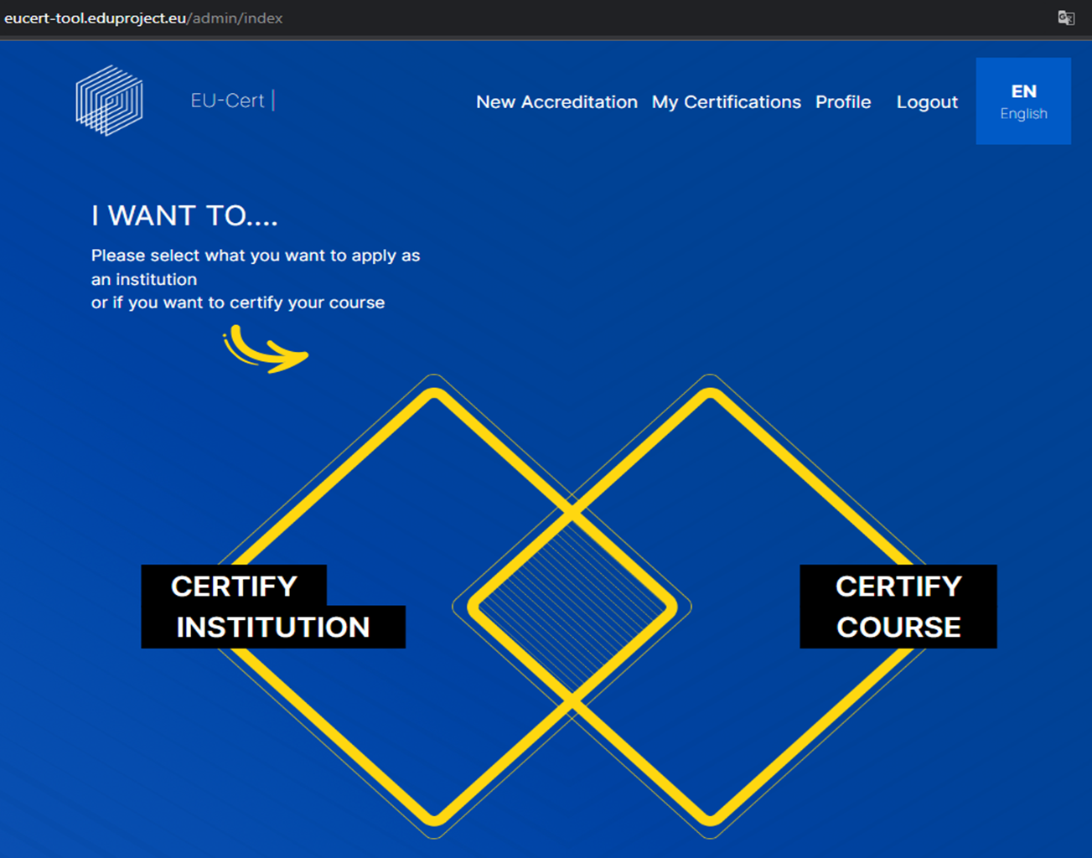
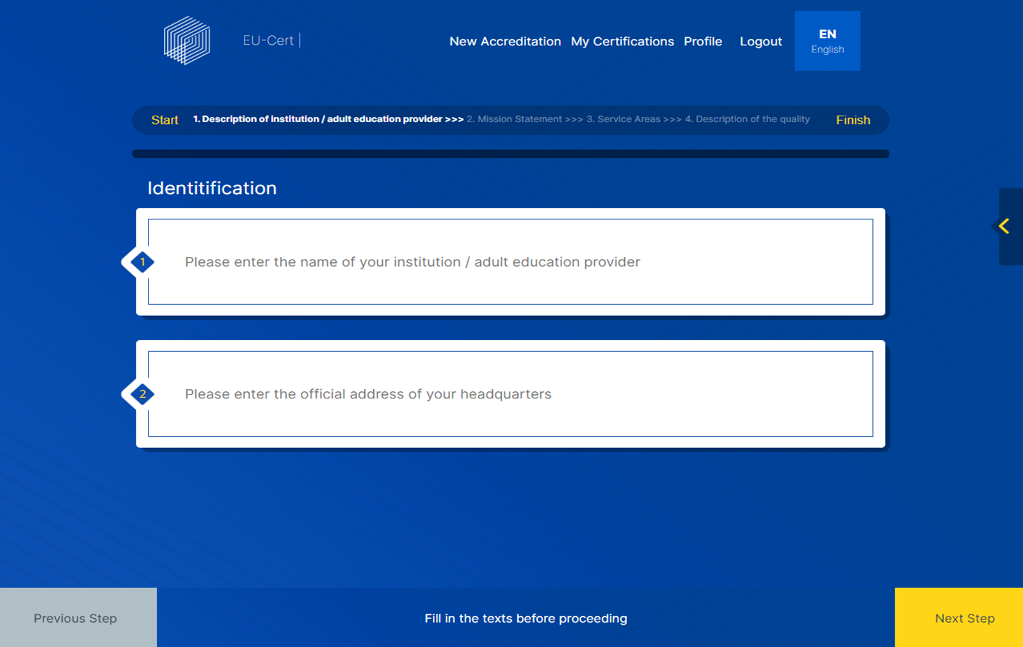
EU-CERT European Certificates and Accreditation for European Projects
Reference Number: 2021-1-DE02-KA220-ADU-000033541 Duration: 01.02.2022 – 31.05.2024 (28 month)
The EU-CERT Accreditation Tool Website
The Accreditation Tool website is the heart of the EU-CERT project, as it is used for the accreditation and certification of ERASMUS+ adult education projects and measures.
EU project coordinators, who seek accredited project results, need an innovative, easily accessible website. This website holds significant information about the accreditation process and ensures transparency in the procedures which impacts credibility and increases the likelihood of improving the transfer of project results.
The website consists of these sections: (1) information about criteria and processes, (2) user section for online application, data uploads and the certification process, (3) evaluator section for the online evaluation, including evaluation regulations and steps of the accreditation process, (4) communication section for interaction between user and evaluator, and (5) database section for storing data in compliance with data security regulations.
PR1
EU-CERT - Research on Quality criteria, Accreditation and Certificate Structures
PR2
EU-CERT - Concept Design for Accreditation and Certification Processes
EU-CERT - Accreditation Website and Data-base Design and Programming
PR3
Some impressions of the website
PR4
PR5
EU-CERT - Accreditation Handbook
EU-CERT - Accreditation and Certification - Roll-out to adult education providers
PR6
PR7
EU-CERT - Policy paper
EU-CERT - Layman ́s report
EU- CERT Project partner
The project partners are working on the final project results so that the project as a whole can report great successes.
Associação Rede de Universidades da Terceira Idade PortugalCentro
University of Paderborn Germany (Coordinator)
TIR Consulting Group j.d.o.o Croatia Grad Zagreb
Esquare France Provence-Alpes-Côte d'Azur
STANDO LTD Cyprus Κύπρος (Kýpros) Nicosia
Ingenious Knowledge GmbH Germany
(Technical partner)
a https://EU-CERT.eduproject.eu
Project coordination
Prof. Dr. Marc Beutner
••••••
••••••

