Slide 1
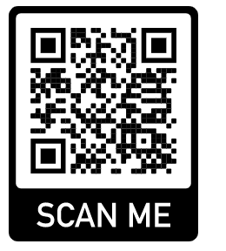
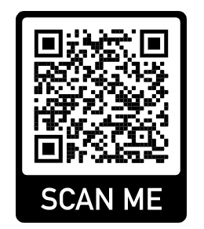
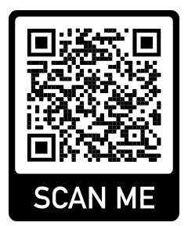
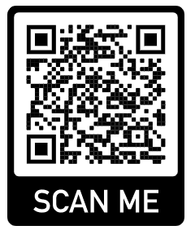
EU-CERT European Certificates and Accreditation for European Projects Projektnummer: 2021-1-DE02-KA220-ADU-00003354
The Erasmus+ Project EU-CERT focuses on elevating the quality and transparency of adult education in Europe. Our primary aim is to develop and implement a robust accreditation system for adult education projects, ensuring that educational results are of the highest standard and can be seamlessly integrated into daily practices.
Main Objectives:
Define European Criteria: Establish clear, consistent criteria for accrediting ERASMUS+ adult education projects.
Develop Accreditation Processes: Create a reliable and sustainable accreditation structure that remains effective beyond the project's duration.
Promote Quality and Transparency: Ensure that adult education providers can easily identify and utilize high-quality educational resources.
Support Lifelong Learning: Foster a community of lifelong learners by upholding rigorous standards and shared values in adult education.
Join us in advancing the excellence of adult education across Europe with EU-CERT!
Visit our website
The European Commsson support for the producton of ths publcaton does not consttute an endorsement of the contents whch reflects
the vews only of the authors, and the Commsson cannot be held responsble for any use whch may be made of the nformaton
contaned theren
Die DigI-VET Lernplattform ist in den Projektsprachen – Deutsch, Englisch, Rumänisch und Griechisch verfügbar.
Englische
Lernplattform:
Deutsche
Lernplattform:
Griechische Lernplattform:
Rumänische Lernplattform:

