Slide 1
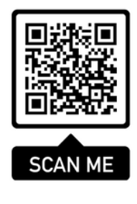
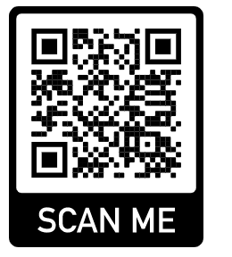
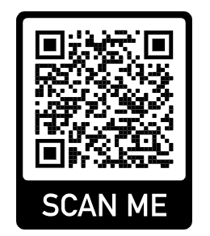
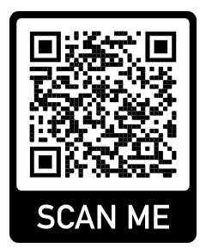
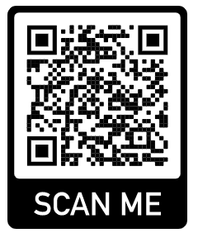
EU-CERT European Certificates and Accreditation for European Projects Projektnummer: 2021-1-DE02-KA220-ADU-00003354
Discover the EU-CERT Accreditation Website
The Erasmus+ project EU-CERT is proud to present our accreditation website. On this platform, you will find all the important information and resources for accrediting adult education projects.
Here is the QR code that will take you directly to our website:
Visit us and discover how EU-CERT is contributing to the improvement of quality and transparency in adult education!
Visit our website
Accreditation Tool
Project Website
The European Commsson support for the producton of ths publcaton does not consttute an endorsement of the contents whch reflects
the vews only of the authors, and the Commsson cannot be held responsble for any use whch may be made of the nformaton
contaned theren
Die DigI-VET Lernplattform ist in den Projektsprachen – Deutsch, Englisch, Rumänisch und Griechisch verfügbar.
Englische
Lernplattform:
Deutsche
Lernplattform:
Griechische Lernplattform:
Rumänische Lernplattform:

