Slide 1
EU-CERT: European Certificates and Accreditation for European Projects
EU-CERT PR2 Accreditation Tool Website
Material Assessment
University of Paderborn
Reference Number: 2021-1-DE02-KA220-ADU-000033541
Duration:
01.02.2022 – 31.05.2024 (28 month)

Slide 2
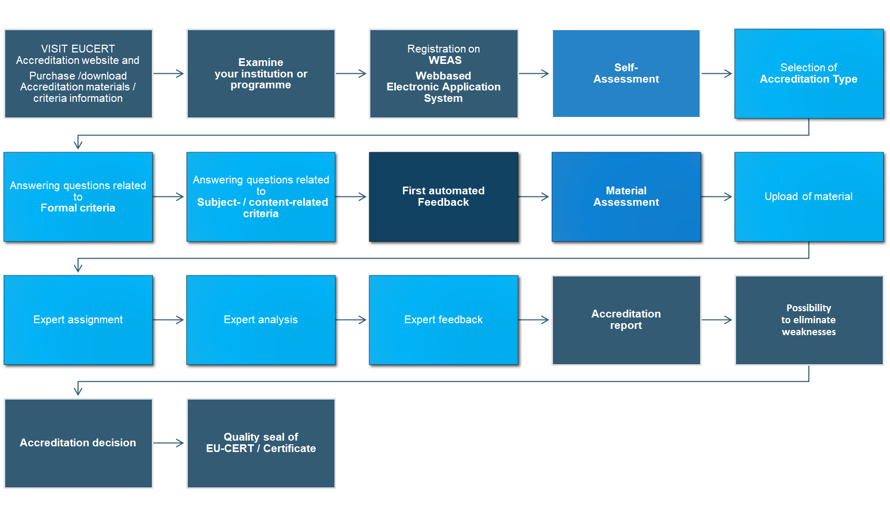
Material Assessment

Slide 3
Material Assessment
Upload of Material
Expert Assignment
Expert Analysis
Expert Feedback

Slide 4
Material Assessment

Slide 5
1. Upload of Material
The upload of material is in connection with the Self Assessment of the tool.
The user is going to be asked to upload the materials which the user has previously entered.
The uploaded materials can then be viewed or downloaded by the evaluator.

Slide 6
1. Upload of Material III System/Institutional Accreditation III.I Formal Criteria
Self Assessment |  | Upload of Material
Question (8): Does your institution have a quality management system? |  | Quality Management System upload button e.g. user could upload their QM-document
Question (8.2): Does your institution have a quality management system according to the ISO standard? |  | Upload button for ISO certificate

Slide 7
1. Upload of Material III System/Institutional Accreditation III.I Formal Criteria
Self Assessment |  | Upload of Material
Question (9): Will the applications of employees will be checked? |  | Upload of checklist for hire employees
Question (11): Performance metrics for each job available? |  | Upload of performance metrics for each job

Slide 8
1. Upload of Material III System/Institutional Accreditation III.I Formal Criteria
Self Assessment |  | Upload of Material
Question (12): Continuous trainings and development (ongoing trainings) |  | Upload of overview of continuous trainings and development (ongoing trainings)
Question (13): Regular performance evaluations |  | Upload of performance evaluation sheet

Slide 9
1. Upload of Material III System/Institutional Accreditation III.I Formal Criteria
Self Assessment |  | Upload of Material
Question (14): Employee feedback |  | Upload of employee feedback sheet
Question (15): Appraisal interview |  | Upload of appraisal interview sheet/structure
Question (17): Staff training |  | Upload of overview of all kind of staff training offer

Slide 10
1. Upload of Material III System/Institutional Accreditation III.I Formal Criteria
Self Assessment |  | Upload of Material
Question (18): Stakeholder Communication – Which communication channels and forms of communication do you use for communication? |  | Link to (if selected by user) - Institution Website - Institution blog - Institution Newsletter - etc.
Question (19): Social Media Accounts |  | Link to (if selected by user) - Facebook - Instagram - LinkedIn - Twitter - etc.

Slide 11
1. Upload of Material III System/Institutional Accreditation III.I Formal Criteria
Self Assessment |  | Upload of Material
Question (20): Other communication channels |  | Upload of selected communication channel

Slide 12
1. Upload of Material III System/Institutional Accreditation III.II Subject-/Content-related Criteria
Self Assessment |  | Upload of Material
Question (21): Standardised decision-making process |  | Upload of standardised decision-making process document
Question (22): quality assessment |  | Upload of quality assessment document, institutional policies
Question (23): resource allocation |  | Upload of business plan
Question (24): curriculum |  | Upload of curriculum

Slide 13
1. Upload of Material III System/Institutional Accreditation III.II Subject-/Content-related Criteria
Self Assessment |  | Upload of Material
Question (25): Does your institution have a “Student support service”? |  | (if yes) Upload of student support materials, link to student support service
Question (26): Qualified instructors |  | Upload of certificates of any trainings
Question (27): Train-the-trainer workshops |  | Upload of overview of train-the-trainer workshops offered, links
Question (28): Does your institution have a feedback system? |  | (if yes) - Upload of feedback system - Upload of feedback questionnaire etc.

Slide 14
1. Upload of Material III System/Institutional Accreditation III.II Subject-/Content-related Criteria
Self Assessment |  | Upload of Material
Question (29): program evaluation |  | Upload of program evaluation of the adult education program
Question (34): cooperations |  | Upload link to organisation of cooperation

Slide 15
1. Upload of Material IV Product, Material, OER and Course Accreditation IV.I Formal Criteria
Self Assessment |  | Upload of Material
Question (8): staff qualification |  | Upload of overview of staff qualification offers of the institution
Question (10): What type of product, material, OER or course do you offer? |  | (if selected by user) - upload of textbooks, workbooks, lesson plan, instructional materials, course curriculum
Question (28): Through which channel or person do you get feedback about the clarity of purpose from the students? |  | (if yes) - Upload of channel or information to person
Question (34): Is proof of payment issued? |  | (if yes) - Upload of proof of payment (example)

Slide 16
1. Upload of Material IV Product, Material, OER and Course Accreditation IV.I Formal Criteria
Self Assessment |  | Upload of Material
Question (8): staff qualification |  | Upload of overview of staff qualification offers of the institution
Question (9): Do you have any awards and/or accreditation of the institution? |  | (if yes) - Upload of award/certificate, link
Question (10): accreditation of |  | Upload if overview of the chosen type, link
Question (12): curriculum materials |  | Upload of curriculum materials
Question (13): OER |  | Upload of overview of OER
Question (14): Courses |  | Upload of overview of courses, link
Question (21): transparency |  | Upload of overview, link
Question (23): interdisciplinary learning opportunities |  | Upload of documents, links

Slide 17
1. Upload of Material IV Product, Material, OER and Course Accreditation IV.I Formal Criteria
Self Assessment |  | Upload of Material
Question (26): public |  | Upload of links to publicity
Question (28): Through which channel or person do you get feedback about the clarity of purpose from the students? |  | (if yes) - Upload of channel or information to person
Question (34): Is proof of payment issued? |  | (if yes) - Upload of proof of payment (example)

Slide 18
1. Upload of Material IV Product, Material, OER and Course Accreditation IV.I Formal Criteria
Self Assessment |  | Upload of Material
Question (35): Is your product, material, OER or course internationally embedded? |  | (if yes) - Upload of proof
Question (37): Is your product, material, or OER nationally embedded? |  | (if yes) - Upload of proof
Question (39): Is your product, material, or OER regionally embedded? |  | (if yes) - Upload of proof
Question (41): Is your product, material, or OER locally embedded? |  | (if yes) - Upload of proof

Slide 19
1. Upload of Material IV Product, Material, OER and Course Accreditation IV.I Formal Criteria
Self Assessment |  | Upload of Material
Question (35): Have you created Learning Outcomes for students who are working with your product, material, or OER? |  | (if yes) - Upload of learning outcomes (matrix)
Question (36): Do you establish gender equality in your product, material, or OER? |  | (if yes) - Upload of proof
Question (37): How does the institution check and monitor staff qualification? |  | (if selected by user) - Upload of proof
Question (38): performance metrics for each job |  | Upload of performance metrics for each job
Question (39): trainings and development |  | Upload of overview, links
Question (40): evaluation |  | Upload of evaluation sheet

Slide 20
1. Upload of Material IV Product, Material, OER and Course Accreditation IV.I Formal Criteria
Self Assessment |  | Upload of Material
Question (41): Employee feedback |  | Upload button Upload of employee feedback sheet
Question (42): Appraisal interview |  | Upload button Upload of appraisal interview sheet/structure
Question (44): Does your institution foster staff training? |  | (if yes) - Upload of overview, link
Question (45): Do you advertise your product, material, or OER? |  | (if yes) - Upload of advertisement, link

Slide 21
1. Upload of Material IV Product, Material, OER and Course Accreditation IV.II Subject-/Content-related Criteria
Self Assessment |  | Upload of Material
Question (46): Are the subject and content adapted to the life orientation of the students? |  | (if yes) - Upload of proof
Question (49): Do you promote a personal attitude of your students with the subject and content of your product, material, or OER? |  | (if yes) - Upload of proof
Question (50): Do you promote networked thinking of your students with the subject and content of your product, material, or OER? |  | (if yes) - Upload of proof
Question (52): Do you ensure quality within the subject and content of your product, material, or OER? |  | (if yes) - Upload of documents, sheets, links

Slide 22
1. Upload of Material IV Product, Material, OER and Course Accreditation IV.II Subject-/Content-related Criteria
Self Assessment |  | Upload of Material
Question (54): What is the curriculum of your course? |  | Upload curriculum of the course
Question (65): How do you certify the attendance of the course? |  | Upload of certificate (or similar)
Question (66): What kind of degree designation can a student gain in this course? |  | Upload of degree, link
Question (67): What are the admission requirements for this course? |  | Upload of overview of requirements, link
Question (69): How does the assessment of the course look like? |  | Upload of assessment overview of the course

Slide 23
1. Upload of Material IV Product, Material, OER and Course Accreditation IV.II Subject-/Content-related Criteria
Self Assessment |  | Upload of Material
Question (70): What is the didactic setting of this course? |  | Upload didactic setting of the course, link
Question (71): What kind of competencies/skills do you address in the course? |  | Upload of overview of competencies/skills addressed in the course, link

Slide 24
1. Upload of Material IV Product, Material, OER and Course Accreditation IV.II Subject-/Content-related Criteria
Self Assessment |  | Upload of Material
Question (61): Is there digital support in this course? |  | (if yes) Upload of overview of digital support in the course, link

Slide 25
1. Upload of Material Example
Self Assessment | Upload of Material
Question (18): Stakeholder Communication – Which communication channels and forms of communication do you use for communication? | Link to (if selected by user) - Institution Website - Institution blog - Institution Newsletter - etc.
User enters:
Link to Institution Website
Link to Institution blog
Link to Institution Newsletter

Slide 26
1. Upload of Material Example
Self Assessment | Upload of Material
Question (22): Which independent quality assessments are embedded in your institution? | (if selected by user) - institutional policies - etc.
Question (24): Does your institution use a well-designed curriculum structure? | (if yes) - Upload of curriculum
Question (25): Does your institution have a “Student support system”? | (if yes) - link to student support system
Question (28): Does your institution have a feedback system? | (if yes) - Upload of feedback system - Upload of feedback questionnaire etc.
User enters:
Upload of institutional policies
Upload of curriculum
Link to student support system
Upload of feedback system
Upload of feedback questionnaire

Slide 27
Material Assessment

Slide 28
2. Expert Assignment Example
Self Assessment | Upload of Material
Question (18): Stakeholder Communication – Which communication channels and forms of communication do you use for communication? | Link to (if selected by user) - Institution Website - Institution blog - Institution Newsletter - etc.
User enters:
Evaluator:
Link to Institution Website
Opens link to Institution’s Website
Link to Institution blog
Opens link to Institution blog
Link to Institution Newsletter
Opens link to Institution Newsletter

Slide 29
2. Expert Assignment Example
Self Assessment | Upload of Material
Question (22): Which independent quality assessments are embedded in your institution? | (if selected by user) - institutional policies - etc.
Question (24): Does your institution use a well-designed curriculum structure? | (if yes) - Upload of curriculum
Question (25): Does your institution have a “Student support system”? | (if yes) - link to student support system
Question (28): Does your institution have a feedback system? | (if yes) - Upload of feedback system - Upload of feedback questionnaire etc.
User enters:
Evaluator:
Upload of institutional policies
Views/downloads institutional policies
Upload of curriculum
Views/downloads curriculum
Link to student support system
Opens link to student support system
Upload of feedback system
Views/downloads feedback system
Upload of feedback questionnaire
Views/downloads feedback questionnaire

Slide 30
Material Assessment

Slide 31
3. Expert Analysis Example
Evaluator:
Evaluator:
Opens link to Institution’s Website
Analyses Institution’s Website
Opens link to Institution blog
Analyses Institution blog
Opens link to Institution Newsletter
Analyses Institution Newsletter
Views/downloads institutional policies
Analyses institutional policies
Views/downloads curriculum
Analyses curriculum
Opens link to student support system
Analyses student support system
Views/downloads feedback system
Analyses feedback system
Views/downloads feedback questionnaire
Analyses feedback questionnaire

Slide 32
Material Assessment

Slide 33
4. Expert Feedback Example
Evaluator:
Evaluator:
Analyses Institution’s Website
Gives feedback on Institution’s Website
Analyses Institution blog
Gives feedback on Institution blog
Analyses Institution Newsletter
Gives feedback on Institution Newsletter
The evaluator can send a notification if materials are missing
Analyses institutional policies
Gives feedback on institutional policies
Analyses curriculum
Gives feedback on curriculum
Analyses student support system
Gives feedback on student support system
Analyses feedback system
Gives feedback on feedback system
Analyses feedback questionnaire
Gives feedback on feedback questionnaire

Slide 34
4. Expert Feedback Example: Evaluator´s view
Self Assessment | Upload of Material
Question (18): Stakeholder Communication – Which communication channels and forms of communication do you use for communication? | Link to (if selected by user) - Institution Website - Institution blog - Institution Newsletter - etc.
Question (22): Which independent quality assessments are embedded in your institution? | (if selected by user) - institutional policies - etc.
Question (24): Does your institution use a well-designed curriculum structure? | (if yes) - Upload of curriculum
Question (25): Does your institution have a “Student support system”? | (if yes) - link to student support system
Question (28): Does your institution have a feedback system? | (if yes) - Upload of feedback system - Upload of feedback questionnaire etc.
User enters:
Evaluator:
Evaluator:
Evaluator:
Link to Institution Website
Opens link to Institution’s Website
Analyses Institution’s Website
Gives feedback on Institution’s Website
Link to Institution blog
Opens link to Institution blog
Analyses Institution blog
Gives feedback on Institution blog
Link to Institution Newsletter
Opens link to Institution Newsletter
Analyses Institution Newsletter
Gives feedback on Institution Newsletter
Upload of institutional policies
Views/downloads institutional policies
Analyses institutional policies
Gives feedback on institutional policies
Upload of curriculum
Views/downloads curriculum
Analyses curriculum
Gives feedback on curriculum
Link to student support system
Opens link to student support system
Analyses student support system
Gives feedback on student support system
Upload of feedback system
Views/downloads feedback system
Analyses feedback system
Gives feedback on feedback system
Upload of feedback questionnaire
Views/downloads feedback questionnaire
Analyses feedback questionnaire
Gives feedback on feedback questionnaire

Slide 35
4. Expert Feedback Example: User´s view (feedback on each item)
Self Assessment | Upload of Material
Question (18): Stakeholder Communication – Which communication channels and forms of communication do you use for communication? | Link to (if selected by user) - Institution Website - Institution blog - Institution Newsletter - etc.
Question (22): Which independent quality assessments are embedded in your institution? | (if selected by user) - institutional policies - etc.
Question (24): Does your institution use a well-designed curriculum structure? | (if yes) - Upload of curriculum
Question (25): Does your institution have a “Student support system”? | (if yes) - link to student support system
Question (28): Does your institution have a feedback system? | (if yes) - Upload of feedback system - Upload of feedback questionnaire etc.
User enters:
Evaluator´s feedback:
Link to Institution Website
feedback on Institution’s Website
Link to Institution blog
feedback on Institution blog
Link to Institution Newsletter
feedback on Institution Newsletter
Upload of institutional policies
feedback on institutional policies
The evaluator can send a notification if materials are missing
Upload of curriculum
feedback on curriculum
Link to student support system
feedback on student support system
Overall feedback of the evaluator to the user
- positive and negative impressions
Upload of feedback system
feedback on feedback system
Upload of feedback questionnaire
feedback on feedback questionnaire

Slide 36
4. Expert Feedback Example: User´s view (part 2: overall feedback)
Overall feedback of the evaluator to the user
- positive and negative impressions

